Slide 1
Vocabulary
Latin Roots
6th – 8th Reading
J. Galvan
Notes:
This visual aid will allow you to review Latin roots with your students through the use of multiple exposures and other protocols.
For directions on how to review the roots with the students, review the slide show notes listed with the “port” root (slides 3, 4, 5, and 6). Follow these directions while covering each of roots in this PowerPoint presentation with your students.

Slide 2
Vocabulary terms
Below are Latin roots.
port
stru, struct
pel, puls
scrib,
scrip
spir, spire
Luc, lum, lun, lus
spect, spic
duc, duce, duct
mit, mis
junct,
join
judi, judic, jud
anim
cred
vers, vert
rupt
err,
errat
grad, gred, gress
cit
ject
tract
flect, flex
simil,
simul
plor
com
form
dict, dic
fac,
fact
mort, mori, mors
fer,
ferra
fin
Notes:
Choose from among the Latin roots listed on this slide. Each of these buttons are hyperlinked to a place in the document with the corresponding information for each root. This is especially helpful when you decide to review particularly difficult roots with the students; in essence, you can skip around within the document to the roots you desire to focus your attention upon.
Throughout the slide show, you will see a green button which reads “Return to buttons” on the bottom right corner of your screen. While in “Slide Show” mode, you can simply click on this button and you will be immediately taken back here to the main menu.
Enjoy!

Slide 3
port
Definition:
to carry
Example:
When something is portable, it is easy to carry.
Return to buttons
Notes:
First, say the root: “Port”
Next, have the students repeat the root as a class (choral response):
Teacher: “Alright students, our first root is ‘port.’ Everyone say it together!”
Students: “Port”
(optional: you can have the students do this a few more times, depending on how much of the class follows along and participates in the choral response on the first try –
Teacher: “Students, what’s the root again?”
Students: “Port”
Teacher: “One more time?”
Students: “Port”
Teacher: “Port” “Very Good!”)
Next, read the definition. You can also have the students repeat the definition back to you.
Teacher: “The definition of ‘port’ is ‘to carry.’ Everybody say ‘to carry.’”
Students: “To carry”
Teacher: “One more time!”
Students: “To carry”
Teacher: “Excellent job!”
Next, read the example. Again, you can have the students repeat the example back to you, just like with the definition.
Teacher: “Here’s an example. ‘When something is portable, it is easy to carry.’ Let’s say it together. Ready? Go!”
Students: “When something is portable, it is easy to carry.”
Teacher: “One more time. Go!”
Students: “When something is portable, it is easy to carry.”
Teacher: “Very good!”

Slide 4
port
When something is portable, it is easy to carry.
Examples:
Import
to bring a product from one country into another so that it can be sold there; to introduce something new or different in a place where it did not previously exist
Export
to sell goods to another country; to introduce an activity, idea etc to another place or country
Deport
to make someone leave a country and return to the country they came from, especially because they do not have a legal right to stay
Portable
able to be carried or moved easily; a portable computer program can be used on different computer systems
Return to buttons
Notes:
You don’t need to do choral responding when reviewing the “Examples” slide.
Instead, you can simply just read each one, one by one, and check for student understanding of each term by asking questions. If you are pressed for time, you could simply read the term, give your own brief definition of each term, and skip over the definitions provided.
If students wish to share their own examples, you can allow for it and even encourage it. However, be sure to keep the lesson moving forward. They will have ample opportunity to come up with examples in the Think-Turn-Talk portion of the root review.

Slide 5
port
When something is portable, it is easy to carry.
Positive/Negative Questions:
Do the following words use “port?” (Answer “yes” or “no”)
Poor
Support
to hold the weight of something, keep it in place, or prevent it from falling
Compact
Transportation
a system or method for carrying passengers or goods from one place to another
Pathology
Airport
a place where planes take off and land, with buildings for passengers to wait
Return to buttons
Notes:
In this slide, you will review some terms which may or may not be derived from the selected root. Simply move through the slide and ask the students if the term uses the selected root. Have them respond chorally (as a class).
Teacher: “Students, I want you to tell me if the following words use the root ‘port.’ If they do, say ‘yes.’ If they don’t, say ‘no.’ Ready? OK, here we go.”
Teacher: “Poor”
Students: “No”
(optional: if you have limited participation, simply repeat the term, or say something like “I didn’t hear everybody. Does ‘poor’ use the root ‘port?’ Students: “No!” Teacher: “One more time!?” Students: “No!”)
Do the same for the rest of the terms. Additionally, the terms which use the root have accompanying definitions (the others do not). If there is enough time in your class, you may review these definitions with the students. If not, simply move through the exercise and then move on to the next slide.

Slide 6
port
When something is portable, it is easy to carry.
Think of 3 Words using “port:”
Another option: Use your dictionary to find 3 words using “port”
Example: “Portable”
Return to buttons
Notes:
This is a Think-Turn-Talk activity (also known as Think-Pair-Share).
Before the class begins, have students either paired up. However, if the students are seated in rows, simply have them work with whomever is seated closest to them (beware: make sure they are seated next to someone who won’t distract them from the class work). You will be having them think of terms using the selected root.
Possible scaffold: If the students are unable to think of terms on their own, they can also use the dictionary to find words using the root being covered.
Teacher: “Students, now we’re going to Think Turn Talk. First, I want everyone to look at the slide and think about the root “port.” Think for a moment about what words you may have seen which use the root ‘port.’ Now, think!” (teacher allows for a few seconds of thinking time (possibly 10-15 seconds)
Teacher: “Okay, now I want you to pair up and, with your partner, come up with at least 3 words using “port.” Go!
The students will then work with their partners and come up with 3 words using “port.” The teacher should move about the room and engage with students who may be having difficulty or who are off-task. The teacher should also prompt the students to think of words and encourage the use of the dictionary if students are observed to be experiencing too much difficulty with the exercise.
After approximately 2 minutes (the time you provide them will likely vary, as each class will experience varying degrees of difficulty with the exercise), the teacher should get the attention of the class and proceed.
Teacher: “Alright class, I heard a lot of great discussion. Let’s hear some of those examples. Okay, Cassie, you first!”
(note: some students may be eager to volunteer. You should certainly call on them, but you should also make it clear to the class that you will be calling on everyone to share their answers, especially as they have had the opportunity to work with a partner. However, in the case of special education or ESL students, this may not be appropriate. Be sure to follow all Special Ed. and ESL accommodations.)
Cassie (student): “We came up with portal and porter.”
Teacher: “Very good! Anyone else? No? Okay, Joey and Sarah, what did you come up with?”
Sarah: “We had to use a dictionary.”
Teacher: “That’s perfectly fine. Let’s hear what you came up with.”
Sarah: “Portland?”
Teacher: “Portland does use the root “port.” What else?”
Sarah: “How about the word “port” by itself. Is that right?”
Teacher: “Excellent. The word “port” is a common term used in English. Very good!”
If pressed for time, you could just call on a few pairs, rather than call on all the pairs in the class. Be careful, however, as the students may notice that you aren’t calling everyone and begin to stop participating. Many students will be less interested in performing the exercise if they know that they can get away with doing nothing. They need to be held accountable for the work being done in this exercise.
Once you are satisfied with the responses, you can either move on to the next root (located on the next slide), or go back to the main menu by clicking the green button which reads: “Return to buttons.”

Slide 7
spect, spic
Definition:
To see, to watch
Example: A spectator is someone who sees an event.
Return to buttons

Slide 8
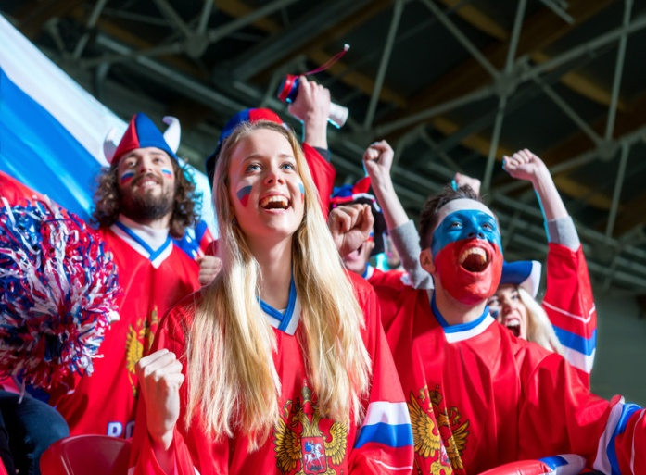
spect, spic
Examples:
Inspector
an official whose job is to check that something is satisfactory and that rules are being obeyed
Perspective
a way of thinking about something, especially one which is influenced by the type of person you are or by your experiences
Spectacle
an unusual or interesting thing or situation that you see or notice
Conspicuous
very easy to notice
Specter
something that people are afraid of because it may affect them badly (the specter of something)
A spectator is someone who is watching an event or game.
Return to buttons

Slide 9
spect, spic
A spectator is someone who is watching an event or game.
Positive/Negative Questions:
Do the following words use “spect or spic?”(Answer “yes” or “no”)
Inspect
to examine something carefully in order to find out more about it or to find out what is wrong with it
Separate
Spectacular
very impressive
Several
Suspicious
thinking that someone might be guilty of doing something wrong or dishonest
Return to buttons

Slide 10
spect, spic
A spectator is someone who is watching an event or game.
Think of 3 Words using “spect/spic:”
Another option: Use your dictionary to find 3 words using “spect or spic”
Example: “Spectator”
Return to buttons

Slide 11
cred
Definition:
To believe
Example: A creed* is a set of beliefs or principles.
*Note: While “creed” has an extra “e” within the word, it is nonetheless derived from the Latin root “cred.”
Return to buttons
Notes:
Note: While “creed” has an extra “e” within the word, it is nonetheless derived from the Latin root “cred”.

Slide 12
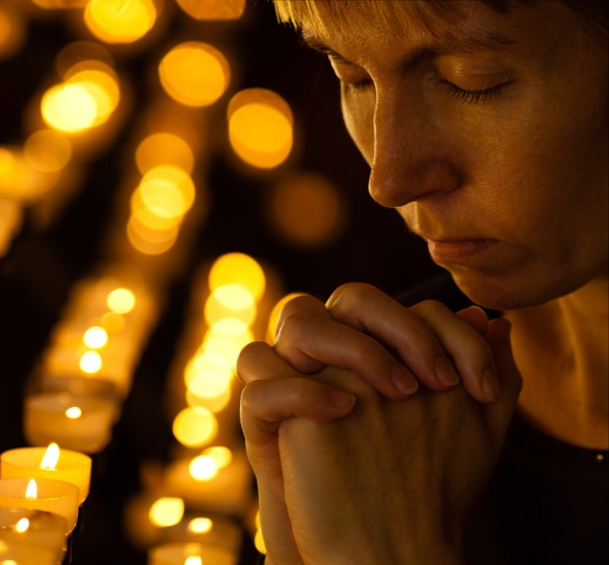
cred
A creed is a set of beliefs or principles.
Examples:
Incredible
too strange to be believed or very difficult to believe
Credit
approval or praise that you give to someone for something they have done
Credentials
someone's education, achievements, experience etc that prove they have the ability to do something
Credulous
always believing what you are told, and therefore easily deceived
Return to buttons

Slide 13
cred
A creed is a set of beliefs or principles.
Positive/Negative Questions:
Do the following words use “cred?” (Answer “yes” or “no”)
Creditor
a person, bank, or company that you owe money to
Creek
Discredit
to make people stop respecting or trusting someone or something
Crab
Credo
a formal statement of the beliefs of a particular person, group, religion etc.
Return to buttons

Slide 14
cred
A creed is a set of beliefs or principles.
Think of 3 Words using “cred”
Another option: Use your dictionary to find 3 words using “cred”
Examples: “Creed,” “Credible”
Return to buttons

Slide 15
ject
Definition:
To throw
Example 1: “If you eject a tape or disk, or if it ejects, it comes out of a machine after you have pressed a particular button.”
Return to buttons

Slide 16
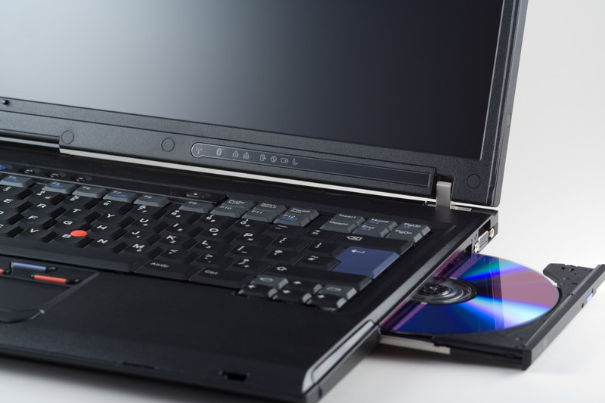
ject
“If you eject a tape or disk, or if it ejects, it comes out of a machine after you have pressed a particular button.”
Examples:
Eject
if a pilot ejects, he or she escapes from a plane, using an ejector seat because it is going to crash; if you eject a tape or disk, or if it ejects, it comes out of a machine after you have pressed a particular button; to suddenly send something out
Object
to feel or say that you oppose or disapprove of something
Reject
to refuse to accept, believe in, or agree with something
Interject
to interrupt what someone else is saying with a sudden remark
Return to buttons

Slide 17
ject
“If you eject a tape or disk, or if it ejects, it comes out of a machine after you have pressed a particular button.”
Positive/Negative Questions:
Do the following words use “ject?” Answer “Yes “or “No”
Conjecture
when you form ideas or opinions without having very much information to base them on
Spectator
Trajectory
the curved path of an object that has been fired or thrown through the air
Bracket
Dejected
unhappy, disappointed, or sad; downcast
Return to buttons

Slide 18
ject
“If you eject a tape or disk, or if it ejects, it comes out of a machine after you have pressed a particular button.”
Think of 3 Words using “ject”
Another option: Use your dictionary to find 3 words using “ject”
Example: “eject”
Return to buttons

Slide 19
form
Definition:
To shape
Example: “A sculptor can transform a piece of clay into a beautiful work of art.”
Return to buttons

Slide 20
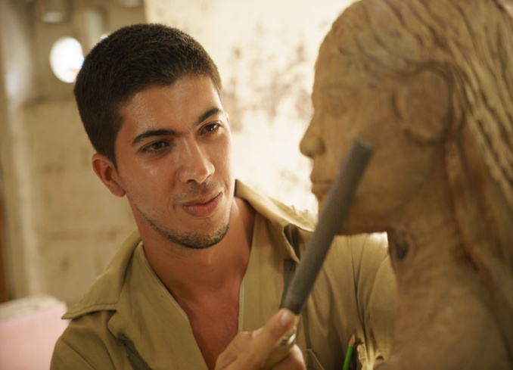
form
“A sculptor can transform a piece of clay into a beautiful work of art.”
Examples:
Deformed:
something that is deformed has the wrong shape, especially because it has grown or developed wrongly
Conform:
to behave in the way that most other people in your group or society behave
Formula:
method or set of principles that you use to solve a problem or to make sure that something is successful
Nonconformist:
someone who does not accept the ways of thinking or behaving accepted by most other people in their society or group
Return to buttons

Slide 21
form
“A sculptor can transform a piece of clay into a beautiful work of art.”
Positive/Negative Questions:
Do the following words use “form?” Answer “Yes “or “No”
Format
the way in which something such as a television show or meeting is organized or arranged
Foam
Formative
having an important influence on the way someone or something develops
Concord
Formal
formal behavior is very polite, and is used in official or important situations, or with people you do not know well
Return to buttons

Slide 22
form
“A sculptor can transform a piece of clay into a beautiful work of art.”
Think of 3 Words using “form”
Another option: Use your dictionary to find 3 words using “form”
Example: “transform”
Return to buttons

Slide 23
stru, struct
Definition:
To build
Example:
When someone tries to construct something, that means that they are trying to build something.
Return to buttons

Slide 24
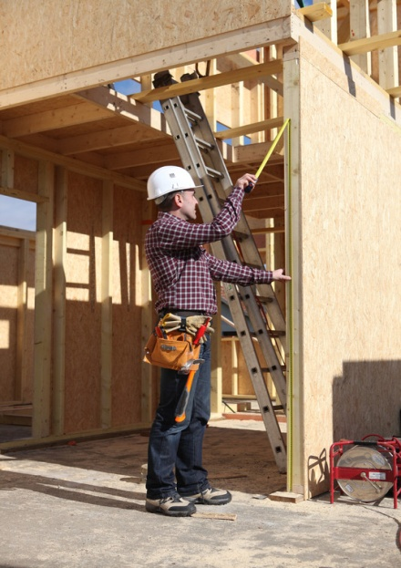
stru, struct
Construct: to build something such as a house, bridge, road etc.
Examples:
Structure
something that has been built, especially something large such as a building or a bridge
Construction
the process of building things such as houses, bridges, roads etc; the process of making something using many parts
Destructive
causing damage to people or things
Instructor
someone who teaches a sport or practical skill
Construe
to understand a remark or action in a particular way
Return to buttons

Slide 25
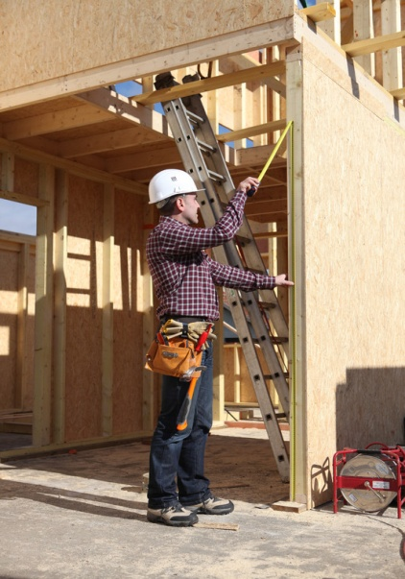
stru, struct
Construct: to build something such as a house, bridge, road etc.
Positive/Negative Questions:
Do the following words use “stru or struct?” Answer “yes” or “no”
Instrument
a small tool used in work such as science or medicine; an object used for producing music, such as a piano or violin
Stuck
Obstruct
to block a road, passage etc; to prevent someone from doing something or something from happening, by making it difficult
Truck
Reconstruct
to build something again after it has been destroyed or damaged; to produce a complete description or copy of an event by collecting together pieces of information
Return to buttons

Slide 26
stru, struct
Construct: to build something such as a house, bridge, road etc.
Think of 3 Words using “stru or struct”
Another option: Use your dictionary to find 3 words using “stru or struct”
Example: “Construct”
Return to buttons

Slide 27
duc, duce, duct
Definition:
To lead
Example: “To educate means to teach a child at a school, college, or university.”
Return to buttons

Slide 28
duc, duce, duct
To educate means to teach a child at a school, college, or university.
Examples:
Abduct
to take someone away by force
Induce
to persuade someone to do something, especially something that does not seem wise
Produce
to cause a particular result or effect; to make, write etc something to be bought, used, or enjoyed by people
Traduce
to deliberately say things that are untrue or unpleasant
Return to buttons

Slide 29
duc, duce, duct
To educate means to teach a child at a school, college, or university.
Positive/Negative Questions:
Do the following words use “duc, duce, or duct?” Answer “Yes” or “No”
Conducive
if a situation is conducive to something such as work, rest etc, it provides conditions that make it easy for you to work etc (“be conducive to …”)
Stuck
Product
something that is grown or made in a factory in large quantities, usually in order to be sold
Scrape
Reduce
to make something smaller or less in size, amount, or price
Return to buttons

Slide 30
duc, duce, duct
To educate means to teach a child at a school, college, or university.
Think of 3 Words using “duc, duce, or duct”
Another option: Use your dictionary to find 3 words using “duc, duce, or duct”
Example: “Educate”
Return to buttons

Slide 31
ver, vers, vert
Definition:
To turn
Example:
The epidermis is our thin, outermost layer of skin.
Return to buttons

Slide 32
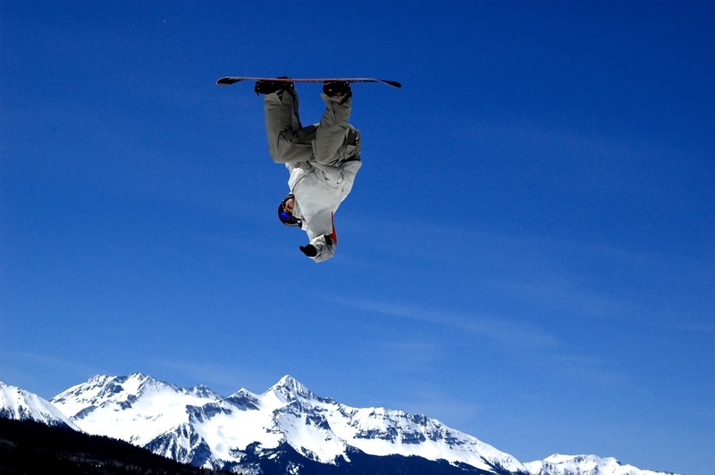
ver, vers, vert
When you invert something, you put it in the opposite direction from what it was before.
Examples:
Versatile
someone who is versatile has many different skills; having many different uses
Averse
unwilling to do something or not liking something
Invert
to put something in the opposite position to the one it was in before, especially by turning it upside down (=the bottom is on the top and the top is on the bottom)
Divert
to change the use of something such as time or money; to change the direction in which something travels
Return to buttons

Slide 33
ver, vers, vert
When you invert something, you put it in the opposite direction from what it was before.
Positive/Negative Questions:
Do the following words use “ver, vers, or vert?” (“yes” or “no”)
Subversive
subversive ideas, activities etc are secret and intended to damage or destroy a government or an established system
Service
Vertigo
a feeling of sickness and dizziness caused by looking down from a high place
Various
Reversible
a change that is reversible can be changed back to how it was before; a piece of clothing or material that is reversible can be worn with either side showing on the outside
Return to buttons

Slide 34
ver, vers, vert
When you invert something, you put it in the opposite direction from what it was before.
Think of 3 Words using “ver, vers, or vert”
Another option: Use your dictionary to find 3 words using “ver, vers, or vert”
Example: “Invert”
Return to buttons

Slide 35
tract
Definition:
To pull
Example: Tractors are often used to pull things on farms and ranches.
Return to buttons

Slide 36
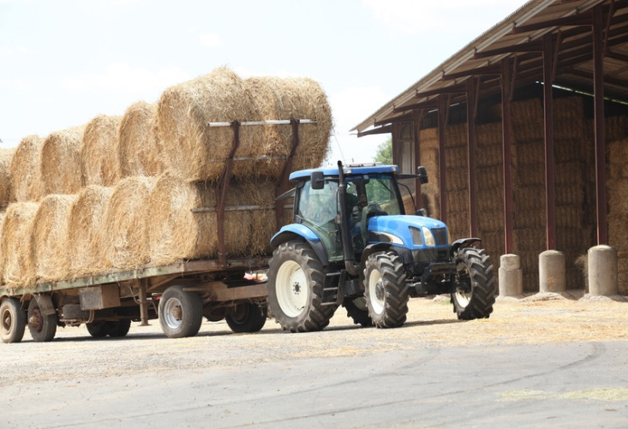
tract
Tractors are often used to pull things on farms and ranches.
Examples:
Tractor
a strong vehicle with large wheels, used for pulling farm machinery
Tractable
easy to control or deal with
Contraction
the process of becoming smaller or narrower; a shorter form of a word or words
Detract
to make something seem less good (detract from something)
Return to buttons

Slide 37
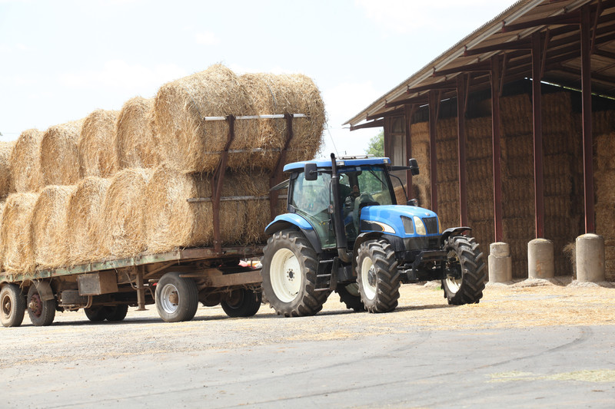
tract
Tractors are often used to pull things on farms and ranches.
Positive/Negative Questions:
Do the following words use “tract?” (“Yes” or “No”)
Protracted
used to describe something that continues for a long time, especially if it takes longer than usual, necessary, or expected
Scrapped
Subtract
to take a number or an amount from a larger number or amount
Fact
Distract
to take someone's attention away from something by making them look at or listen to something else
Return to buttons

Slide 38
tract
Tractors are often used to pull things on farms and ranches.
Think of 3 Words using “tract”
Another option: Use your dictionary to find 3 words using “tract”
Example: “Tractor”
Return to buttons

Slide 39
dic, dict
Definition:
To tell, to say, to declare
Example: To dictate is to say words for someone else to write down.
Return to buttons

Slide 40
dic, dict
To dictate is to say words for someone else to write down.
Examples:
Dictate
to tell someone exactly what they must do or how they must behave; to say words for someone else to write down
Contradict
to disagree with something, especially by saying that the opposite is true
Indicate
to show that a particular situation exists, or that something is likely to be true; to say or do something to make your wishes, intentions, etc clear
Predict
to say that something will happen, before it happens
Return to buttons

Slide 41
dic, dict
To dictate is to say words for someone else to write down.
Positive/Negative Questions:
Do the following words use “dic or dict?” Answer “Yes” or “No”
Dictator
a ruler who has complete power over a country, especially one whose power has been gained by force; also, someone who tells other people what they should do, in a way that seems unreasonable
Describe
Indicative
to be a clear sign that a particular situation exists or that something is likely to be true
Direct
Indication
a sign, remark, event, etc that shows what is happening, what someone is thinking or feeling, or what is true
Return to buttons

Slide 42
dic, dict
To dictate is to say words for someone else to write down.
Think of 3 Words using “dic or dict”
Another option: Use your dictionary to find 3 words using “dic or dict”
Example: “Dictate”
Return to buttons

Slide 43
pel, puls
Definition:
To push, to drive
Example: When you propel something, you move, drive, or push something forward.
Return to buttons

Slide 44
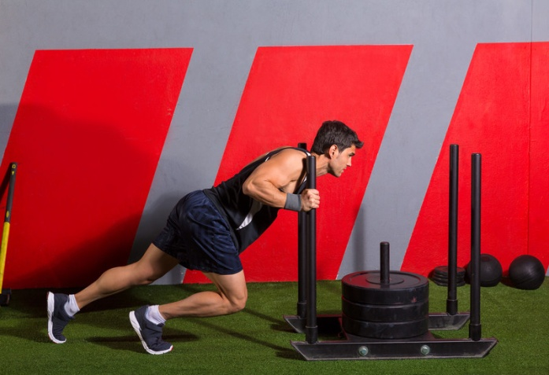
pel, puls
When you propel something, you move, drive, or push something forward.
Examples:
Pulse
the regular beat that can be felt, for example at your wrist, as your heart pumps blood around your body; a strong regular beat in music
Compel
to force someone to do something; to make people have a particular feeling or attitude
Expel
to officially force someone to leave a school or organization; to force a foreigner to leave a country, especially because they have broken the law or for political reasons
Repel
if something repels you, it is so unpleasant that you do not want to be near it, or it makes you feel ill; to make someone who is attacking you go away, by fighting them
Return to buttons

Slide 45
pel, puls
When you propel something, you move, drive, or push something forward.
Positive/Negative Questions:
Do the following words use “pel or puls?” Answer “Yes” or “No”
Peel
Dispel
to make something go away, especially a belief, idea, or feeling
Palace
Impel
if something impels you to do something, it makes you feel very strongly that you must do it
Repellent
a substance that keeps insects away
Return to buttons

Slide 46
pel, puls
When you propel something, you move, drive, or push something forward.
Think of 3 Words using “pel or puls”
Another option: Use your dictionary to find 3 words using “pel or puls”
Example: “Propel”
Return to buttons

Slide 47
mit, miss
Definition:
To send
Example: A missile is a weapon that can fly over long distances and that explodes when it hits the thing it has been aimed at.
Return to buttons

Slide 48
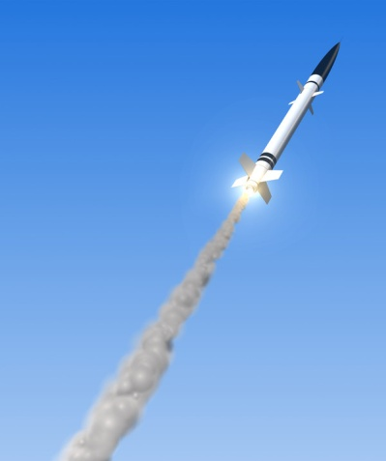
mit, miss
A missile is a weapon that can fly over long distances and that explodes when it hits the thing it has been aimed at.
Examples:
Submit
to give a plan, piece of writing, etc to someone in authority for them to consider or approve; to agree to obey a person, group, set of rules, especially when you have no choice
Transmit
to send out electronic signals, messages etc using radio, television, or other similar equipment; to send or pass something from one person, place or thing to another
Mission
an important job that involves travelling somewhere, done by a member of the air force, army etc, or by a spacecraft; an important job that someone has been given to do, especially when they are sent to another place
Dismiss
to refuse to consider someone's idea, opinion etc, because you think it is not serious, true, or important; to remove someone from their job
Return to buttons

Slide 49
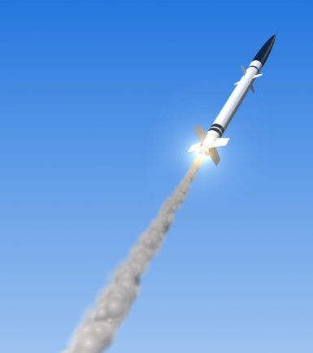
mit, miss
A missile is a weapon that can fly over long distances and that explodes when it hits the thing it has been aimed at.
Positive/Negative Questions:
Do the following words use “mit or miss?” Answer “Yes” or “No”
Emissary
someone who is sent with an official message or to do official work
Prominent
Transmission
the process of sending out electronic signals, messages etc, using radio, television, or other similar equipment ; the process of sending or passing something from one person, place, or thing to another
Promote
Permission
when someone is officially allowed to do something
Return to buttons

Slide 50
mit, miss
A missile is a weapon that can fly over long distances and that explodes when it hits the thing it has been aimed at.
Think of 3 Words using “mit or miss”
Another option: Use your dictionary to find 3 words using “mit or miss”
Example: “Missile”
Return to buttons

Slide 51
rupt
Definition:
To break
Example: “A rupture occurs when something suddenly breaks apart or bursts.”
Return to buttons

Slide 52
rupt
A rupture occurs when something suddenly breaks apart or bursts.
Examples:
Disrupt
to prevent something from continuing in its usual way by causing problems
Erupt
if fighting, violence, noise etc erupts, it starts suddenly; if a volcano erupts, it explodes and sends smoke, fire, and rock into the sky
Interrupt
to stop someone from continuing what they are saying or doing by suddenly speaking to them, making a noise etc; to make a process or activity stop temporarily
Bankrupt
without enough money to pay what you owe
Return to buttons

Slide 53
rupt
A rupture occurs when something suddenly breaks apart or bursts.
Positive/Negative Questions:
Do the following words use “rupt?” Answer “Yes” or “No”
Suspect
Abrupt
sudden and unexpected; seeming rude and unfriendly, especially because you do not waste time in friendly conversation
Trumpet
Disruption
a situation in which something is prevented from continuing in its usual way
Corrupt
using your power in a dishonest or illegal way in order to get an advantage for yourself; immoral or dishonest; something that is corrupt is not pure or has been damaged or partly ruined
Return to buttons

Slide 54
rupt
A rupture occurs when something suddenly breaks apart or bursts.
Think of 3 Words using “rupt”
Another option: Use your dictionary to find 3 words using “rupt”
Example: “Rupture”
Return to buttons

Slide 55
flect, flex
Definition:
To bend
Example: Something that is flexible can bend or be bent easily.
Return to buttons

Slide 56
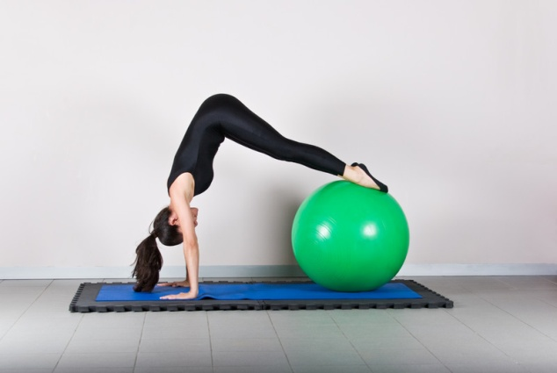
flect, flex
Something that is flexible can bend or be bent easily.
Examples:
Flexible
a person, plan etc that is flexible can change or be changed easily to suit any new situation; something that is flexible can bend or be bent easily.
Flex
to tighten your muscles or bend part of your body; to show your ability to do something, especially your skill or power
Deflect
if someone or something deflects something that is moving, or if it deflects, it turns in a different direction; to do something to stop people paying attention to you, criticizing you etc
Reflect
if a person or a thing is reflected in a mirror, glass, or water, you can see an image of the person or thing on the surface of the mirror, glass, or water; to think carefully about something, or to say something that you have been thinking about
Return to buttons

Slide 57
flect, flex
Something that is flexible can bend or be bent easily.
Positive/Negative Questions:
Do the following words use “flect or flex?” Answer “Yes” or “No”
Reflector
a small piece of plastic that is fastened to a bicycle or to a piece of clothing, so that it can be seen more easily at night; a surface that reflects light
Refinery
Reflex
the natural ability to react quickly and well to sudden situations (reflexes); a sudden uncontrolled movement that your muscles make as a natural reaction to a physical effect
Defect
Reflection
an image that you can see in a mirror, glass, or water; careful thought, or an idea or opinion based on this; the action or process of light, heat, or sound being thrown back from a surface
Return to buttons

Slide 58
flect, flex
Something that is flexible can bend or be bent easily.
Think of 3 Words using “flect or flex”
Another option: Use your dictionary to find 3 words using “flect or flex”
Example: “Flexible”
Return to buttons

Slide 59
fac, fact
Definition:
To make, to do
Example: A factor is one of several things that can influence or cause a situation.
Return to buttons

Slide 60
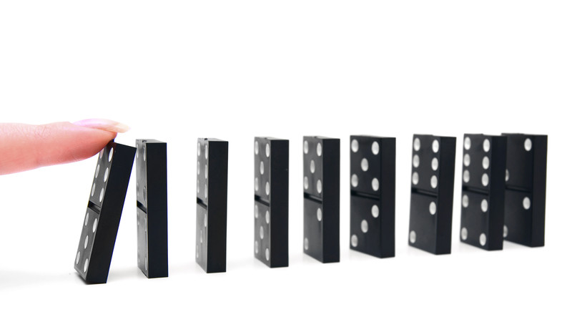
fac, fact
A factor is one of several things that can influence or cause a situation.
Examples:
Factory
a building or group of buildings in which goods are produced in large quantities, using machines
Facility
rooms, equipment, or services that are provided for a particular purpose; a place or building used for a particular activity or industry, or for providing a particular type of service
Manufacturer
a company that makes large quantities of goods.
Satisfaction
a feeling of happiness or pleasure because you have achieved something or got what you wanted
Return to buttons

Slide 61
fac, fact
A factor is one of several things that can influence or cause a situation.
Positive/Negative Questions:
Do the following words use “fac or fact?” Answer “Yes” or “No”
Fact
a piece of information that is known to be true
Fault
Facilitate
to make it easier for a process or activity to happen.
Fanatic
Dissatisfaction
a feeling of not being satisfied
Return to buttons

Slide 62
fac, fact
A factor is one of several things that can influence or cause a situation.
Think of 3 Words using “fac or fact”
Another option: Use your dictionary to find 3 words using “fac or fact”
Example: “Factor”
Return to buttons

Slide 63
scrib, scrip
Definition:
To write
Example: When someone scribbles, he/she draws marks that have no meaning.
Return to buttons

Slide 64
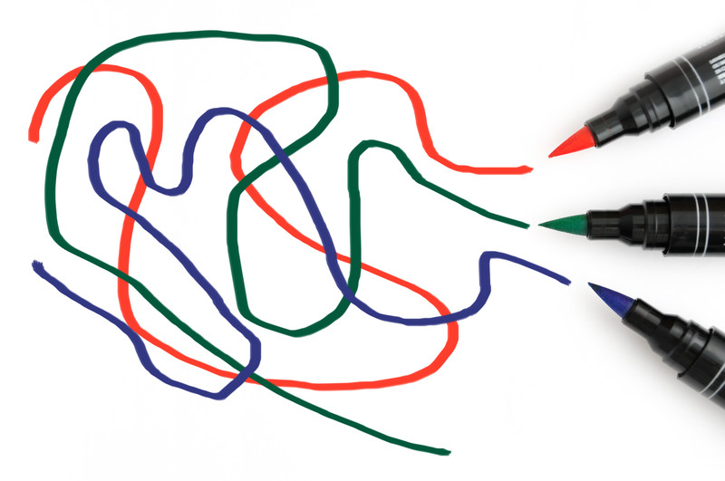
scrib, scrip
When someone scribbles, he/she draws marks that have no meaning.
Examples:
Scribble
to draw marks that have no meaning; to write something quickly and untidily
Subscription
an amount of money you pay, usually once a year, to receive copies of a newspaper or magazine, or receive a service, or the act of paying money for this
Script
the written form of a speech, play, film etc; the set of letters that are used in writing a language;
Describe
a rock fragment that is enveloped in a larger rock during the latter's development and hardening
Return to buttons

Slide 65
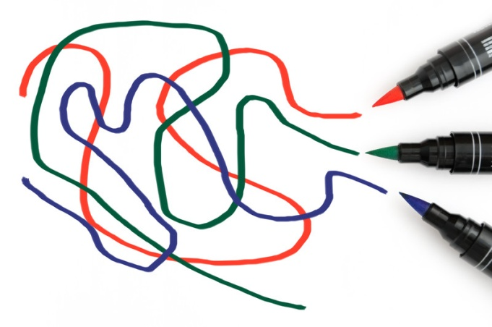
scrib, scrip
When someone scribbles, he/she draws marks that have no meaning.
Positive/Negative Questions:
Do the following words use “scrib or scrip?” Answer “Yes” or “No”
Prescription
a piece of paper on which a doctor writes what medicine a sick person should have, so that they can get it from a pharmacist
Specific
Transcript
a written or printed copy of a speech, conversation etc; an official college document that shows a list of a student's classes and the results they received
Pictograph
Scripture
the holy books of a particular religion.
Return to buttons

Slide 66
scrib, scrip
When someone scribbles, he/she draws marks that have no meaning.
Think of 3 Words using “scrib or scrip”
Another option: Use your dictionary to find 3 words using “scrib or scrip”
Example: “scribble”
Return to buttons

Slide 67
junct, join
Definition:
To join
Example: “A joint is a part of your body that can bend because two bones meet there.”
Return to buttons

Slide 68
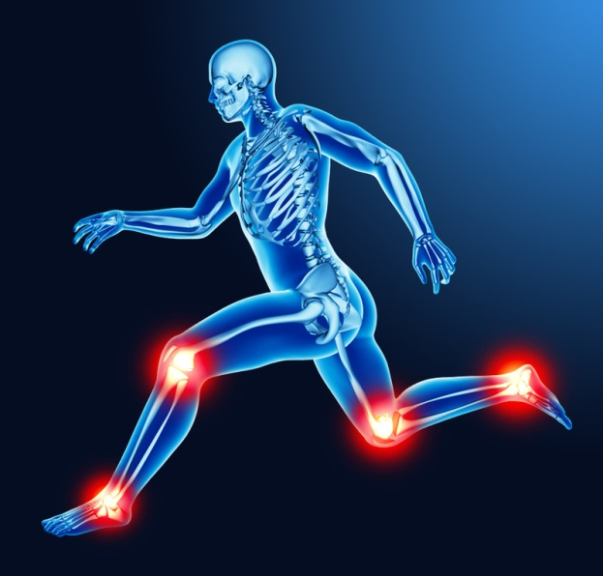
junct, join
A joint is a part of your body that can bend because two bones meet there.
Examples:
Joint
a part of your body that can bend because two bones meet there; a place where two things or parts of an object are joined together
Juncture
a particular point in an activity or period of time
Disjoint
to disturb the orderly structure or arrangement of; to take apart at the joints
Conjunction
working, happening, or being used with someone or something else; a word such as 'and', 'but', or 'because' which joins parts of a sentence
Return to buttons

Slide 69
junct, join
A joint is a part of your body that can bend because two bones meet there.
Positive/Negative Questions:
Do the following words use “junct or join?” Answer “Yes” or “No”
Enjoin
to order or try to persuade someone to do something; to legally prevent someone from doing something
Conform
Adjoin
a room, building, or piece of land that adjoins something is next to it and connected to it
Coins
Conjoin
to join together, or to make things or people do this
Return to buttons

Slide 70
junct, join
A joint is a part of your body that can bend because two bones meet there.
Think of 3 Words using “junct or join”
Another option: Use your dictionary to find 3 words using “junct or join”
Example: “joint”
Return to buttons

Slide 71
err, errat
Definition:
wander, stray, rove; deviate
Example: “Sometimes an error message is displayed on a computer when it can’t do something.”
Return to buttons

Slide 72
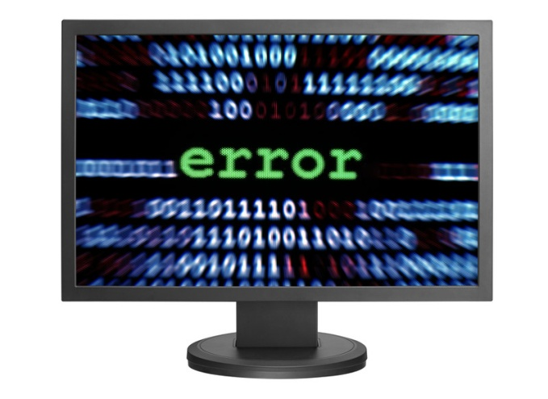
err, errat
Sometimes an error message is displayed on a computer when it can’t do something.
Examples:
Error
a mistake; a mistake when you are working on a computer, which means that the computer program cannot do what you want it to do
Err
to make a mistake; err on the side of something is to be more careful or safe than is necessary, in order to make sure that nothing bad happens
Errant
behaving badly, usually by not obeying your parents or not being faithful to your husband or wife
Erratic
something that is erratic does not follow any pattern or plan but happens in a way that is not regular
Return to buttons

Slide 73
err, errat
Sometimes an error message is displayed on a computer when it can’t do something.
Positive/Negative Questions:
Do the following words use “err or errat?” Answer “Yes” or “No”
Aberration
an action or event that is different from what usually happens or what someone usually does
Separate
Erroneous
erroneous ideas or information are wrong and based on facts that are not correct
Ferocious
Aberrant
not usual or normal
Return to buttons

Slide 74
err, errat
Think of 3 Words using “err or errat”
Another option: Use your dictionary to find 3 words using “err or errat”
Example: “error”
Sometimes an error message is displayed on a computer when it can’t do something.
Return to buttons

Slide 75
simil, simul
Definition:
Like and resembling
Example: When two things are similar, they are almost the same.
Return to buttons

Slide 76
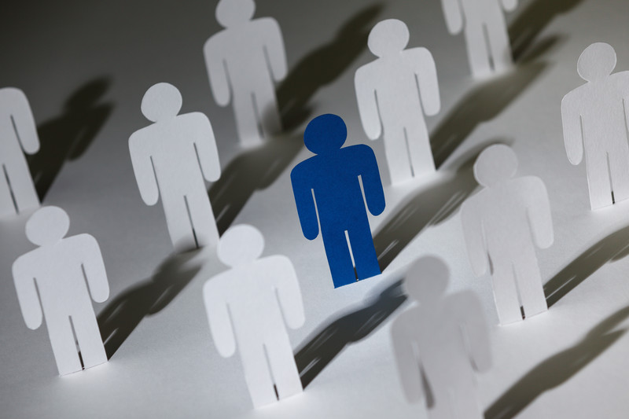
simil, simul
When two things are similar, they are almost the same.
Examples:
Similarity
if there is a similarity between two things or people, they are similar in some way
Simile
an expression that describes something by comparing it with something else, using the words 'as' or 'like', for example 'as white as snow'
Simulate
to make or produce something that is not real but has the appearance or feeling of being real.
Dissimilar
not the same.
Return to buttons

Slide 77
simil, simul
When two things are similar, they are almost the same.
Positive/Negative Questions:
Do the following words use “simil or simul?” Answer “Yes” or “No”
Assimilate
to completely understand and begin to use new ideas, information etc; if people assimilate or are assimilated into a country or group, they become part of that group and are accepted by the people in that group
Macroeconomics
Simultaneous
things that are simultaneous happen at exactly the same time
Market
Simulator
a machine that is used for training people by letting them feel what real conditions are like, for example in a plane
Return to buttons

Slide 78
simil, simul
Think of 3 Words using “simil or simul”
Another option: Use your dictionary to find 3 words using “simil or simul”
Example: “similar”
When two things are similar, they are almost the same.
Return to buttons

Slide 79
mort, mori, mors
Definition:
death
Example: As humans, we are mortal, which means that we are not able to live forever.
Return to buttons

Slide 80
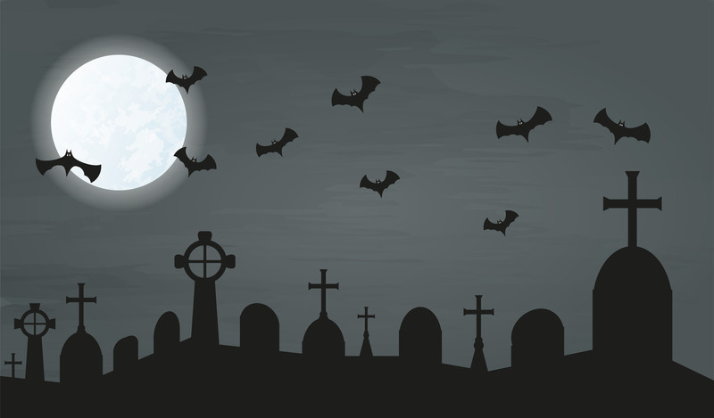
mort, mori, mors
As humans, we are mortal, which means that we are not able to live forever.
Examples:
Mortal
Not able to live forever; something very serious that may cause the end of something; something that causes death or may cause death (ex: mortal wound)
Mortuary
a building or room, for example in a hospital, where dead bodies are kept before they are buried or cremated; the place where a body is kept before a funeral and where the funeral is sometimes held
Moribund
a moribund organization, industry, etc is no longer active or effective and may be coming to an end; slowly dying
Immortal
living or continuing for ever; an immortal line, play, song etc is so famous that it will never be forgotten
Return to buttons

Slide 81
mort, mori, mors
As humans, we are mortal, which means that we are not able to live forever.
Positive/Negative Questions:
Do the following words use “mort, mori, or mors?” Answer “Yes” or “No”
Mortality
the condition of being human and having to die; also mortality rate the number of deaths during a particular period of time among a particular type or group of people
Moveable
Remorse
a strong feeling of being sorry that you have done something very bad
Mortician
someone whose job is to arrange funerals and prepare bodies to be buried
Monopoly
Mortify
to cause someone to feel extremely embarrassed or ashamed
Return to buttons

Slide 82
mort, mori, mors
As humans, we are mortal, which means that we are not able to live forever.
Think of 3 Words using “mort, mori, or mors”
Another option: Use your dictionary to find 3 words using “mort, mori, or mors”
Example: “mortal”
Return to buttons

Slide 83
spir, spire
Definition:
breath
Example: People who work with hazardous chemicals must wear a respirator in order to prevent the inhalation of toxic gas.
Return to buttons

Slide 84
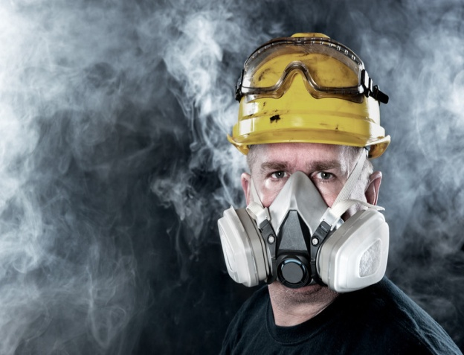
spir, spire
People who work with hazardous chemicals must wear a respirator in order to prevent the inhalation of toxic gas.
Examples:
Respirator
A piece of equipment that you wear over your nose and mouth to help you breathe in a place where there is harmful gas, smoke etc; Also, a piece of equipment that pumps air in and out of someone's lungs if they are too ill or weak to breathe
Spirit
the qualities that make someone live the way they do, and make them different from other people; the part of someone that you cannot see, that consists of the qualities that make up their character, which many people believe continues to live after the person has died
Perspire
if you perspire, parts of your body become wet, especially because you are hot or have been doing hard work (sweat)
Inspire
to encourage someone by making them feel confident and eager to do something; to give someone the idea for something, especially a story, painting, poem etc.
Return to buttons

Slide 85
spir, spire
People who work with hazardous chemicals must wear a respirator in order to prevent the inhalation of toxic gas.
Positive/Negative Questions:
Do the following words use “spir or spire?” Answer “Yes” or “No”
Aspire
to desire and work towards achieving something important
Response
Respiration
the process of breathing
Sport
Expire
if an official document expires, it can no longer be legally used; if a period of time when someone has a particular position of authority expires, it ends; if someone expires, they die
Return to buttons

Slide 86
spir, spire
People who work with hazardous chemicals must wear a respirator in order to prevent the inhalation of toxic gas.
Think of 3 Words using “spir or spire”
Another option: Use your dictionary to find 3 words using “spir or spire”
Example: “respirator”
Return to buttons

Slide 87
judi, judic & jud
Definition:
One who gives an opinion, judge
Example: A judge is the official in control of a court who decides how criminals should be punished.
Return to buttons

Slide 88
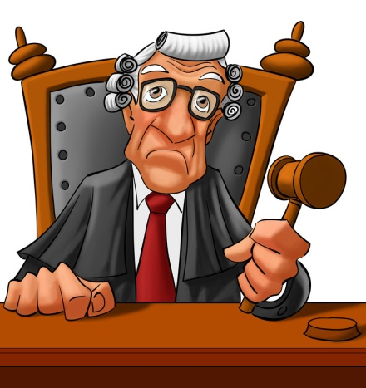
judi, judic & jud
A judge is the official in control of a court who decides how criminals should be punished.
Examples:
Judge
The official in control of a court who decides how criminals should be punished; someone who decides on the result of a competition
to form or give an opinion about someone or something after thinking carefully about all the information you know about them
Judgment
an opinion that you form, especially after thinking carefully about something; the ability to make sensible decisions about what to do and when to do it; an official decision given by a judge or a court of law
Injustice
a situation in which people are treated very unfairly and not given their rights
Prejudice
an unreasonable dislike and distrust of people who are different from you in some way, especially because of their race, sex, religion etc - used to show disapproval
Return to buttons

Slide 89
judi, judic & jud
A judge is the official in control of a court who decides how criminals should be punished.
Positive/Negative Questions:
Do the following words use “judi, judic, jud?” Answer “Yes” or “No”
Judicial
a colorless, odorless, highly flammable gas, the chemical element of atomic number 1.
Juice
Adjudicate
to officially decide who is right in a disagreement and decide what should be done; to be the judge in a competition
Jupiter
Judicious
done in a sensible and careful way
Return to buttons

Slide 90
judi, judic & jud
A judge is the official in control of a court who decides how criminals should be punished.
Think of 3 Words using “judi, judic, jud”
Another option: Use your dictionary to find 3 words using “judi, judic, or jud”
Example: “Judge”
Return to buttons

Slide 91
grad, gred & gress
Definition:
step, degree, walk
Example: When something is gradual, this means that it is happening slowly over a long period of time.
Return to buttons

Slide 92
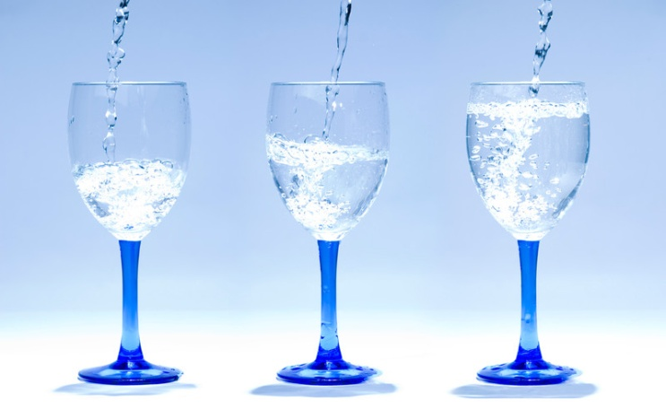
grad, gred & gress
When something is gradual, this means that it is happening slowly over a long period of time.
Examples:
Gradual
the branch of science that deals with celestial objects, space, and the physical universe as a whole
Gradient
a slope or a degree of slope, especially in a road or railway
Digress
to talk or write about something that is not your main subject
Degree
a unit for measuring temperature. It can be shown as a symbol after a number; the level or amount of something
Return to buttons

Slide 93
grad, gred & gress
When something is gradual, this means that it is happening slowly over a long period of time.
Positive/Negative Questions:
Do the following words use “grad, gred, or gress?” Answer “Yes” or “No”
Graduation
the time when you complete a university degree course or your education at an American high school; a ceremony at which you receive a university degree or a diploma from an American high school
Gambling
Progress
he process of getting better at doing something, or getting closer to finishing or achieving something; slow or steady movement somewhere
Grouping
Egress
the act of leaving a building or place, or the right to do this
Return to buttons

Slide 94
grad, gred & gress
Think of 3 Words using “grad, gred, or gress”
Another option: Use your dictionary to find 3 words using “grad, gred, or gress”
Example: “gradual”
When something is gradual, this means that it is happening slowly over a long period of time.
Return to buttons

Slide 95
plor
Definition:
To weep, to cry out, to lament, to bewail
Example: To implore means to ask for something in an emotional way.
Return to buttons

Slide 96
plor
“To implore means to ask for something in an emotional way.”
Examples:
Implore
to ask for something in an emotional way (to beg)
Explore
a picture made using a camera, in which an image is focused onto film or other light-sensitive material and then made visible and permanent by chemical treatment, or stored digitally
Deplore
chemical reaction initiated by the absorption of energy in the form of light.
Return to buttons

Slide 97
plor
“To implore means to ask for something in an emotional way.”
Positive/Negative Questions:
Do the following words use “plor?” Answer “Yes” or “No”
Explorer
someone who travels through an unknown area to find out about it
Store
Exploration
the act of travelling through a place in order to find out about it or find something such as oil or gold in it; when you try to find out more about something by discussing it, thinking about it etc.
Contour
Deplorable
very bad, unpleasant, and shocking
Return to buttons

Slide 98
plor
“To implore means to ask for something in an emotional way.”
Think of 3 Words using “plor”
Another option: Use your dictionary to find 3 words using “plor”
Example: “implore”
Return to buttons

Slide 99
fer, ferra
Definition:
To carry, to bring, to bear
Example: To transfer is to move from one place, school, job etc to another, or to make someone do this, especially within the same organization.
Return to buttons

Slide 100
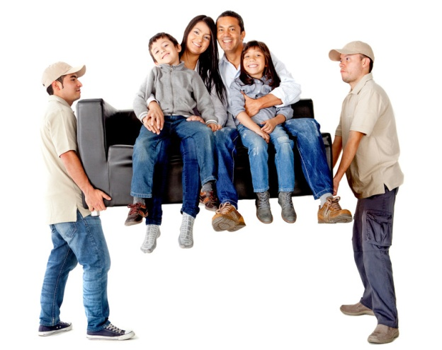
fer, ferra
To transfer is to move from one place, school, job, etc. to another; or to make someone do this, especially within the same organization.
Examples:
transfer
to move from one place, school, job etc to another, or to make someone do this, especially within the same organization; to move from one place to another, or to move something from one place to another; to move money from one account or institution to another
ferry
a boat that carries people or goods across a river or a narrow area of water; to carry people or things a short distance from one place to another in a boat or other vehicle
suffer
to experience physical or mental pain; to become worse in quality because a bad situation is affecting something or because nobody is taking care of it
defer
to delay something until a later date; (defer to somebody/something) to agree to accept someone's opinion or decision because you have respect for that person
Return to buttons

Slide 101
fer, ferra
To transfer is to move from one place, school, job, etc. to another; or, to make someone do this, especially within the same organization.
Positive/Negative Questions:
Do the following words use “fer or ferra?” Answer “Yes” or “No”
Confer
to discuss something with other people, so that everyone can express their opinions and decide on something
Affected
Conference
a large formal meeting where a lot of people discuss important matters such as business, politics, or science, especially for several days; a private meeting for a few people to have formal discussions; a group of teams that play against each other to see who is the best
Fencing
Proliferate
if something proliferates, it increases quickly and spreads to many different places
Return to buttons

Slide 102
fer, ferra
To transfer is to move from one place, school, job, etc. to another; or to make someone do this, especially within the same organization.
Think of 3 Words using “fer or ferra”
Another option: Use your dictionary to find 3 words using “fer or ferra”
Example: “transfer”
Return to buttons

Slide 103
luc, lum, lun, lus
Definition:
Light; to shine
Example: When something is luminous, it is very brightly colored, especially in green, pink, or yellow.
Return to buttons

Slide 104
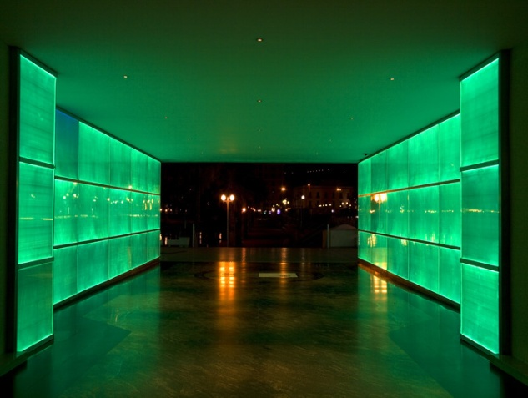
luc, lum, lun, lus
“When something is luminous, it is very brightly colored, especially in green, pink, or yellow.”
Examples:
luminous
shining in the dark; very brightly colored, especially in green, pink, or yellow
lucid
expressed in a way that is clear and easy to understand; able to understand and think clearly (used especially about someone who is not always able to do this)
luminary
someone who is very famous or highly respected for their skill at doing something or their knowledge of a particular subject
luster
an attractive shiny appearance; the quality that makes something interesting or exciting
Return to buttons

Slide 105
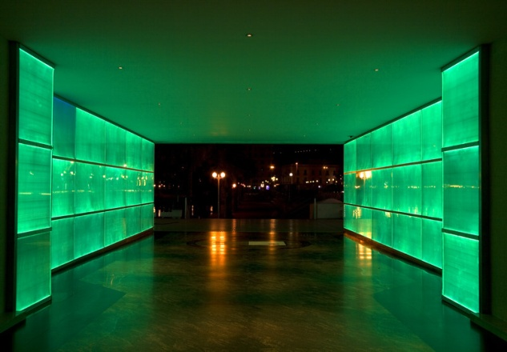
luc, lum, lun, lus
“When something is luminous, it is very brightly colored, especially in green, pink, or yellow.”
Positive/Negative Questions:
Do the following words use “luc, lum, lun, or lus?” (“Yes” or “No”)
Translucent
not transparent, but clear enough to allow light to pass through
Luxurious
Elucidate
to explain something that is difficult to understand by providing more information
Lupus
Illuminate
to make a light shine on something, or to fill a place with light; to make something much clearer and easier to understand
Return to buttons

Slide 106
luc, lum, lun, lus
Think of 3 Words using “luc, lum, lun, or lus”
Another option: Use your dictionary to find 3 words using “luc, lum, lun, or lus”
Example: “luminous”
“When something is luminous, it is very brightly colored, especially in green, pink, or yellow.”
Return to buttons

Slide 107
anim
Definition:
Mind, spirit
Example: An animal is a living creature such as a dog or cat, that is not an insect, plant, bird, fish, or person.
Return to buttons

Slide 108
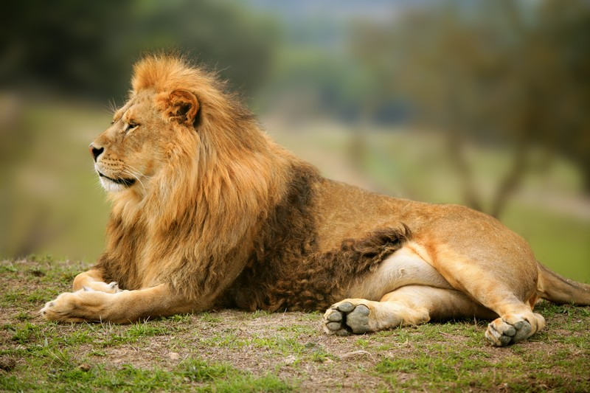
anim
An animal is a living creature such as a dog or cat, that is not an insect, plant, bird, fish, or person.
Examples:
Animation
the process of making animated films, television programs, computer games etc; a film, television program, computer game etc that has pictures, clay models etc that seem to be really moving; liveliness and excitement
Inanimate
Not living
animosity
Strong dislike or hatred.
equanimity
calmness in the way that you react to things, which means that you do not become upset or annoyed
Return to buttons

Slide 109
anim
An animal is a living creature such as a dog or cat, that is not an insect, plant, bird, fish, or person.
Positive/Negative Questions:
Do the following words use “anim?” Answer “Yes” or “No”
Animal
a living creature such as a dog or cat, that is not an insect, plant, bird, fish, or person
Amorous
Magnanimity
kind and generous, especially to someone that you have defeated
Amazing
Reanimate
to give new strength to someone or something or the energy to start again
Return to buttons

Slide 110
anim
An animal is a living creature such as a dog or cat, that is not an insect, plant, bird, fish, or person.
Think of 3 Words using “anim”
Another option: Use your dictionary to find 3 words using “anim”
Example: “animal”
Return to buttons

Slide 111
cit
Definition:
Moved, stirred up
Example: When you excite someone, you make them feel happy, interested, or eager.
Return to buttons

Slide 112
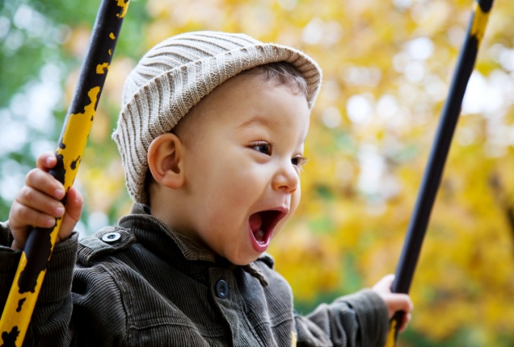
cit
When you excite someone, you make them feel happy, interested, or eager.
Examples:
Excite
to make someone feel happy, interested, or eager; to cause a particular feeling or reaction
Citation
a formal statement or piece of writing publicly praising someone's actions or achievements; an official order for someone to appear in court or pay a fine for doing something illegal
Incite
to deliberately encourage people to fight, argue etc.
Recite
to say a poem, piece of literature etc that you have learned, for people to listen to; to tell someone a series or list of things
Return to buttons

Slide 113
cit
When you excite someone, you make them feel happy, interested, or eager.
Positive/Negative Questions:
Do the following words use “cit?” Answer “Yes” or “No”
Cite
to mention something as an example, especially one that supports, proves, or explains an idea or situation; to give the exact words of something that has been written, especially in order to support an opinion or prove an idea
Except
Solicit
to try to sell a product or service by taking it to homes or businesses and showing it to the people there; to ask someone for money, help, or information
Susceptible
Resuscitate
to make someone breathe again or become conscious after they have almost died
Return to buttons

Slide 114
cit
When you excite someone, you make them feel happy, interested, or eager.
Think of 3 Words using “cit”
Another option: Use your dictionary to find 3 words using “cit”
Example: “excite”
Return to buttons

Slide 115
com
Definition:
Thoroughly, completely
Example: The word “complete” is used to emphasize that a quality or situation is as great as it could possibly be.
Return to buttons

Slide 116
com
The word “complete” is used to emphasize that a quality or situation is as great as it could possibly be.
Examples:
Complete
used to emphasize that a quality or situation is as great as it could possibly be; including all parts, details, facts, etc. and with nothing missing; finished; (complete with...) having particular equipment or features
Compromise
an agreement that is achieved after everyone involved accepts less than what they wanted at first, or the act of making this agreement;
Composure
the state of feeling or seeming calm
Compliant
willing to obey or to agree to other people's wishes and demands; made or done according to particular rules or standards
Return to buttons

Slide 117
com
The word “complete” is used to emphasize that a quality or situation is as great as it could possibly be.
Positive/Negative Questions:
Do the following words use “com?” Answer “Yes” or “No”
Compare
to examine or judge two or more things in order to show how they are similar to or different from each other; used when considering the size, quality, or amount of something in relation to something similar
Constant
Competent
having enough skill or knowledge to do something to a satisfactory standard; satisfactory but not especially good
Coordinate
Commemorate
to do something to show that you remember and respect someone important or an important event in the past
Return to buttons

Slide 118
com
The word “complete” is used to emphasize that a quality or situation is as great as it could possibly be.
Think of 3 Words using “com”
Another option: Use your dictionary to find 3 words using “com”
Example: “complete”
Return to buttons

Slide 119
fin
Definition:
End; form a boundary
Example: When something is final, it is last in a series of actions, events, parts of a story, etc.
Return to buttons

Slide 120
fin
“When something is final, it is last in a series of actions, events, parts of a story, etc.”
Examples:
Final
last in a series of actions, events, parts of a story etc; being the result at the end of a process; if a decision, offer, answer etc is final, it cannot or will not be changed
Confine
to keep someone or something within the limits of a particular activity or subject; to keep someone in a place that they cannot leave, such as a prison; to stop something bad from spreading to another place
Finesse
if you do something with finesse, you do it with a lot of skill and style
Define
to describe something correctly and thoroughly, and to say what standards, limits, qualities etc it has that make it different from other things; to explain exactly the meaning of a particular word or idea
Return to buttons

Slide 121
fin
“When something is final, it is last in a series of actions, events, parts of a story, etc.”
Positive/Negative Questions:
Do the following words use “fin?” Answer “Yes” or “No”
Affinity
a strong feeling that you like and understand someone or something; a close relationship between two things because of qualities or features that they share
Flexible
Infinite
very great in amount or degree; without limits in space or time
Fantastic
Finite
having an end or a limit
Return to buttons

Slide 122
fin
“When something is final, it is last in a series of actions, events, parts of a story, etc.”
Think of 3 Words using “fin”
Another option: Use your dictionary to find 3 words using “fin”
Example: “final”
Return to buttons

