Slide 1
WELCOME TO THE 1ST ANNUAL
TEXAS LEADERSHIP SUMMIT 2012
Información General de la Iniciativa de Capacidad de Leer y Escribir de Tejas
Presented by Jason Galvan, TLI Specialist
Presentación para Padres
8 de Octubre del 2013 Oliveira Middle School

Slide 2
Metas de la Iniciativa de Capacidad de Leer y Escribir de Tejas
La meta de esta iniciativa de Tejas es asegurar que todo estudiante de Tejas este preparado para las demandas académicas a nivel universitario o carrera al termino de graduación de preparatoria. Por lo tanto, el distrito escolar de Brownsville tiene las siguientes metas :
Incrementar la expresión oral y las habilidades de pre-alfabetización en niños de preescolar participantes.
Mejorar el desempeño de los alumnos de K-2 participantes en las evaluaciones de lectura prematura.
Incrementar el porcentaje de alumnos participantes que logren o excedan el dominio del idioma inglés en las evaluaciones del estado en artes de lenguaje, desde el tercero al doceavo año.
Incrementar el uso y análisis a base de datos para informar a los distritos participantes, escuelas, aulas, espacios de aprendizaje preescolar de toda toma de decisiones.
Incrementar la aplicaciٕón de la alfabetización efectiva a través de líneas de comunicación de instrucción.
Notes:
Now I’d like to spend some time reviewing the past 16 years of literacy history in Texas. JUST TEASING…but we are fortunate enough that we began Literacy Initiatives in 1996, with then Governor George Bush, and have continued to build upon the research and materials year after year, without changing directions, and without stopping and restarting…. we have kept progressing at a steady pace!!
GO TO BULLETS

Slide 3
Números Preliminares de la Iniciativa de Capacidad de Leer y Escribir de Tejas
Tejas otorgó 30 fondos económicos
Representando 30 Líneas de Liderazgo escolar (421 to 49,625 estudiantes)
~121+ (Provedores de educación prematura y
Preescolar)
~259+ K-5
~120+ 6-12
Esto apoyará un total de 221,248+ estudiantes en Tejas!!!!!
Notes:
Here is our current status.
Texas awarded 30 grants. The 30 funded Literacy Lines range in size. The smallest Literacy Line serves 421 students, and the largest serves 49,625 students.
Across the 30 funded Literacy Lines, there are about 121 ECE providers, about 259 elementary schools, and about 120 middle and high schools.
In total, these Literacy Lines support more than 221,248 students!

Slide 4
Infraestructura de Apoyo para la Iniciativa de Capacidad de Leer y Escribir de Tejas
Los Líderez de la Agencia Educativa de Tejas (TEA)
-Centros de Sistemas Educativos
-Universidad de Texas de Salud (UT Health)
_Instituto para Iniciativas de Escuelas Publicas
_Centro de Lectura y Artes de Lenguaje de Vaughn Gross
Línea local de Apoyo para la de Alfabetización
El Comité de liderazgo del distrito
(GI T)
El Director del departamento de la Iniciativa de Tejas (TLI)
El Superintendente del Distrito Escolar de Brownsville
Directores/Liderez de Programas pre-escolares (ECE)
El comité de liderazgo escolar (CBLT)
Línea de Alfabetización.
Edad de O a nivel 12
+Provedores de Educación Prematura/Preescolar
+Escuelas Primarias
+Escuelas Secundarias/
+ Escuelas Preparatorias
Notes:
READ THE BULLETS.

Slide 5
Notes:
This chart will be updated based on BISD zoning and possible shifts in the clusters. New chart for the year will be sent out in September.

Slide 6
Texas State Literacy Plan/ Plan de Iniciativa de Alfabetización del Estado de Tejas
Part 1: Overview/ Información General
TSLP
http://www.tea.state.tx.us/literacy/tli
Notes:
TLI grantees will work to accomplish the five grant goals through the implementation of the TSLP and the development of a comprehensive literacy plan. The TSLP booklet can be downloaded from the web address on the slide.

Slide 7
Plan Framework/ Estructura del Plan
Leadership/Liderazgo
Assessment/Evaluación
page 2-3
Standard-based Instruction/ Instrucción basada en estándares
Effective Instructional Framework/ Estructura de Educación Efectiva
Reporting and Accountability/ Reporte y Responsibilidad
Sustainability/ Sostenimiento
Notes:
The LASERS framework contains six essential components: Leadership, Assessment, Standards-based Instruction, Effective Instructional Framework (RtI), Reporting and Accountability, and Sustainability.

Slide 8
Table of Contents Three Age/Grade Levels
page 5-20
page 21-38
page 39-54
Notes:
For each LASERS component, the TSLP identifies key action steps for ECE sites and K-12 campuses.
Action Steps have been created for and are organized by the three age/grade levels: Age 0 to School Entry, Kindergarten to Grade 5, and Grade 6 to Grade 12.
Three online tools have been created to help schools implement the Action Steps.

Slide 9
Oliveira CBLT/ Comité de Liderazgo Escolar
Responsabilidades
Brindar apoyo a la escuela con la Iniciativa de Capacidad de Leer y Escribir de Tejas
Assistir con el monitoreo del progreso hacia las metas de la escuela.
Establecer un sistema de capacitación profesional, observación y opinión constructiva.
Completar el curso sobre los seis componentes de la Iniciativa de Capacidad de leer y Escribir de Teja mediante “Project Share”
Evaluar la eficacia de los programas o estrategias educativas en los logros académicos de los estudiantes.
Crear un plan educativo para alcanzar las metas de la Iniciativa de Alfabetización de Tejas. (Campus DIP)
Identificar las areas académicas que necesitan fortalecerse.
Notes:
As previously stated, the Implementation Inventory serves as a starting point for taking stock of current practices and identifying strengths and challenges. The Inventory also leads users to monitor progress and change over time.
In order to do this, the Inventory provides implementation levels for each Action Step.
The Leadership Team at each site or campus will examine an Action Step and decide if its site is
A. Planning Implementation of this Action Step,
B. In Initial Implementation of the action,
C. At Full Implementation with Fidelity, or
D. At Reflective Sustainability.

Slide 10
Texas State Literacy Plan: Implementation Tools
Texas State Literacy Plan: Implementation Tools/ Herramientas para la Implementación de la iniciativa de Alfabetización de Tejas
Inventario de Implementación
-completado por cada comité de Liderazgo escolar ( CBLT)
-Proporciona los niveles de implementación para cada medida de acción y los recursos necesarios para obtener el nivel deseado.
Mapa de Implementación
-Creado al completar el inventario
Notes:
(Click) Once a site or school completes the Implementation Inventory and determines their level of implementation on the Action Steps, an Implementation Map is created.
(Click) The Implementation Map is automatically generated when a campus rates its implementation status on all of the Action Steps within a component.

Slide 11
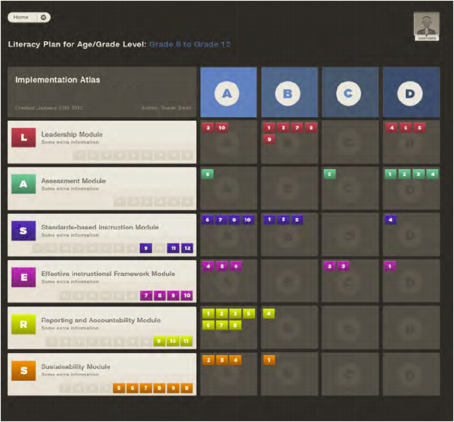
Notes:
As a campus Leadership Team-- completes each module of the Implementation Inventory, a summary is archived-- and placed in—
(CLICK) An Implementation Atlas. The Atlas is in development and we just received this screen shot. We wanted you to be the first to learn about it. Let’s take a closer look.
(CLICK CLICK) All six components or modules of the Inventory are represented and color coded—note the LASERS framework on the left.
(CLICK CLICK) Now notice the ABCD—representing our Implementation Ratings. The Action Steps are sorted according to the way each campus Leadership Team rated its campus.
Planning, B. Initial, C. Full Implementation and D. Reflective Sustainability.
Study the table for a minute (PAUSE)—at a glance, (CLICK CLICK) you can SEE that most Assessment Action Steps are at Reflective Sustainability—meaning this campus believes-----they are implementing critical Assessment Actions well—I’m curious about Action Step A6 in the Initial Planning Stage—this may indicate a need for further action OR it may indicate that this is an Action Step the LT has decided not to implement at this time--you can look later in your TSLP booklet to find out what A6 is!
(CLICK CLICK) We can also immediately see that we are in the Planning stage with many of our Reporting and Accountability Action Steps. PAUSE
(CLICK CLICK) The Inventory Atlas also records which Action Steps have not yet been Completed.
A variety of reports can be generated from the Implementation Atlas.
This Atlas provides another piece of the data puzzle. Individualized, customized data allows each campus to tailor the creation of its comprehensive literacy plan. When combined with our achievement data, the Atlas provides valuable information about each LASERS component---about staffing needs, areas of strength, and areas for targeted PD. We are really excited about the development of the Atlas and we can’t wait for you to start using it and letting us know all the possibilities it represents.

Slide 12
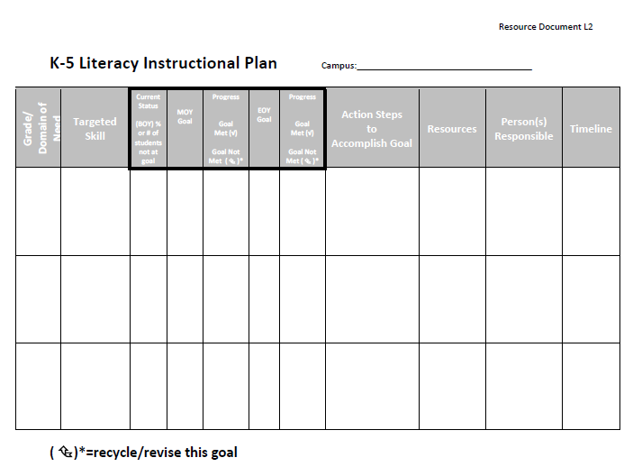
Data-informed Plan Template
Notes:
The Leadership Team is immediately linked to a sample template, a resource that directly supports the implementation of the L2 (targeted) Action Step.
There is one more online tool to help Literacy Lines implement the TSLP.

Slide 13
Standards-based Instruction
RESOURCES/ Recursos para la Instrucción basada en Estándares
ELAR / SLAR Texas Essential Knowledge and Skills (TEKS)
English Language Proficiency Standards (ELPS)
College and Career Readiness Standards (CCRS)
Textbook Adoption List – Proclamations 2010 and 2011
FCRR: Reviewing a Reading Program K-12
Online Teacher Reading Academics (OTRAs)
Critical Elements Analysis
Return to RESOURCES
Notes:
In this case, a Leadership Team chooses the link for FCRR: Reviewing a Reading Program K-12.

Slide 14
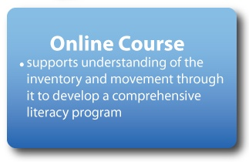
Texas State Literacy Plan:
Implementation Tools/ Herramientas para la Implementacion de la Iniciativa de Alfabetización Tejas
Notes:
(Click) The third tool to assist with the implementation of the TSLP is an online course. Members of the TLI Leadership team at each site or campus will be the first participants in a new Project Share™ course focused on the TSLP. The TSLP Online Course is designed to help each site/campus and each Literacy Line understand, use, and progress through the Action Steps in the TSLP.
On each campus, only the members of the TLI Leadership team will need to participate in the online course. Their work in the course will help to inform the work the whole school community does to implement the TSLP.

Slide 15
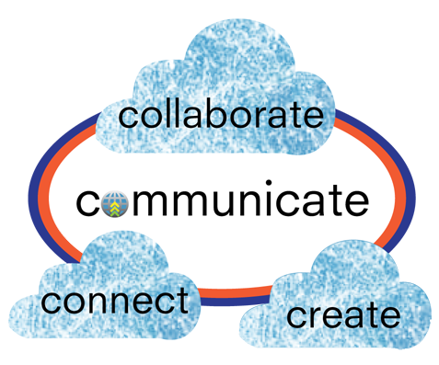
Professional Development in Project Share
www.projectsharetexas.org
Notes:
So what will it mean to participate actively in Project Share™?
For the Texas Literacy Initiative, participation in Project Share will include 4 main activities:
Creating a comprehensive literacy program as a result of working in the TSLP online course
Collaborating with colleagues within the Literacy Line
Connecting within a Literacy Line by building an online professional learning community, where members will meet to learn, discuss, examine student data and practices, develop goals to provide the learning necessary to reach those goals, create plans for implementation across all ages in the literacy line, and monitor those plans for effectiveness
Communicating between the State Leadership Team and the grantees in a grant-wide Professional Learning Community where announcements and general information can be shared across Literacy Lines.
Anyone who hasn’t signed-up for Project Share™ yet is encouraged to sign-up!

Slide 16
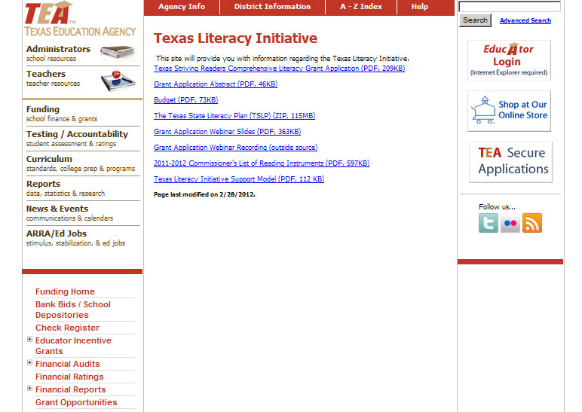
http://www.tea.state.tx.us/literacy/tli
Notes:
Most of the information that sites and schools will need to support their work with the TSLP will be housed in Project Share™. However, the TEA website will also be a great resource. There is a page on the TEA website dedicated specifically to the Texas Literacy initiative.
BISD will have their own link to this resource under C & I web site for TLI Grant.

Slide 17
1.Lleve a sus hijos a la Biblioteca Pública de Brownsville regularmente. La mayoría del tiempo la biblioteca tiene varias actividades para formentar la lectura. Pregunte por el calendario de eventos
2.La Biblioteca Pública de Brownsville tiene un departamento llamado “Friends of the Library” /Amigos de la Biblioteca donde usted puede comprar libros o revistas desde diez centavos.
3.Mantenga contacto con la maestra de sus hijos para que sepa el nivel de fluídez de ellos.
4. Tenga tiempo de deja todo y lee (D.E.A.R. (Drop Everything and Read) (http://www.dropeverythingandread.com) en su casa por 15 minutos cada día, Apague la televisión, radios, juegos electronicos etc.
5.Trate de leerle a sus hijos y hagales preguntas de comprención
6. Si tiene computadora en casa, puede utilizar los siguientes recursos de lectura.
www.starfall.com
www.ereadingworksheets.com/
www.ctlreadingclinic.uoregon.edu/home_activities.html
Ideas para Padres de Como Apoyar la Iniciativa de Alfabetización deTejas
Notes:
The objective of the online course and indeed all the professional development, technical assistance, and support from the State Leadership Team is to achieve the goals of the Texas Leadership Initiative. We know that Project Share may be new to many of you. We’re with you. We’ll be your partners every step of the way.

Slide 18
"Alfabetización eficaz menudo monta una asociación, una colaboración
entre todas las partes interesadas, y la coordinación estratégica de la enseñanza
para satisfacer las necesidades del estudiante. " --Murphy, 2004
Oliveira Middle School TLI Webpage:
http://oliveirabisd-tli.weebly.com/
Maria V. Gonzales, TLI Project Director – mvgonzales@bisd.us
Sonia Perales, TLI Project Secretary – sperales@bisd.us
Jason Galvan, TLI Specialist – jgalvan@bisd.us
TLI Project Office 1900 Price Road -- Suite 208 956-698-1650
Notes:
The objective of the online course and indeed all the professional development, technical assistance, and support from the State Leadership Team is to achieve the goals of the Texas Leadership Initiative. We know that Project Share may be new to many of you. We’re with you. We’ll be your partners every step of the way.

