Slide 1
WELCOME TO THE 1ST ANNUAL
TEXAS LEADERSHIP SUMMIT 2012
OVERVIEW OF THE
TEXAS LITERACY INITIATIVE
Jason Galvan – TLI Specialist
Parent Presentation
October 8, 2013 Oliveira Middle School

Slide 2
TLI Goals
The ultimate goal of this initiative is to ensure that all Texas students are prepared for college-level academic demands, or for a career at the end of their high school graduation. Therefore, BISD has the following goals:
1. Increase the oral language and preliteracy skills of participating preschool children.
2. Improve the performance of participating K-2 students on early reading assessments.
3. Increase the percentage of participating students who meet or exceed proficiency on the state English language arts assessments in grades 3 through 12.
4. Increase the use of data and data analysis to inform all decision making in participating districts, campuses, classrooms, and early learning settings.
5. Increase the implementation of effective literacy instruction through Literacy Lines.
Notes:
READ SLIDE.
ALL the Texas Literacy Initiative goals mention the words “increase” and “improve.” The state will work with leaders in the funded Literacy Lines to determine expectations for what “increase” means, and what benchmarks will be set along the way.
Future funding for each Literacy Line depends on achieving literacy success, and future funding for Texas depends on the collective success of all the Literacy Lines.
The TLI goals help to clarify what Texas wants to achieve through the grant. We’ll now turn our attention to how we will accomplish the work of the Texas Literacy Initiative.

Slide 3
Preliminary TLI Numbers
30 Grant Recipients
Representing 30 Literacy Lines (421 to 49,625 students)
~121+ ECE Providers
~259+ K-5
~120+ 6-12
That will support 221,248+ students in Texas!!!!!
Notes:
Here is our current status.
Texas awarded 30 grants. The 30 funded Literacy Lines range in size. The smallest Literacy Line serves 421 students, and the largest serves 49,625 students.
Across the 30 funded Literacy Lines, there are about 121 ECE providers, about 259 elementary schools, and about 120 middle and high schools.
In total, these Literacy Lines support more than 221,248 students!

Slide 4
Notes:
This graphic represents the TLI Support Structure.
The bottom box represents our Literacy Line.
Within every Literacy Line, there are educators from Early Childhood Education, the Elementary level, the Middle/Intermediate level, and
High School level.
The focus of the middle box is the LOCAL Line of Support for our Literacy Line. For each Literacy Line there is a Grant Implementation Team that leads the initiative at the district level. This leadership team includes ECE Directors and leaders, school superintendents and leaders, literacy line leaders from the campus level, and a Project Manager for the district. The site or campus based leadership teams are also part of this support structure.
The top box represents TEA and the Statewide Leadership Support. Statewide Leadership support includes members from TEA, ESCs, the Institute for Public Schools, UT Health, and the Vaughn Gross Center for Reading and Language Arts.
To help us all focus on the work we need to achieve through the Texas Literacy initiative, we have identified five main, overarching goals which we will look at next.

Slide 5
Notes:
This chart will be updated based on BISD zoning and possible shifts in the clusters. New chart for the year will be sent out in September.

Slide 6
Texas State Literacy Plan
Part 1: Overview
TSLP
http://www.tea.state.tx.us/literacy/tli
Notes:
TLI grantees will work to accomplish the five grant goals through the implementation of the TSLP and the development of a comprehensive literacy plan. The TSLP booklet can be downloaded from the web address on the slide.

Slide 7
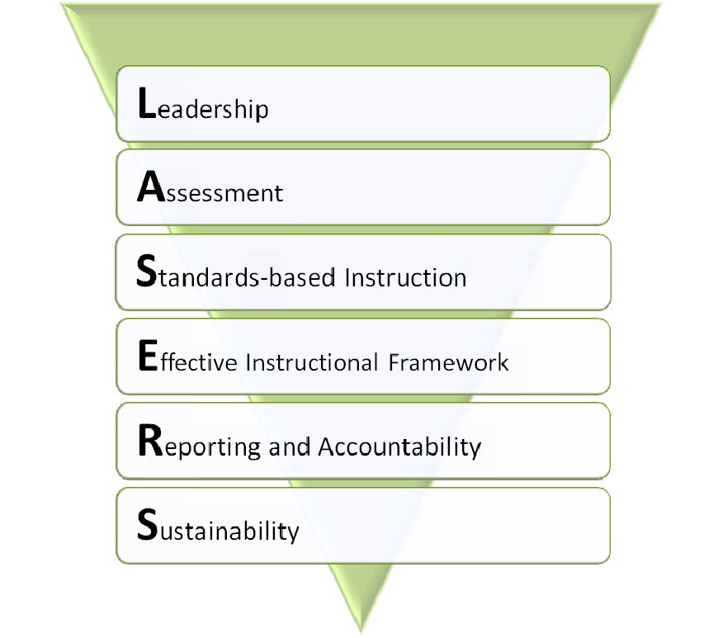
Plan Framework
page 2-3
Notes:
The LASERS framework contains six essential components: Leadership, Assessment, Standards-based Instruction, Effective Instructional Framework (RtI), Reporting and Accountability, and Sustainability.

Slide 8
Table of Contents Three Age/Grade Levels
page 5-20
page 21-38
page 39-54
Notes:
For each LASERS component, the TSLP identifies key action steps for ECE sites and K-12 campuses.
Action Steps have been created for and are organized by the three age/grade levels: Age 0 to School Entry, Kindergarten to Grade 5, and Grade 6 to Grade 12.
Three online tools have been created to help schools implement the Action Steps.

Slide 9
Oliveira CBLT
Responsibilities
Support the Texas Literacy Initiative Grant at the campus.
Attend to the monitoring of progress towards the goals of the school.
Establish a system of training, observation, and constructive opinion.
Complete the course of the six components of the Texas Literacy Initiative through "Project Share"
Assess the effectiveness of educational programs or strategies on academic achievement of students.
Create an educational plan to achieve the goals of the Texas Literacy Initiative. (Campus Data Informed Plan – DIP)
Identify academic areas that need strengthening.
Notes:
As previously stated, the Implementation Inventory serves as a starting point for taking stock of current practices and identifying strengths and challenges. The Inventory also leads users to monitor progress and change over time.
In order to do this, the Inventory provides implementation levels for each Action Step.
The Leadership Team at each site or campus will examine an Action Step and decide if its site is
A. Planning Implementation of this Action Step,
B. In Initial Implementation of the action,
C. At Full Implementation with Fidelity, or
D. At Reflective Sustainability.

Slide 10
Texas State Literacy Plan: Implementation Tools
Texas State Literacy Plan: Implementation Tools
Notes:
(Click) Once a site or school completes the Implementation Inventory and determines their level of implementation on the Action Steps, an Implementation Map is created.
(Click) The Implementation Map is automatically generated when a campus rates its implementation status on all of the Action Steps within a component.

Slide 11
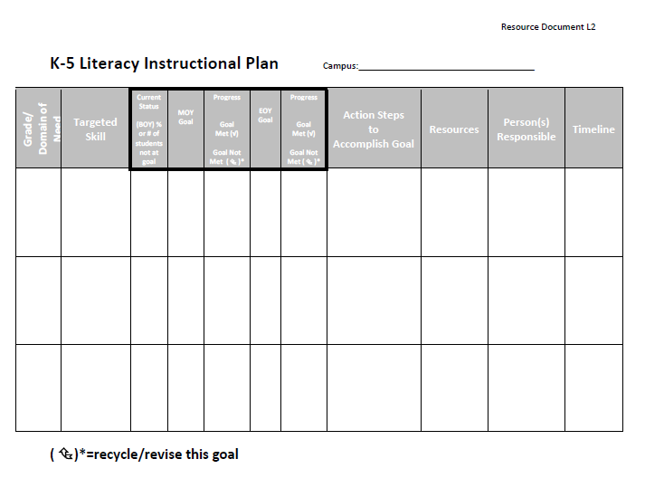
Data-informed Plan Template
Notes:
The Leadership Team is immediately linked to a sample template, a resource that directly supports the implementation of the L2 (targeted) Action Step.
There is one more online tool to help Literacy Lines implement the TSLP.

Slide 12
Standards-based Instruction
RESOURCES
ELAR / SLAR Texas Essential Knowledge and Skills (TEKS)
English Language Proficiency Standards (ELPS)
College and Career Readiness Standards (CCRS)
Textbook Adoption List – Proclamations 2010 and 2011
FCRR: Reviewing a Reading Program K-12
Online Teacher Reading Academics (OTRAs)
Critical Elements Analysis
Return to RESOURCES
Notes:
In this case, a Leadership Team chooses the link for FCRR: Reviewing a Reading Program K-12.

Slide 13
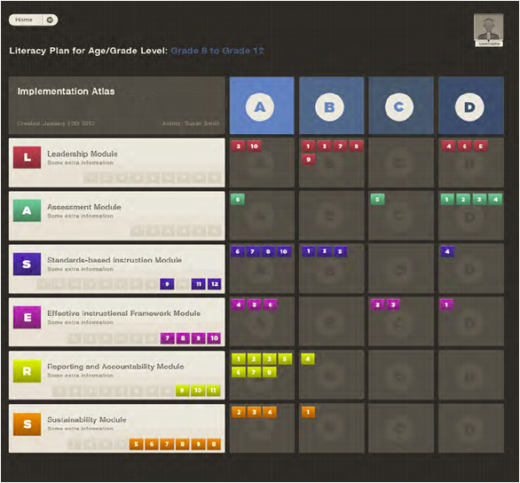
Notes:
As a campus Leadership Team-- completes each module of the Implementation Inventory, a summary is archived-- and placed in—
(CLICK) An Implementation Atlas. The Atlas is in development and we just received this screen shot. We wanted you to be the first to learn about it. Let’s take a closer look.
(CLICK CLICK) All six components or modules of the Inventory are represented and color coded—note the LASERS framework on the left.
(CLICK CLICK) Now notice the ABCD—representing our Implementation Ratings. The Action Steps are sorted according to the way each campus Leadership Team rated its campus.
Planning, B. Initial, C. Full Implementation and D. Reflective Sustainability.
Study the table for a minute (PAUSE)—at a glance, (CLICK CLICK) you can SEE that most Assessment Action Steps are at Reflective Sustainability—meaning this campus believes-----they are implementing critical Assessment Actions well—I’m curious about Action Step A6 in the Initial Planning Stage—this may indicate a need for further action OR it may indicate that this is an Action Step the LT has decided not to implement at this time--you can look later in your TSLP booklet to find out what A6 is!
(CLICK CLICK) We can also immediately see that we are in the Planning stage with many of our Reporting and Accountability Action Steps. PAUSE
(CLICK CLICK) The Inventory Atlas also records which Action Steps have not yet been Completed.
A variety of reports can be generated from the Implementation Atlas.
This Atlas provides another piece of the data puzzle. Individualized, customized data allows each campus to tailor the creation of its comprehensive literacy plan. When combined with our achievement data, the Atlas provides valuable information about each LASERS component---about staffing needs, areas of strength, and areas for targeted PD. We are really excited about the development of the Atlas and we can’t wait for you to start using it and letting us know all the possibilities it represents.

Slide 14
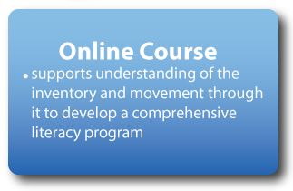
Texas State Literacy Plan:
Implementation Tools
Notes:
(Click) The third tool to assist with the implementation of the TSLP is an online course. Members of the TLI Leadership team at each site or campus will be the first participants in a new Project Share™ course focused on the TSLP. The TSLP Online Course is designed to help each site/campus and each Literacy Line understand, use, and progress through the Action Steps in the TSLP.
On each campus, only the members of the TLI Leadership team will need to participate in the online course. Their work in the course will help to inform the work the whole school community does to implement the TSLP.

Slide 15
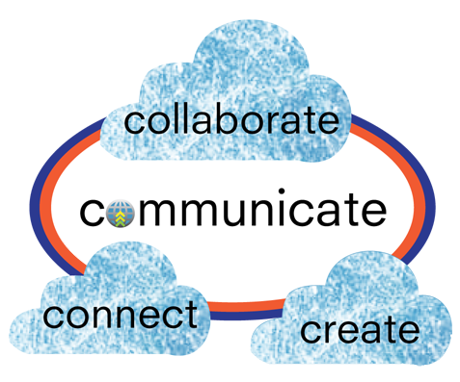
Professional Development in Project Share
www.projectsharetexas.org
Notes:
So what will it mean to participate actively in Project Share™?
For the Texas Literacy Initiative, participation in Project Share will include 4 main activities:
Creating a comprehensive literacy program as a result of working in the TSLP online course
Collaborating with colleagues within the Literacy Line
Connecting within a Literacy Line by building an online professional learning community, where members will meet to learn, discuss, examine student data and practices, develop goals to provide the learning necessary to reach those goals, create plans for implementation across all ages in the literacy line, and monitor those plans for effectiveness
Communicating between the State Leadership Team and the grantees in a grant-wide Professional Learning Community where announcements and general information can be shared across Literacy Lines.
Anyone who hasn’t signed-up for Project Share™ yet is encouraged to sign-up!

Slide 16
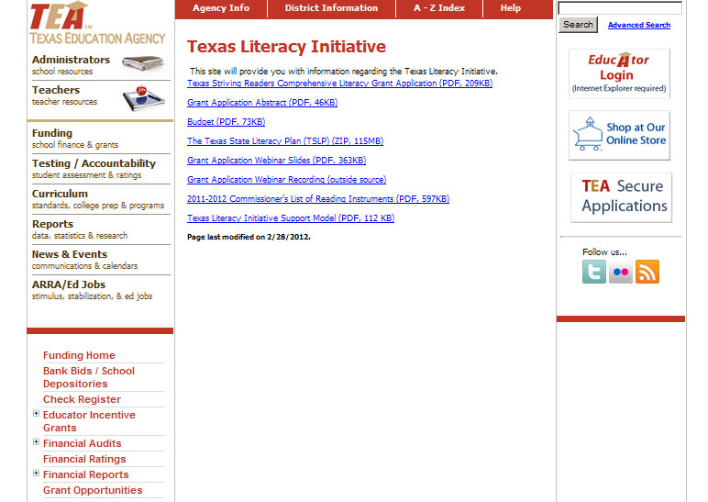
http://www.tea.state.tx.us/literacy/tli
Notes:
Most of the information that sites and schools will need to support their work with the TSLP will be housed in Project Share™. However, the TEA website will also be a great resource. There is a page on the TEA website dedicated specifically to the Texas Literacy initiative.
BISD will have their own link to this resource under C & I web site for TLI Grant.

Slide 17
Ideas for Parents to Assist with this Literacy Initiative
1. Take your kids to the Brownsville Public Library regularly. Most of the time the library has several activities to promote reading. Ask for the calendar of events.
2. The Brownsville Public Library has a department called "Friends of the Library” in through which you can buy books or magazines for as little as 10 cents, depending on what you purchase.
3. Maintain contact with your child's teacher so you can keep track of their fluency levels.
4. Take time to stop everything and read (DEAR – Drop Everything and Read) (http://www.dropeverythingandread.com) at home for 15 minutes each day: Turn off the TV, radios, electronic games etc.
5. Try to read to your child and ask comprehension questions.
6. If you have a computer at home, you can use the following reading resources.

Slide 18
“Effective literacy often mounts a partnership, a collaboration
between all stakeholders, and strategic coordination of instruction
to meet student needs.” -Murphy, 2004
Oliveira Middle School TLI Webpage:
http://oliveirabisd-tli.weebly.com/
Maria V. Gonzales, TLI Project Director – mvgonzales@bisd.us
Sonia Perales, TLI Project Secretary – sperales@bisd.us
Jason Galvan, TLI Specialist – jgalvan@bisd.us
TLI Project Office 1900 Price Road -- Suite 208 956-698-1650
TLI Project Office 1900 Price Road -- Suite 208 956-698-1650
Notes:
The objective of the online course and indeed all the professional development, technical assistance, and support from the State Leadership Team is to achieve the goals of the Texas Leadership Initiative. We know that Project Share may be new to many of you. We’re with you. We’ll be your partners every step of the way.

