Slide 1
Vocabulary
Greek Roots
7th Reading
J. Galvan

Slide 2
Vocabulary terms
Below are Greek roots.
ology
itis
met/
meta
litho/
lith
vore
graph/ gram
ologist
derma
proto
tri
hydro
bio
cyto/
cyte
epi
scope
sub
astro
ectomy
Hypo
phyto/
phyte
a/an/in
micro
photo
anti
Mono
di/bi
poly
Hema/
hemo
cide
aero

Slide 3
-ology
Definition:
  “The study of…”
Example :
  “biology.”
Return to buttons

Slide 4

-ology
Examples:
  Biology: the study of living things
  Kinesiology: study of kinetics in body movements and functions
  Sociology: the study of society
  Psychology: the study of the mind
  Pathology: the study of diseases (like viruses)
Biology is the study of living things.
Return to buttons

Slide 5
-ology
Positive/Negative Questions: (Answer “yes” or “no”):
  Sociology
  Astronomy
  Anatomy
  Psychology
  Pathology
  Criminology
  Cardiology
Biology is the study of living things.
Return to buttons

Slide 6
-ology
(v.) & (n.)
Think of 3 Words using “-ology:”
  Example: “Microbiology”
Biology is the study of living things.
Return to buttons

Slide 7
-ologist
Definition:
  A person who studies.
Example: “Biologists study the earth and living systems .”
Return to buttons

Slide 8

-ologist
Examples:
  Paleontologist
    a scientist who studies dinosaurs
  Archaeologist
    A person who studies prehistoric people and their cultures
  Zoologist
    Life scientists who study animals in laboratories or in their natural habitats
  Cardiologist
    doctors specializing in diagnosing or treating diseases of the heart
  Criminologist
    People who study the nature, management, causes, consequences, control, and prevention of criminal behavior in individuals or in society
“A person must study for several years to become a paleontologist.”(scientist who studies dinosaurs)
Return to buttons

Slide 9
-ologist
“A person must study for several years to become a paleontologist.”(scientist who studies dinosaurs)
Positive/Negative Questions: Answer “yes” or “no”:
  Cosmologist
  Musicologist
  Astronomer
  Blacksmith
  Etymologist
Return to buttons

Slide 10
- ologist
“A person must study for several years to become a paleontologist.”(scientist who studies dinosaurs)
Think of 3 Words using “-ologist:”
  Example: “Microbiologist”
Return to buttons

Slide 11
-cyto/-cyte
Definition:
  Referring to a cell
Example: “Animal cells are filled with cytoplasm.”
Return to buttons

Slide 12
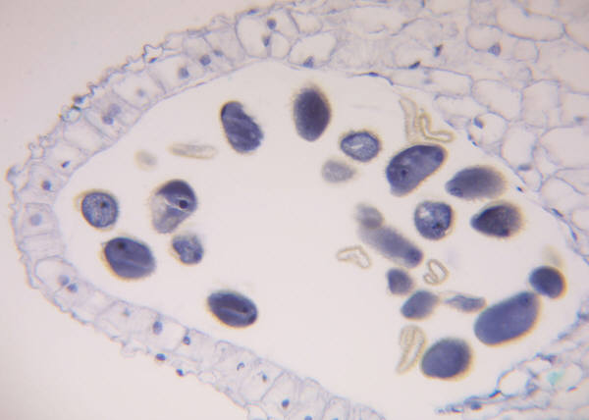
-cyto/-cyte
The enclosed area in the middle of this cell is filled with a material called: cytoplasm.
Examples:
  Cytoplasm (chemical compounds within a cell)
  Cytoplast (a cell which has had the nucleus removed)
  Leukocytes (white blood cell)
  Phagocytes (a cell in the body’s bloodstream and tissues)
Return to buttons

Slide 13
-cyto/-cyte
Positive/Negative Questions: (Answer “yes” or “no”)
  Nucleus
  Lymphocyte
    (cells in the immune system which produce antibodies)
  Mitochondria
  Granulocyte
    (a white blood cell t hat contains many granular particles in its cytoplasm)
The enclosed area in the middle of this cell is filled with a material called: cytoplasm.
Return to buttons

Slide 14
-cyto/-cyte
Think of 3 Words using “-cyte: -cyto”
  Example: “Melanocyte”
The enclosed area in the middle of this cell is filled with a material called: cytoplasm.
Return to buttons

Slide 15
Hypo-
Definition 1:
  Under, below, beneath
Example 1: “A hypothesis is a proposal intended to explain certain facts or observations.”
Return to buttons

Slide 16
Hypo-
Examples:
  Hypothesis
    (an explanation for something, used as a basis for investigation)
  Hypothalamus
    (a central area on the underside of the brain, controlling involuntary functions such as body temperature)
  Hypodermic
    (relating to or involving the area of tissue lying beneath the skin)
  Hypothermia
    (dangerously low body temperature caused by prolonged exposure to the cold)
Definition of hypo: Under, below, beneath
Return to buttons

Slide 17
Hypo-
Positive/Negative Questions: Answer “Yes “or “No”
  Hypersensitive
    Very easily upset or offended
  Hypothesis
    an explanation for something, used as a basis for investigation
  Hiccup
    An involuntary contraction of the diaphragm causing a convulsive gasp
  Hypogastric
    The part of the front of the human abdomen that lies below the navel
  Hypoallergenic
    Not likely to cause an allergic reaction
Definition of hypo: Under, below, beneath
Return to buttons

Slide 18
Hypo-
Think of 3 Words using “hypo-”
  Example: “hypothesis”
Definition of hypo: Under, below, beneath
Return to buttons

Slide 19
Mono-
Definition:
  One
  Example: “In a monopoly, one company owns and controls all business for a certain item (like if one company owned and sold all the oil in the world).”
Return to buttons

Slide 20

Mono-
Mono- one.
Examples:
  Mononucleosis:
    illness with a significant rise in lymphocytes in the blood
  Monotype:
    a plant or animal that is the only member of the category to which it belongs
  Monopoly:
    Situation where one company controls an industry or is the only provider of a service or product
  Monorail:
    A passenger railroad transport system in which the cars straddle or are suspended from a single team
Return to buttons

Slide 21
Mono-
Mono- one.
Positive/Negative Questions:
  Monastery
    a building or buildings with grounds in which a group of people observing religious vows, especially monks, live together
  Montgomery
    A city in Alabama
  Monocle
    an eyeglass for correcting the vision of one eye
  Monday
    the first day of the traditional working week, coming after Sunday
  Monochromatic
    having only one color
Return to buttons

Slide 22
Mono-
Mono- one.
Think of 3 Words using “mono-”
  Example: “monopoly”
Return to buttons

Slide 23
-itis
Definition:
  Inflammation of…
  Example: “That baseball pitcher has tendonitis.”
Return to buttons

Slide 24
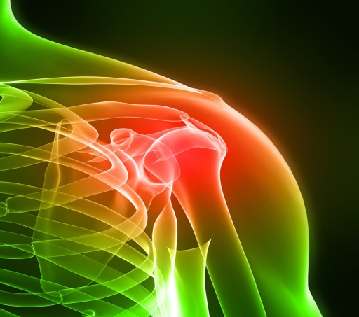
-itis
Tendonitis: A condition in which the tissue connecting muscle to bone becomes inflamed
Examples:
  Arthritis
    a medical condition affecting a joint or joints, causing pain, swelling, and stiffness
  Dermatitis
    inflammation of the skin from any cause, resulting in a range of symptoms such as redness, swelling, itching, or blistering
  Gastritis
    Any of a group of conditions in which the stomach lining is inflamed
  Bronchitis
    inflammation of the mucous membrane in the airway bronchial tubes of the lungs, resulting from infection or irritation and causing breathing problems and severe coughing
  Sinusitis
    A condition in which the cavities around the nasal passages become inflamed
Return to buttons

Slide 25
-itis
Tendonitis: A condition in which the tissue connecting muscle to bone becomes inflamed
Positive/Negative Questions: Answer “yes” or “no”
  Infection
  Meningitis
    a serious, sometimes fatal illness in which a viral or bacterial infection inflames the meninges, causing symptoms such as severe headaches, vomiting, stiff neck, and high fever
  Thrombosis
  Hepatitis
    inflammation of the liver, causing fever, jaundice, abdominal pain, and weakness
Return to buttons

Slide 26
-itis
Tendonitis: A condition in which the tissue connecting muscle to bone becomes inflamed
Think of 3 Words using “-itis”
  Example: “Bronchitis”
Return to buttons

Slide 27
derma
Definition:
  skin
Example: “The epidermis includes our skin.”
Return to buttons

Slide 28
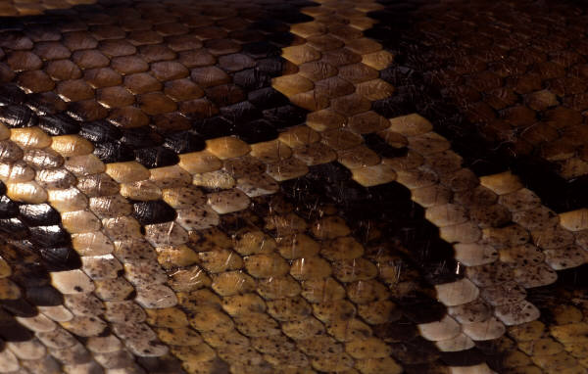
derma
Reptiles are covered with scales, which are formed from their epidermis.
Examples:
  Epidermis
    the thin outermost layer of the skin, itself made up of several layers, that covers and protects the underlying dermis
  Dermatitis
    inflammation of the skin from any cause, resulting in a range of symptoms such as redness, swelling, itching, or blistering
  Dermatologist
    the branch of medicine that deals with the skin and diseases affecting the skin
  Hypodermal
    lying beneath an outer skin or epidermis
Return to buttons

Slide 29
derma
Reptiles are covered with scales, which are formed from their epidermis.
Positive/Negative Questions: Answer “Yes” or “No”
  Hydroelectric
  Dermatology
    the branch of medicine that deals with the skin and diseases affecting the skin
  Epidemic
  Hypodermic
    relating to or involving the area of tissue lying beneath the skin
Return to buttons

Slide 30
derma
Reptiles are covered with scales, which are formed from their epidermis.
Think of 3 Words using “derma”
  Example: “Dermatitis”
Return to buttons

Slide 31
epi
Definition:
  On, upon, or above
Example:
  The “epidermis” is our thin, outermost layer of skin.
Return to buttons

Slide 32
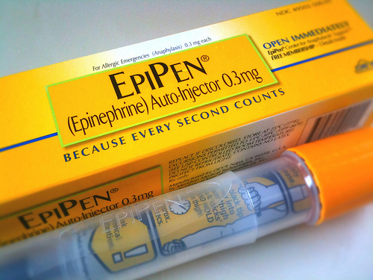
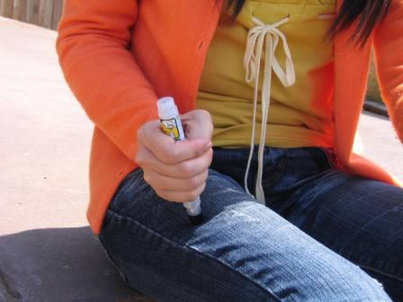
epi
An EpiPen is used on a patient who has a severe allergic reaction.
Examples:
  Epidermis
    Outermost layer of skin
  Epinephrine
    Treats severe allergic reactions (including anaphylaxis) in an emergency situation.
  Epiglottis
    The epiglottis is a flap that is made of elastic cartilage tissue covered with a mucous membrane, attached to the entrance of the larynx
  Epicenter
    the point on the Earth's surface that is directly above the hypocenter or focus, the point where an earthquake or underground explosion originates
Return to buttons

Slide 33
epi
An EpiPen is used on a patient who has a severe allergic reaction.
Positive/Negative Questions: Answer “yes” or “no”
  Epithelial
    describes tissue that forms a thin protective layer on exposed bodily surfaces and forms the lining of internal cavities, ducts, and organs
  Periodical
  Epitome
    a highly representative example of a type, class, or characteristic
  Envelope
  Epidemiology
    scientific /medical study of the causes & transmission of disease within a population
Return to buttons

Slide 34
epi
An EpiPen is used on a patient who has a severe allergic reaction.
Think of 3 Words using “epi”
  Example: “Epinephrine”
Return to buttons

Slide 35
phyto/phyte
Definition:
  Referring to plants
Example: “Phytology is the study of plants, which is also known as botany.”
Return to buttons

Slide 36
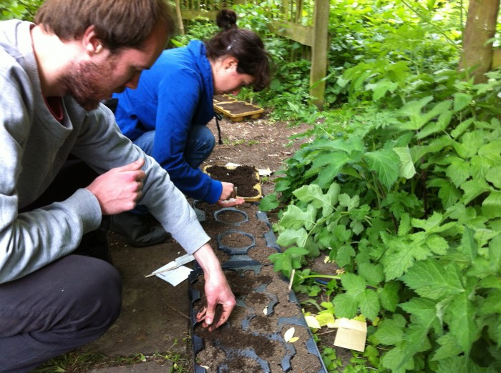
phyto/phyte
Phytology is the study of plants, which is also known as botany.
Examples:
  Phytology
    the study of plants; botany
  Phytoplankton
    very small free-floating plants, e.g. one-celled algae, found in plankton
  Macrophyte
    An aquatic plant that grows in or near water and is either emergent, submergent, or floating
  Phytobacterium
    A bacterium that occurs in or on a plant
Return to buttons

Slide 37
phyto/phyte
Phytology is the study of plants, which is also known as botany.
Positive/Negative Questions: “Yes” or “No”
  Photograph
  Chlorophyte
    Any of the green algae that comprise the division Chlorophyta
  Phytoclast
    A microscopic plant fragment present in the fossil record
  Biophyte
    Any plant that obtains nourishment from the bodies of insects (or other once-living organisms)
  Phobia
Return to buttons

Slide 38
phyto/phyte
Think of 3 Words using “phyto or phyte”
  Example: “Phytoplankton”
Phytology is the study of plants, which is also known as botany.
Return to buttons

Slide 39
di/bi
Definition:
  two
Example: Something which occurs “biannually” happens twice a year.
Return to buttons

Slide 40
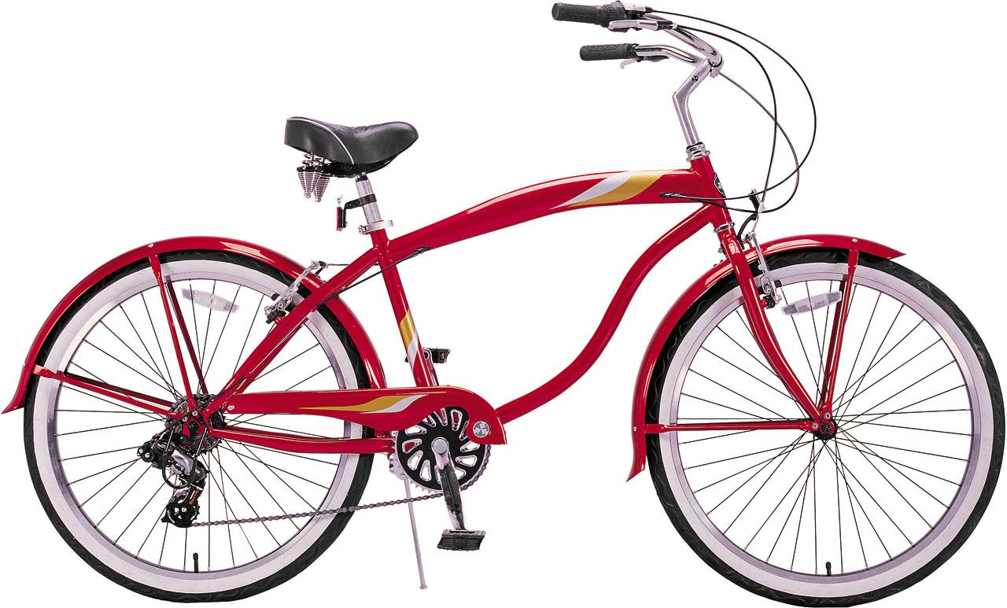
di/bi
A bicycle has two wheels.
Examples:
  Diphosphorous
    (chemistry, in combination) two atoms of phosphorus in a compound
  Bimetal
    Consisting of two metals.
  Binucleus
    A cell which contains two nuclei
  Diploid
    A cell or organism that has paired chromosomes, one from each parent
Return to buttons

Slide 41
di/bi
A bicycle has two wheels.
Positive/Negative Questions: Answer “Yes” or “No”
  Diploid
    a cell or organism that has paired chromosomes, one from each parent
  Describe
  Diode
    A diode is an electrical device allowing current to move through it in one direction with far greater ease than in the other
  Biped
    an animal that uses two legs for walking
Return to buttons

Slide 42
di/bi
A bicycle has two wheels.
Think of 3 Words using “di or bi”
  Example: “Bicycle”
Return to buttons

Slide 43
met/meta
Definition:
  Beyond or higher; changed or transformed
Example: “A metamorphosis occurs when something transforms into something else (like a caterpillar turning into a butterfly).”
Return to buttons

Slide 44
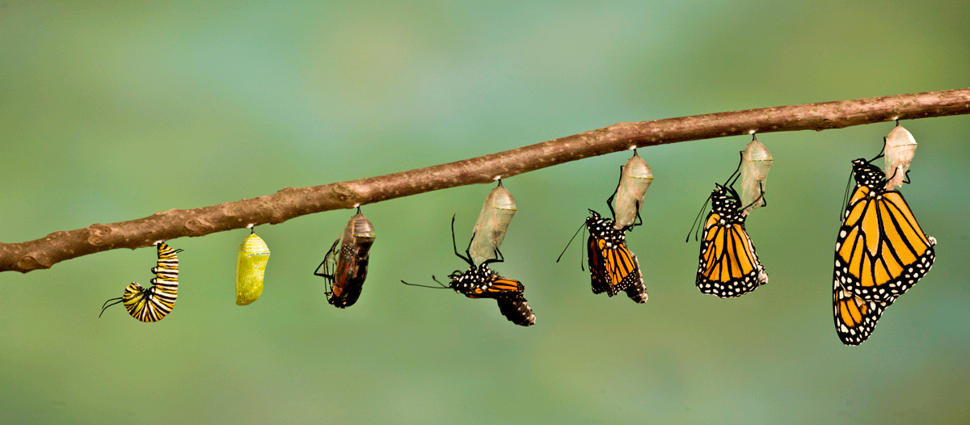
met/meta
A metamorphosis occurs when something transforms into something else
Examples:
  Metabolism
    the set of life-sustaining chemical transformations within the cells of living organisms
  Metamorphize
    To transform or change
  Metanalysis
    statistical methods for contrasting and combining results from different studies in the hope of identifying patterns among study results
  Metabiosis
    a condition in which the growth and metabolism of one organism alter the environment to allow the growth of another organism.
Return to buttons

Slide 45
met/meta
A metamorphosis occurs when something transforms into something else
Positive/Negative Questions: Answer “Yes” or “No”
  Membrane
  Metastasis
    the spread of a cancer or disease from one organ or part to another not directly connected with it
  Meatball
  Metastasize
    (of a cancer) spread to other sites in the body by metastasis
  Metabolic
    Relating to metabolism, the whole range of biochemical processes that occur within us (or any living organism). Metabolism consists of anabolism (the buildup of substances) and catabolism (the breakdown of substances)
Return to buttons

Slide 46
met/meta
A metamorphosis occurs when something transforms into something else
Think of 3 Words using “met/meta”
  Example: “Metamorphosis”
Return to buttons

Slide 47
Proto
Definition:
  First or earliest
Example: “An inventor needs to create a prototype of his invention before having it mass produced.
Return to buttons

Slide 48
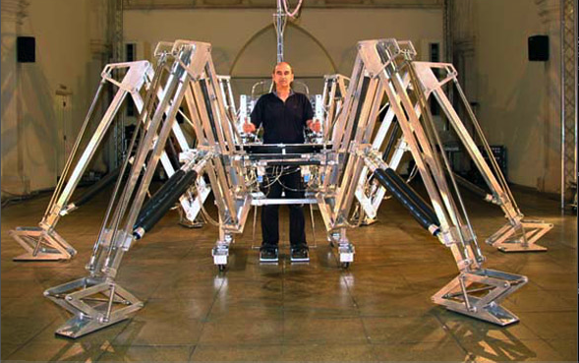
Proto
A prototype is a first or preliminary model of something, especially a machine, from which other forms are developed or copied.
Examples:
  Prototypical
    An original type, form, or instance serving as a basis or standard: "The abolitionists were the prototype of modern citizen activism"
  Protobird
    Any of several extinct animals proposed as an evolutionary link between fossil reptiles and fossil birds
  Protohuman
    of, relating to, or resembling extinct hominid populations that had some, but not all, the features of modern Homo sapiens
  Protoscience
    The earliest eras of the history of science, when the scientific method was embryonic
  Protoplastid
    An immature plastid that is incapable of photosynthesis
Return to buttons

Slide 49
Proto
A prototype is a first or preliminary model of something, especially a machine, from which other forms are developed or copied.
Positive/Negative Questions: Answer “Yes” or “No”
  Protozoan
    a diverse group of mostly motile unicellular eukaryotic organisms
  Prominent
  Prototype
    a first or preliminary model of something, especially a machine, from which other forms are developed
  Promote
  Protoculture
    the passing of behaviors from one generation to another among non-human primates. These cultures are very rudimentary, and do not exhibit complex cultural technology
Return to buttons

Slide 50
Proto
A prototype is a first or preliminary model of something, especially a machine, from which other forms are developed or copied.
Think of 3 Words using “proto”
  Example: “Prototype”
Return to buttons

Slide 51
scope
Definition:
  An instrument for viewing
Example: “A telescope is used to look at things which are very far away. Some telescopes can also be used to look into outer space.”
Return to buttons

Slide 52

scope
A microscope is used to look at organisms which are very small.
Examples:
  Telescope
    An instrument that aids in the observation of remote objects by collecting electromagnetic radiation (such asvisible light)
  Gyroscope
    a device for measuring or maintaining orientation, based on the principle of preserving angular momentum. Mechanical gyroscopes typically comprise a spinning wheel or disc in which the axle is free to assume any orientation
  Kaleidoscope
    a cylinder with mirrors containing loose, colored objects such as beads or pebbles and bits of glass. As the viewer looks into one end, light entering the other creates a colorful pattern
  Electroscope
    a device that can be used to test for the presence of charge, or that can be charged
Return to buttons

Slide 53
scope
A microscope is used to look at organisms which are very small.
Positive/Negative Questions: Answer “Yes” or “No”
  Landscape
  Periscope
    An instrument for observation over, around or through an object, obstacle or condition that prevents direct line-of-sight observation from an observer's current position
  Scapegoat
  Thermoscope
    a device that shows changes in temperature
  Volumescope
    An instrument consisting of a glass tube with a graduated scale that shows the changes in volume of a gas or gaseous mixture
Return to buttons

Slide 54
scope
A microscope is used to look at organisms which are very small.
Think of 3 Words using “scope”
  Example: “Telescope”
Return to buttons

Slide 55
a/an/in
Definition:
  Without; Not
Example: “When you show ingratitude, you are not expressing gratitude or thankfulness for what someone has done for you.”
Return to buttons

Slide 56

a/an/in
A person who is insufferable is someone who you can’t tolerate being around.
Examples:
  Atypical
    not representative of a type, group, or class
  Anaerobic
    Anaerobic literally means "living without air", as opposed to aerobic which means "living in the presence of air“
  Atheism
    Atheism is, in a broad sense, the rejection of belief in the existence of deities
  Inhuman
    lacking human qualities of compassion and mercy; cruel and barbaric
Return to buttons

Slide 57
a/an/in
A person who is insufferable is someone who you can’t tolerate being around.
Positive/Negative Questions: Answer “Yes” or “No”
  Inoperable
    (in medicine) not able to be suitably operated on
  Independent
    not influenced or controlled by others in matters of opinion, conduct, etc.; thinking or acting for oneself
  Amorphous
    without a clearly defined shape or form
  A priori
    A priori knowledge or justification is independent of experience (for example "All bachelors are unmarried")
  Anarchy
    a state of disorder due to absence or non-recognition of authority
Return to buttons

Slide 58
a/an/in
A person who is insufferable is someone who you can’t tolerate being around.
Think of 3 Words using “a, an, or in”
  Example: “Independent”
Return to buttons

Slide 59
poly
Definition:
  Many; More than one
Example: “A person who is considered a polyglot can speak multiple languages.
Return to buttons

Slide 60

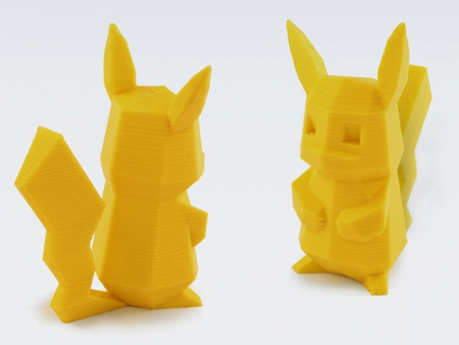
poly
poly: Many; more than one
Examples:
  Polymetallic
    Composed of multiple metals
  Polytheism
    The belief of the existence of many gods
  Polysyllable
    A word with more than two syllables.
  Polyglot
    One who masters and speaks several languages
  Polyarchy
    A government in which power is invested in multiple people.
Return to buttons

Slide 61
poly
poly: Many; more than one
Positive/Negative Questions: Answer “Yes” or “No”
  Polymorphism
    The ability to assume different forms or shapes
  North Pole
  Polychemotherapy
    Chemotherapy involving several different drugs.
  Poland
  Polyclinic
    A clinic in which diseases of many sorts are treated; especially, an institution in which clinical instruction is given in all kinds of disease
Return to buttons

Slide 62
poly
poly: Many; more than one
Think of 3 Words using “poly”
  Example: “Polyglot”
Return to buttons

Slide 63
litho/lith
Definition:
  Stone or rock
Example: “In lithography, a person can print texts or images by using a stone.
Return to buttons

Slide 64
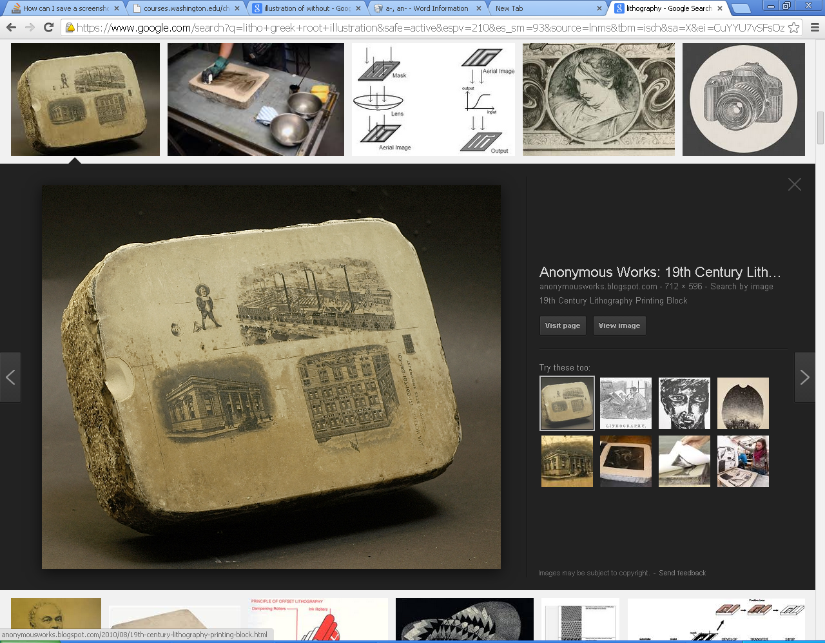
litho/lith
lithograph: printing from a stone or metal plate, or other smooth surface
Examples:
  Lithography
    a method of printing on paper from a stone or a metal plate with a smooth surface
  Monolith
    a large single upright block of stone, especially one shaped into or serving as a pillar or monument
  Neolithic
    of, relating to, or denoting the later part of the Stone Age, when ground or polished stone weapons and implements prevailed.
  Xenolith
    a rock fragment that is enveloped in a larger rock during the latter's development and hardening
  Microlith
    a small stone tool usually made of flint or chert )typically a centimetre or so in length and half a centimetre wide).
Return to buttons

Slide 65
litho/lith
lithograph: printing from a stone or metal plate, or other smooth surface
Positive/Negative Questions: Answer “Yes” or “No”
  Monolith
    a large single upright block of stone, especially one shaped into or serving as a pillar or monument
  Litter
  Lithography
    a method of printing on paper from a stone or a metal plate with a smooth surface
  Pictograph
  Neolithic
    of, relating to, or denoting the later part of the Stone Age, when ground or polished stone weapons and implements prevailed.
Return to buttons

Slide 66
litho/lith
lithograph: printing from a stone or metal plate, or other smooth surface
Think of 3 Words using “litho or lith”
  Example: “lithography”
Return to buttons

Slide 67
tri
Definition:
  three
Example: “A tricycle, is a vehicle with three wheels and which is operated by foot pedals.
Return to buttons

Slide 68
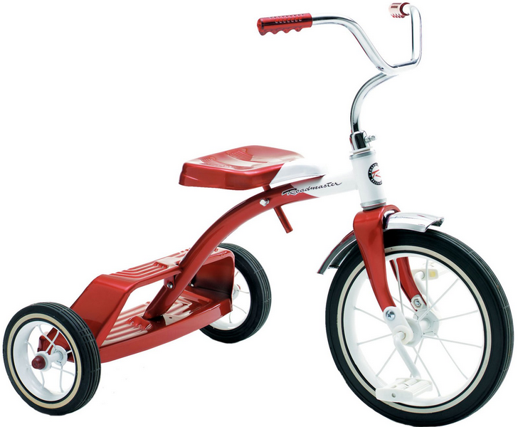
tri
tricycle: a three-wheeled vehicle that a person rides by pushing on foot pedals
Examples:
  Triangle
    A 3-sided polygon sometimes; Every triangle has three sides and three angles
  Triple
    consisting of or involving three parts, things, or people
  Trilogy
    a set of three works of art that are connected, and that can be seen either as a single work or as three individual works. They are commonly found in literature, film, or video games.
  Trimester
    A time period made up of three months (often used when referring to pregnancy)
  Trident
    A three-pronged spear - It is used for spear fishing and historically used as a weapon
Return to buttons

Slide 69
tri
tricycle: a three-wheeled vehicle that a person rides by pushing on foot pedals
Positive/Negative Questions: Answer “Yes” or “No”
  Triannual
    Something which happens three times per year.
  Tilt
  Trimodular
    Having three modes of operation
  Tip
  Tricolor
    Having three colors
Return to buttons

Slide 70
tri
tricycle: a three-wheeled vehicle that a person rides by pushing on foot pedals
Think of 3 Words using “tri”
  Example: “trilogy”
Return to buttons

Slide 71
sub
Definition:
  Under; below
Example: “A submarine is a type of ship which can be used to travel underwater.
Return to buttons

Slide 72
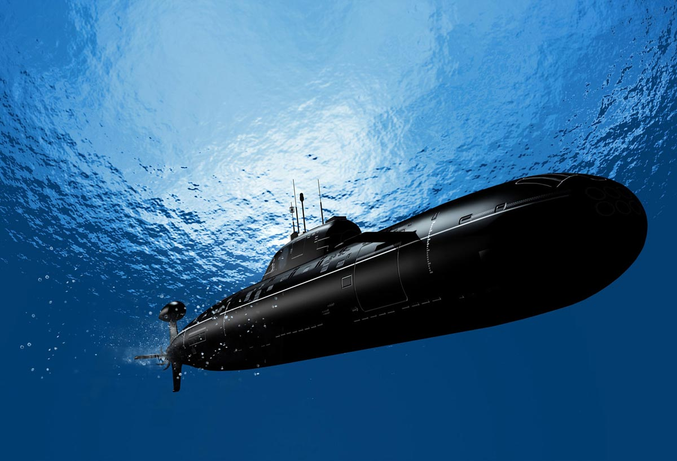
sub
submarine: A submarine is a watercraft capable of independent operation underwater
Examples:
  submit
    to give over or yield to the power or authority of another
  Submersible
    designed to be completely submerged or to operate while submerged
  Subatomic
    smaller than or occurring within an atom.
  Subterranean
    existing, situated, or operating below the surface of the earth; underground
  Subconscious
    of or concerning the part of the mind of which one is not fully aware but which influences one's actions and feelings.
Return to buttons

Slide 73
sub
submarine: A submarine is a watercraft capable of independent operation underwater
Positive/Negative Questions: Answer “Yes” or “No”
  Subcutaneous
    situated or applied under the skin
  Scrumptous
  Subaltern
    of lower status
  Sunspot
  Submachine gun
    An air-cooled, magazine-fed, automatic carbine designed to fire pistol cartridges. The term "submachine gun" was coined by John T. Thompson, the inventor of the Thompson submachine gun.; developed during World War I .
Return to buttons

Slide 74
sub
submarine: A submarine is a watercraft capable of independent operation underwater
Think of 3 Words using “sub”
  Example: “submarine”
Return to buttons

Slide 75
micro
Definition:
  Very small
Example: “In microbiology, we study microscopic organisms, those being unicellular (single cell), multicellular (cell colony), or acellular (lacking cells).
Return to buttons

Slide 76
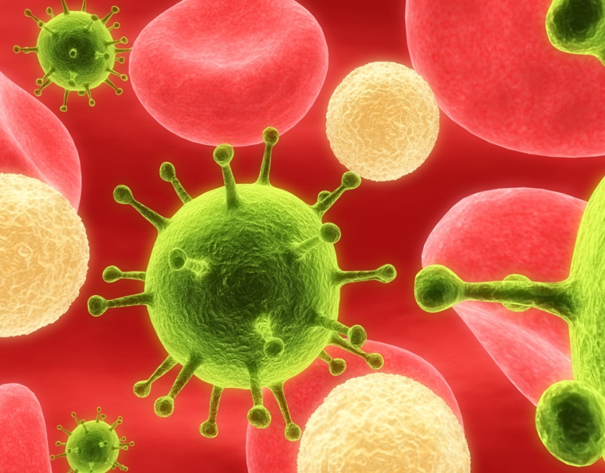
micro
microbiology: the study of study microscopic organisms
Examples:
  Microscope
    An instrument used to see objects that are too small for the naked eye
  Microphone
    n instrument for converting sound waves into electrical energy variations, which may then be amplified, transmitted, or recorded
  Microscopic
    so small as to be visible only with a microscope.
  Microbe
    any living organism that spends its life at a size too tiny to be seen with the naked eye, like bacteria and archaebacteria, protists, some fungi and even some very tiny animals.
  Microchip
    a group of tiny electronic circuits that work together on a very small piece of hard material (such as silicon)
Return to buttons

Slide 77
micro
microbiology: the study of study microscopic organisms
Positive/Negative Questions: Answer “Yes” or “No”
  Microeconomics
    The field of economics that deals with small-scale economic activities such as those of an individual or company
  Macroeconomics
  Microfiber
    Very fine synthetic fiber; cloth made of such fiber
  Market
  Microwave
    An electromagnetic wave with wavelength between that of infrared light and radio waves
  Microwave Oven
    An oven that uses microwave energy to heat food or other items placed within it.
Return to buttons

Slide 78
micro
microbiology: the study of study microscopic organisms
Think of 3 Words using “micro”
  Example: “microbiology”
Return to buttons

Slide 79
Hema/Hemo
Definition:
  (referring to) blood
Example: “Hemoglobin is the protein molecule in red blood cells that carries oxygen from the lungs to the body
Return to buttons

Slide 80
Hema/hemo
hemoglobin: the protein molecule in red blood cells that carries oxygen from the lungs to the body
Examples:
  Hemophilia
    a group of hereditary genetic disorders that impair the body's ability to control blood clotting, which is used to stop bleeding when a blood vessel is broken
  Hematoma
    a localized collection of blood outside the blood vessels,[1] usually in liquid form within the tissue
  Hemorrhage
    an escape of blood from a ruptured blood vessel, especially when profuse.
  Hemostat
    a surgical tool used in many surgical procedures to control bleeding
  Hemochrome
    The red coloring matter of the blood; an oxygen containing component of the blood
Return to buttons

Slide 81
Hema/hemo
hemoglobin: the protein molecule in red blood cells that carries oxygen from the lungs to the body
Positive/Negative Questions: Answer “Yes” or “No”
  Hematose
    Bloody; full of blood
  Honorable
  Hematoxic
    Causing blood-poisoning
  Homeland
  Hemospasia
    Draining of blood.
Return to buttons

Slide 82
Hema/hemo
hemoglobin: the protein molecule in red blood cells that carries oxygen from the lungs to the body
Think of 3 Words using “hemo or hema”
  Example: “hemoglobin”
Return to buttons

Slide 83
vore
Definition:
  To devour, eat
Example: “An omnivore is an animal, such as a human, that eats food of both plant and animal origin.
Return to buttons

Slide 84
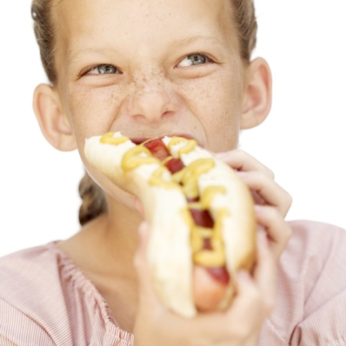
vore
omnivore: an animal that eats food of both plant and animal origin
Examples:
  Carnivore
    an animal that feeds on flesh
  Herbivore
    An animal that gets its energy from eating plants, and only plants
  Voracious
    wanting or devouring great quantities of food.
  Electrovore
    (science fiction) An organism or entity which feeds on electricity.
Return to buttons

Slide 85
vore
omnivore: an animal that eats food of both plant and animal origin
Positive/Negative Questions: Answer “Yes” or “No”
  Carnivore
    an animal that feeds on flesh
  Voices
  Herbivore
    An animal that gets its energy from eating plants, and only plants
  Vault
  Omnivore
    an animal that eats food of both plant and animal origin
  Oval
Return to buttons

Slide 86
vore
omnivore: an animal that eats food of both plant and animal origin
Think of 3 Words using “vore”
  Example: “omnivore”
Return to buttons

Slide 87
Hydro/Hydr
Definition:
  Water; combined with hydrogen
Example: “Hydroelectricity is the term referring to electricity generated by hydropower; the production of electrical power through the use of the gravitational force of falling or flowing water.”
Return to buttons

Slide 88
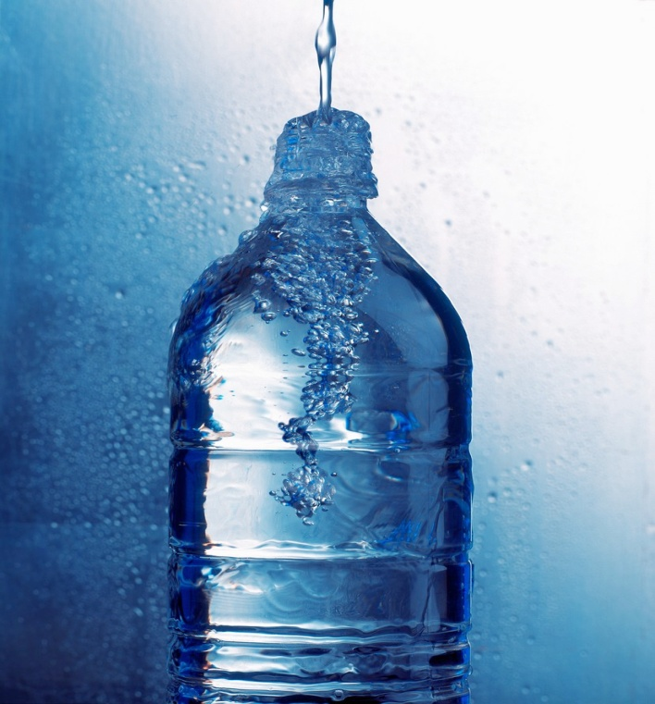
Hydro/Hydr
hydrate: To supply water to (a person, for example) in order to restore or maintain fluid balance
Examples:
  Hydrant
    an upright water pipe, especially one in a street, with a nozzle to which a fire hose can be attached
  Dehydrate
    To cause (a person or a person's body) to lose a large amount of water
  Hydraulics
    the branch of science and technology concerned with the conveyance of liquids through pipes and channels, especially as a source of mechanical force or control.
  Hydrophobia
    extreme or irrational fear of water, especially as a symptom of rabies in humans
Return to buttons

Slide 89
Hydro/Hydr
hydrate: To supply water to (a person, for example) in order to restore or maintain fluid balance
Positive/Negative Questions: Answer “Yes” or “No”
  hydrogen
    a colorless, odorless, highly flammable gas, the chemical element of atomic number 1.
  Hyperion
  Hydroponics
    the process of growing plants in sand, gravel, or liquid, with added nutrients but without soil
  Hide
  Hydrolysis
    the chemical breakdown of a compound due to reaction with water
Return to buttons

Slide 90
Hydro/Hydr
hydrate: To supply water to (a person, for example) in order to restore or maintain fluid balance
Think of 3 Words using “Hydro/Hydr”
  Example: “Hydrate”
Return to buttons

Slide 91
Astro
Definition:
  Star-shaped; (referring to) outer space
Example: “Astronomy is the branch of science that deals with celestial objects, space, and the physical universe as a whole.
Return to buttons

Slide 92
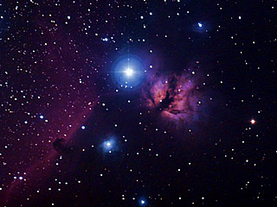
Astro
Astronomy: the branch of science that deals with celestial objects, space, and the physical universe as a whole
Examples:
  Astronomy
    the branch of science that deals with celestial objects, space, and the physical universe as a whole
  Astrology
    the study of the movements and relative positions of celestial bodies interpreted as having an influence on human affairs and the natural world
  Astronomer
    an expert in or student of astronomy.
  Astronaut
    a person who is trained to travel in a spacecraft.
Return to buttons

Slide 93
Astro
Astronomy: the branch of science that deals with celestial objects, space, and the physical universe as a whole
Positive/Negative Questions: Answer “Yes” or “No”
  Astrophysics
    the branch of astronomy concerned with the physical nature of stars and other celestial bodies, and the application of the laws and theories of physics to the interpretation of astronomical observations .
  Assemble
  Astrochimp
    A chimpanzee used in a spaceflight program.
  Asterisk
  Astronomical
    Of or relating to astronomy; (of an amount) extremely large
Return to buttons

Slide 94
Astro
Astronomy: the branch of science that deals with celestial objects, space, and the physical universe as a whole
Think of 3 Words using “astro”
  Example: “astronomy”
Return to buttons

Slide 95
photo
Definition:
  light
Example: “Photosynthesis is the process by which green plants and some other organisms use sunlight to synthesize foods from carbon dioxide and water.
Return to buttons

Slide 96
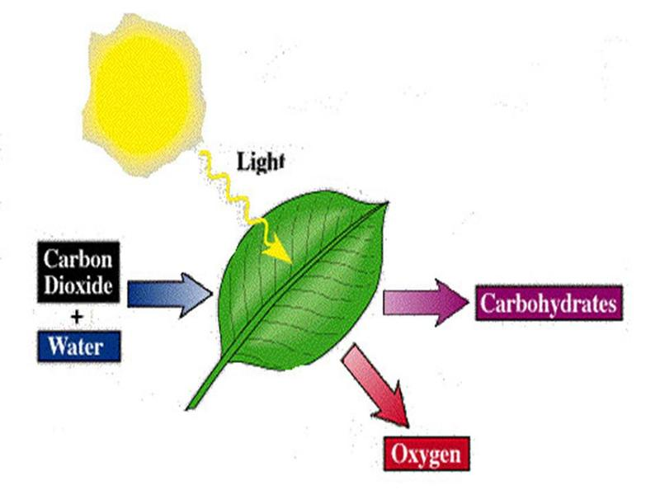
photo
Photosynthesis: the process by which green plants and some other organisms use sunlight to synthesize foods from carbon dioxide and water.
Examples:
  Photosynthesis
    the process by which green plants and some other organisms use sunlight to synthesize foods from carbon dioxide and water
  Photograph
    a picture made using a camera, in which an image is focused onto film or other light-sensitive material and then made visible and permanent by chemical treatment, or stored digitally
  Photochemical
    chemical reaction initiated by the absorption of energy in the form of light.
  Photobiologist
    a branch of biology that deals with the effects on living organisms of radiant energy (as light).
  Phototoxic
    rendering the skin susceptible to damage (as sunburn or blisters) upon exposure to light and especially ultraviolet light
Return to buttons

Slide 97
photo
Photosynthesis: the process by which green plants and some other organisms use sunlight to synthesize foods from carbon dioxide and water.
Positive/Negative Questions: Answer “Yes” or “No”
  Telephoto
    a lens with a longer focal length than standard, giving a narrow field of view and a magnified image
  Phobia
  Photographer
    a person who takes photographs, especially as a job
  Phoenix
  Radiophoto
    a picture transmitted by radio
Return to buttons

Slide 98
photo
Photosynthesis: the process by which green plants and some other organisms use sunlight to synthesize foods from carbon dioxide and water.
Think of 3 Words using “photo”
  Example: “photosynthesis”
Return to buttons

Slide 99
cide
Definition:
  Substance that kills
Example: “Insecticide is a substance used for killing insects.
Return to buttons

Slide 100
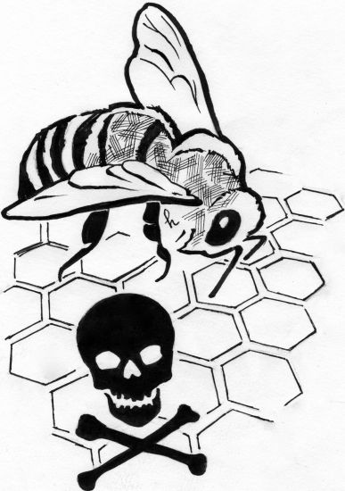
cide
Insecticide: a substance used for killing insects
Examples:
  Insecticide
    An instrument used to see objects that are too small for the naked eye
  Herbicide
    a substance that is toxic to plants and is used to destroy unwanted vegetation
  Regicide
    the action of killing a king; a person who kills or takes part in killing a king.
  Homicide
    the deliberate and unlawful killing of one person by another; murder
Return to buttons

Slide 101
cide
Insecticide: a substance used for killing insects
Positive/Negative Questions: Answer “Yes” or “No”
  Pesticide
    a substance used for destroying insects or other organisms harmful to cultivated plants or to animals
  Side
  Genocide
    the deliberate killing of a large group of people, especially those of a particular ethnic group or nation
  Cycle
  Germicide
    a substance or other agent that destroys harmful microorganisms; an antiseptic
Return to buttons

Slide 102
cide
Insecticide: a substance used for killing insects
Think of 3 Words using “cide”
  Example: “insecticide”
Return to buttons

Slide 103
Graph/gram
Definition:
  Written, drawn
Example: “A telegraph is a system for transmitting messages from a distance along a wire, especially one creating signals by making and breaking an electrical connection.
Return to buttons

Slide 104
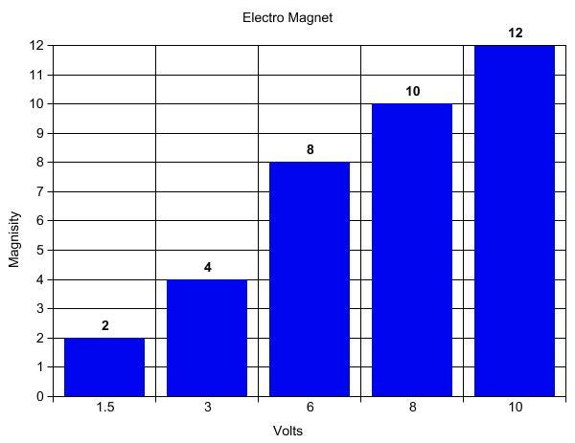
Graph/gram
graph: a diagram showing the relation between variable quantities, typically of two variables, each measured along one of a pair of axes at right angles.
Examples:
  Graphology
    the study of written and printed symbols and of writing systems
  Grapheme
    the smallest meaningful contrastive unit in a writing system
  Hologram
    a three-dimensional image formed by the interference of light beams from a laser or other coherent light source.
  Telegram
    a message sent by telegraph and then delivered in written or printed form.
  Photograph
    a picture made using a camera, in which an image is focused onto film or other light-sensitive material and then made visible and permanent by chemical treatment, or stored digitally
Return to buttons

Slide 105
Graph/gram
graph: a diagram showing the relation between variable quantities, typically of two variables, each measured along one of a pair of axes at right angles.
Positive/Negative Questions: Answer “Yes” or “No”
  Graphite
    a gray, crystalline, allotropic form of carbon that occurs as a mineral in some rocks and can be made from coke. It is used as a solid lubricant, in pencils, and as a moderator in nuclear reactors
  Macroeconomics
  Anagram
    a word, phrase, or name formed by rearranging the letters of another, such ascinema, formed from iceman
  Market
  Paragraph
    a distinct section of a piece of writing, usually dealing with a single theme and indicated by a new line, indentation, or numbering
  Program
    a sheet or booklet giving details of items or performers at an event or performance.
Return to buttons

Slide 106
Graph/gram
graph: a diagram showing the relation between variable quantities, typically of two variables, each measured along one of a pair of axes at right angles.
Think of 3 Words using “graph”
  Example: “telegraph”
Return to buttons

Slide 107
bio
Definition:
  life
Example: A biography is a book that tells what has happened in someone's life (it is written by someone else).
Return to buttons

Slide 108

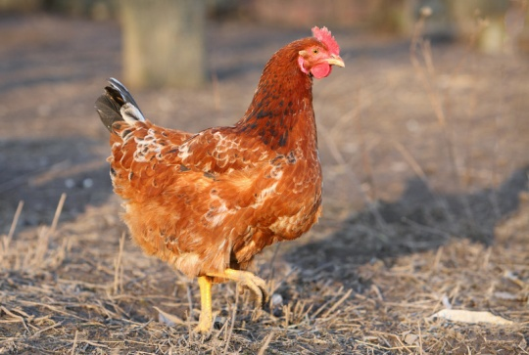
bio
Biology: the study of life
Turn to your partner and think of 2 examples using “bio”
Examples:
  Biology
    The study of life
  Biophysics
    the scientific study of how physics relates to biological processes
  Biodiversity
    the variety of plants and animals in a particular place.
  Symbiotic
    A relationship in which in which the people, organizations, or living things involved depend on each other
Return to buttons

Slide 109


bio
Biology: the study of life
Positive/Negative Questions:
Do the following words use “bio?” Answer “Yes” or “No”
  Biopsy
    the removal of cells, tissue etc from someone's body in order to find out more about a disease they may have
  Bicycle
  Amphibious
    able to live on both land and water
  Boisterous
  Biochemistry
    the scientific study of the chemistry of living things
Return to buttons

Slide 110
bio
Biology: the study of life
Think of 3 Words using “bio”
  Example: “biology”
Return to buttons

Slide 111
ectomy
Definition:
  life
Example: An appendectomy is a medical operation in which your appendix is removed.
Return to buttons

Slide 112
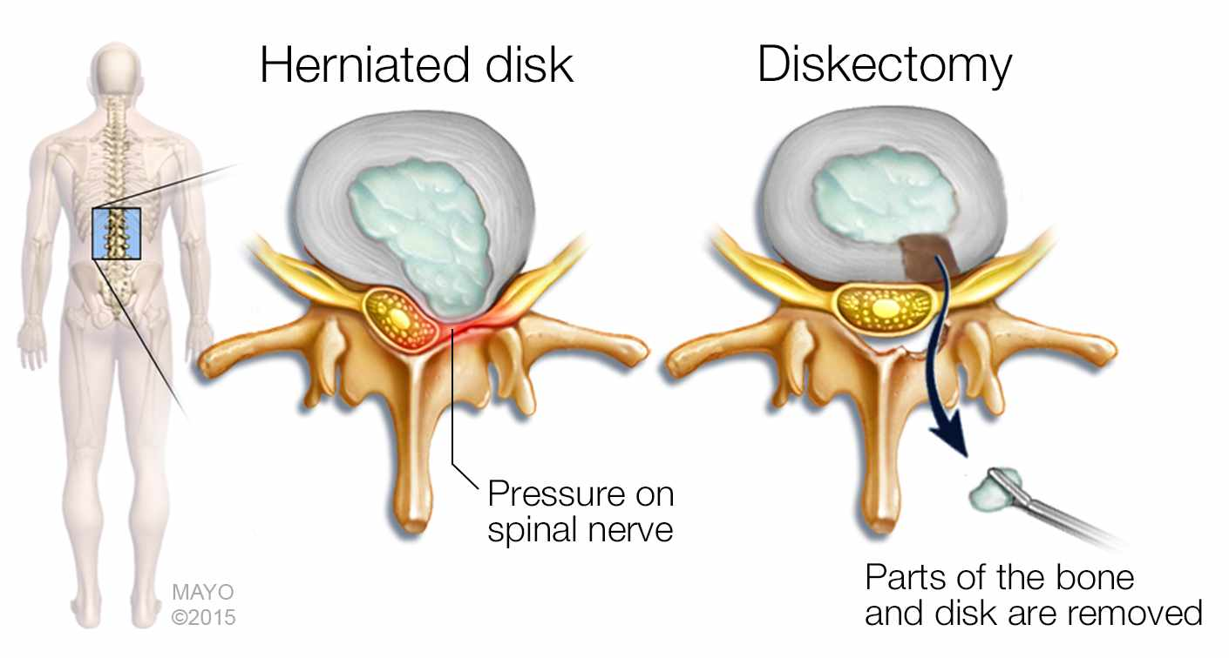
ectomy
A diskectomy is a surgical procedure to remove the damaged portion of a herniated disk in your spine.
Turn to your partner and think of 2 examples using “ectomy”
Examples:
  Lumpectomy
    an operation in which a tumor is removed from someone's body
  Pneumonectomy
    The surgical removal of all or part of the lungs
  Tonsillectomy
    The surgical removal of the tonsils
  Pancreatectomy
    The procedure to remove part or all of the pancreas
Return to buttons

Slide 113
ectomy
A diskectomy is a surgical procedure to remove the damaged portion of a herniated disk in your spine.
Positive/Negative Questions:
Do the following words use “ectomy?” Answer “Yes” or “No”
  Gastrectomy
    a medical procedure where all or part of the stomach is surgically removed
  Stomach
  Encephalectomy
    Removal of the brain
  Perfect
  Neurectomy
    surgical removal of all or part of a nerve
  Spectrometer
Return to buttons

Slide 114
ectomy
A diskectomy is a surgical procedure to remove the damaged portion of a herniated disk in your spine.
Think of 3 Words using “ectomy”
  Another option: Use your dictionary to find 3 words using “ectomy”
  Example: “appendectomy”
Return to buttons

Slide 115
Ant/Anti
Definition:
  Against; opposite of
Example: An antagonist is a person who actively opposes or is hostile to someone or something; an adversary.
Return to buttons

Slide 116

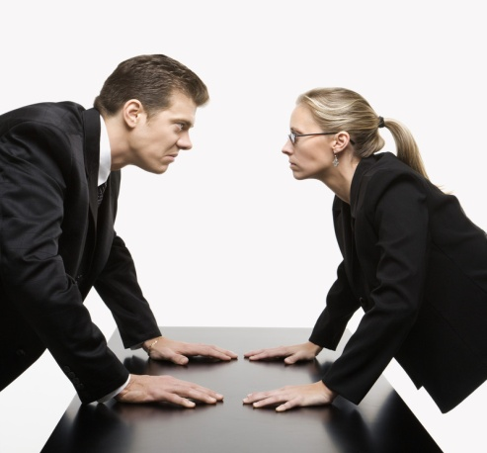
Ant/Anti
Antagonist: a person who actively opposes or is hostile to someone or something; an adversary
Turn to your partner and think of 2 words with “ant or anti”
Examples:
  Antibiotic
    a drug that is used to kill bacteria and cure infections
  Antagonize
    To annoy someone very much by doing something that they do not like
  Antipode
    the direct opposite of something else
  Antiseptic
    a medicine that you put onto a wound to stop it from becoming infected
Return to buttons

Slide 117


Ant/Anti
Antagonist: a person who actively opposes or is hostile to someone or something; an adversary
Positive/Negative Questions:
Do the following words use “ant or anti?” Answer “Yes” or “No”
  Antithesis
    the complete opposite of something
  Another
  Antifreeze
    a liquid that is put in the water in car engines to stop it from freezing
  Cantaloupe
  Antivirus Software
    a type of software that looks for and removes viruses in programs and documents on your computer
  Interior
Return to buttons

Slide 118


Ant/Anti
Antagonist: a person who actively opposes or is hostile to someone or something; an adversary
Think of 3 Words using “ant or anti”
  Another option: Use your dictionary to find 3 words using “ant or anti”
  Example: “antitrust”
Return to buttons

Slide 119
aero
Definition:
  Air; atmosphere
Example: Aerodynamics is a science that studies the movement of air and the way that objects (such as airplanes or cars) move through air.
Return to buttons

Slide 120
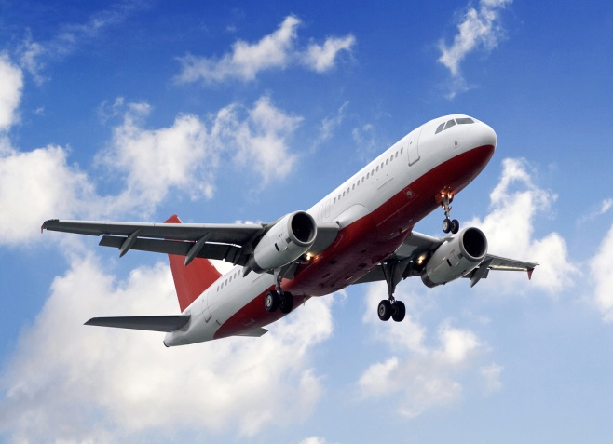
aero
An aeroplane (or airplane) is a flying vehicle with wings and at least one engine
Turn to your partner and think of 2 words with “aero”
Examples:
  Aeronautics
    the science of designing and flying planes
  Aeroplane
    a flying vehicle with wings and at least one engine
  Anaerobic
    not needing oxygen in order to live
  Aerobic
    using oxygen
    (aerobic exercise): a type of exercise intended to strengthen the heart and lungs
Return to buttons

Slide 121
aero
An aeroplane (or airplane) is a flying vehicle with wings and at least one engine
Positive/Negative Questions:
Do the following words use “aero?” Answer “Yes” or “No”
  Aeronautics
    the science of designing and flying planes
  Actuator
  Aeroplane
    a flying vehicle with wings and at least one engine
  Analogy
  Anaerobic
    not needing oxygen in order to live
  Apology
Return to buttons

Slide 122
aero
An aeroplane (or airplane) is a flying vehicle with wings and at least one engine
Think of 3 Words using “aero”
  Another option: Use your dictionary to find 3 words using “aero”
  Example: “aeroplane”
Return to buttons

