Slide 1
Determining Importance & Summarizing Informational Text
Grade 6 − Grade 12
Notes:
Say: Welcome to Determining Importance & Summarizing Informational Text.
Let’s begin by reviewing the materials you need for this training.
(Hold items up as you talk.)
Say: You should have four sets of handouts, the PowerPoint Handout, Additional Handouts, Text Excerpts and a package of graphic organizers. You will also need your blue and white Cognitive Strategy Routine Card and the orange Lesson Planning Card for Determining Importance and Summarizing. At the end of this training, you will each pick up a Determining Importance Tools poster.
Now that we have all of our materials ready, let’s begin our session.

Slide 2
Determining Importance & Summarizing
Identify text type
Reread!
Mathematical Formulation
The inner product between two state vectors is a complex number known as a probability amplitude. During a measurement, the probability that a system collapses from a given initial state to a particular eigenstate is given by the square of the absolute value of the probability amplitudes between the initial and final states.
(“Quantum mechanics,” in wikipedia.org)
Use text features.
Rely on background knowledge.
Look at ideas that are repeated
Handout
1
Notes:
Say: Before we begin to address our task as instructors, let us take a moment to reflect upon our own thinking. Because Determining Importance and Summarizing is challenging for our students, we are going to present a task that was designed to be challenging for you.
I am going to show you a short text. I will give you a moment to read it, and I would like you to do two things: First, determine the main idea of the passage. Second, if you have time, write a summary. When the time is up, we will discuss what all you did to complete this task and what made this activity challenging. Handout 1 contains the text you see on the slide and space for you to write.
Are you ready?
Click to reveal text. Allow participants a moment to read the text and write their main idea/ summary statements.
Say: Were you able to determine what information is important in this text?
Ask participants to volunteer main ideas or read summary statements.
Say: Let’s consider what all you did to determine importance with this challenging text. Think-Turn-Talk about how you attacked this text.
Allow participants a moment to Think-Turn-Talk. Select two to three participants to share with the group.
Say: You have identified many of the things that proficient readers do when they try to determine importance in challenging text.
(For each click listed below, a text box will appear stating the processes we might use to determine importance).
Click and Say: We may begin by attempting to identify the type of text – informational or literary? The heading “Mathematical Formulation” suggests that this is an informational piece. Knowing genre or text type aids in comprehension (Fletcher, Lyon, Fuchs & Barnes, 2007; RAND, 2002). Headings also give us clues to the main idea of a piece (Zimmermann & Hutchins, 2003). Before beginning to read, we might determine that this will be about some kind of mathematical formula.
Click and Say: Fonts and effects, such as italics, also suggest importance (Harvey & Goudvis, 2007; Zimmermann & Hutchins, 2003). Here, italics emphasize the words “probability amplitude.”
Click and Say: We also rely on our background knowledge (Johnston & Afflerbach, 1985). Because I have heard the term “probability” before, I may determine that it is important, whether it is or not.
Click and Say: Proficient readers also focus on ideas which are repeated throughout the text (Johnston & Afflerbach, 1985). The word probability appears three times in this text. Several clues point to the fact that probability is important here.
Click and Say: Finally, rereading can help us determine what is important. Through rereading several times, putting together the text structure, and text features with my background knowledge, I can determine that this piece describes a mathematical formula for the probability of some event, although I might not be able to create a more specific summary.
We hope our students will use similar thought processes when they determine importance and summarize, but because of the level of complexity in this cognitive strategy, it will take a great deal of explicit teaching, over a number of years, for our students to be able to determine importance and summarize text that is challenging for them.

Slide 3

Goals for the Training
Reinforce the importance of teaching Determining Importance & Summarizing to students.
Learn and practice various tools which help readers determine importance & summarize informational texts successfully.
Notes:
Say: Let’s take a moment to consider our goals for this training.
Read slide.
Although good readers determine importance and summarize all kinds of text, today we are going to specifically look at how we determine importance and summarize informational text. We need to think about literary text separately from informational, because with this strategy, we teach them quite differently. With informational text we depend on text structure, text features, signal words etc. to help us determine importance while reading. When we read narrative text, we depend on story structure to help us determine what information is most important. For this reason, teaching students to Determine Importance and Summarize literary text is a two session training separate from this training.
In this training, we will begin our focus on Determining Importance and Summarizing informational text. This by itself, is an awfully big topic. As you are well aware, informational text encompasses a number of various text structures. For this reason, we will divide this training into two parts.

Slide 4
Training Design
Determining Importance & Summarizing Informational Text
Part 1 | Part 2
1. Introduction 2. Why Should we Teach it? 3. How do we Teach it? 8 step Cognitive Strategy Routine Introducing Determining Importance Tools with a focus on Descriptive Text Structure Summarizing Descriptive Text | 1. Why Should we Teach it Review 2. How do we Teach it? Sequence/Chronological Text Cause and Effect Text Compare and Contrast Text Problem and Solution Text 3. Conclusion
Notes:
Review slide.

Slide 5
Determining Importance & Summarizing?
Why Should We Teach
Notes:
Say: So why should we teach Determining Importance and Summarizing?

Slide 6
Why Should We Teach
Determining Importance & Summarizing?
It helps readers to…
Improve overall comprehension.
Manage excessive amounts of information.
Focus attention.
Extract relevant information.
Build relationships among concepts contained in text.
(CIERA 2003; Coyne, Chard, Zipoli, & Ruby, 2007; Duke & Pearson, 2002;
Keene & Zimmermann, 2007 Silver, Strong, & Perini, 2000; Thiede & Anderson, 2003)
)
Notes:
Say: Being able to determine importance and summarize is critical to being a successful student. This cognitive strategy has a number of benefits . It helps readers to …
Read bulleted statements on slide. Continue reading bullets on next slide.

Slide 7
Why Should We Teach
Determining Importance & Summarizing?
It helps readers to…
Understand author’s purpose.
Remember text.
Identify theme.
Make connections.
Monitor understanding.
(CIERA 2003; Coyne, Chard, Zipoli, & Ruby, 2007; Duke & Pearson, 2002;
Keene & Zimmermann, 2007 Silver, Strong, & Perini, 2000; Thiede & Anderson, 2003)
Notes:
Read bulleted statements on slide.

Slide 8

Why Should We Teach Determining Importance and Summarizing?
Students are expected to:
6.10(A): summarize the main ideas and supporting details in text, demonstrating an understanding that a summary does not include opinions
English III & IV: 9.10(A): summarize a text in a manner that captures the author’s viewpoint, its main ideas, and its elements without taking a position or expressing an opinion;
Figure 19(C): reflect on understanding to monitor comprehension (e.g., summarizing and synthesizing; asking textual, personal, and world connections; creating sensory images);
Figure 19(E): summarize, paraphrase, and synthesize texts in ways that maintain meaning and logical order within a text and across texts;
Notes:
Say: As you are aware, it is an expectation from our state standards that we teach students to determine importance and summarize - which also means that students will be assessed on their use of this strategy as well.

Slide 9


Why Should We Teach Determining Importance and Summarizing?
The student is expected to:
Social Studies 7.21(B): analyze information by sequencing, categorizing, identifying cause-and-effect relationships, comparing, contrasting, finding the main idea, summarizing, making generalizations and predictions, and drawing inferences and conclusions;
Notes:
Say: In other content areas, students are also expected to find the main idea and summarize text. For example, in middle school Social Studies students are expected to analyze information by finding the main idea and summarizing.

Slide 10

Why Should We Determining
Importance and Summarizing?
ELPS Reading 4(I) demonstrate English comprehension and expand reading skills by employing basic reading skills such as demonstrating understanding of supporting ideas and details in text and graphic sources, summarizing text, and distinguishing main ideas from details commensurate with content area needs;
Notes:
Say: The ELPS clarify expectations for students that relate to Determining Importance and Summarizing for students as well.

Slide 11


Why Should We Teach Making
Determining Importance & Summarizing?
Think about your data.
  What does your data indicate regarding our students’ ability to determine importance and summarize?
© 2013 Texas Education Agency / The University of Texas System
11
Notes:
Read slide.
Say: Regardless, of what data we look at, we likely can agree that we want all of our students to be successful at Determining Importance and Summarizing. In fact, we likely feel a sense of urgency in helping students to improve their ability to summarize effectively. We know that as text becomes more and more complex, it becomes more difficult to comprehend. It is critical that our students have a good understanding of the strategies proficient readers use to comprehend well. Explicitly teaching our students to Determine Importance and Summarize is important in supporting student comprehension.
So, let’s talk about how we should teach students to Determine Importance and Summarize effectively.
Include Data from Tango indicating students’ success/deficiencies with TEKS.

Slide 12
Determining Importance & Summarizing?
How Should We Teach

Slide 13
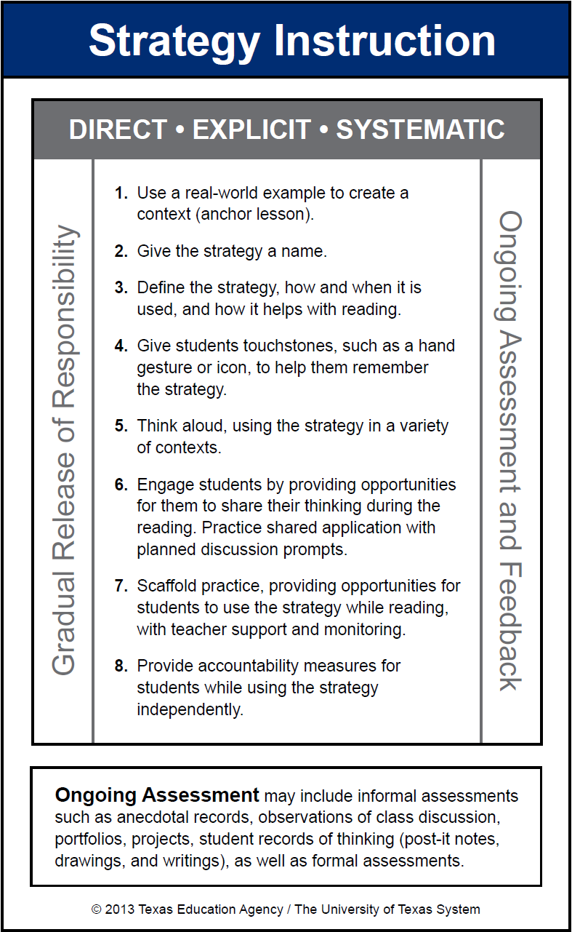
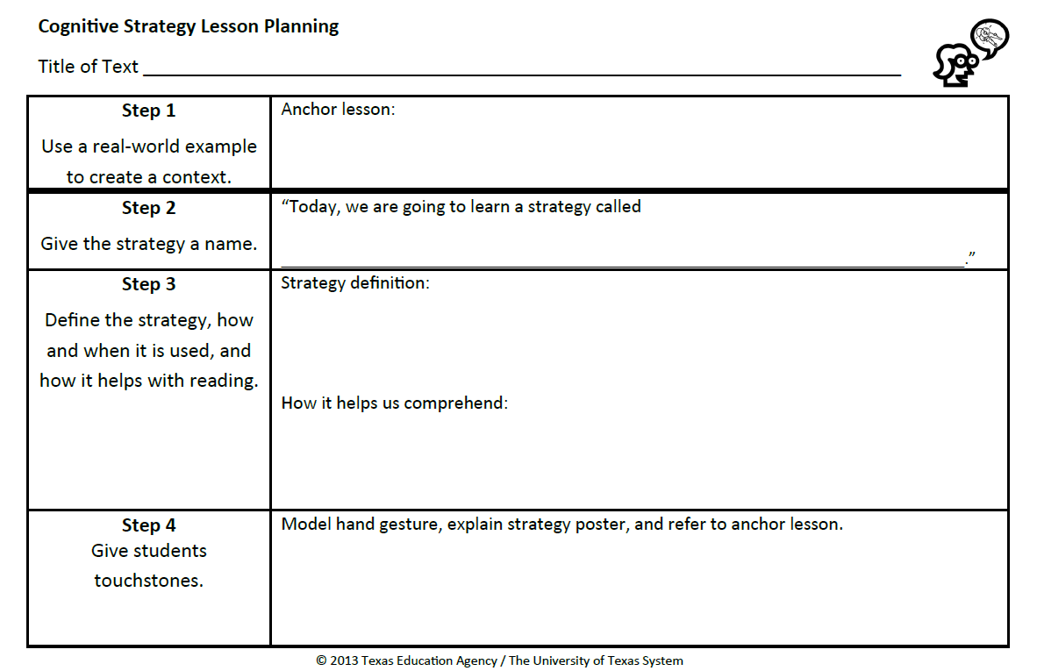
Cognitive Strategy Routine
Notes:
Say: Of course we will follow our 8 step Cognitive Strategy Routine for teaching students to Determine Importance and Summarize.

Slide 14

Use a Real-World Example (Step 1)
An anchor lesson is a real-world example used to create context for a cognitive strategy.
It is useful to create a different anchor lesson for each cognitive strategy.
We refer to the anchor lesson to remind students of the cognitive strategy.
Learning is more consistent for students when the same anchor lesson is used within and across grade levels.
Notes:
Say: We begin all strategy instruction the same way – with Step 1, using a real-world example to create a context for the strategy. This step is important because cognitive strategies are just that – cognitive. That means that they happen in our heads, which makes it hard for students to see or understand what we are talking about. For many of our students, these cognitive strategies are abstract concepts. A real-world example helps students to realize what the strategy is, and that they already use it in their everyday lives. It is important that we know our students well and are familiar with their backgrounds and interests so we can choose examples that will have meaning to them.
Read slide.
Say: Let me share an example of an anchor lesson that could be used for Determining Importance and Summarizing.

Slide 15


The Babysitter …
Notes:
Say: Imagine, big brother has been asked to take his little brother to the park. The older brother gets distracted. Finally, he looks up and notices that his little brother is no where to be found. After an extensive search, he begins to panic. He realizes that he needs to call for help.
Big brother begins to make a mental list of all of the things he can think about his little brother. But time is of the essence. What information is important to give to the police right away?

Slide 16

5 years old
Likes to play Nintendo
Brownish blonde hair
Cheerios for breakfast
Wears glasses
Runs really fast
Was on the swings
Best friend is John
Name is Alex
Wearing a navy jacket
In kindergarten
Likes to play hide and seek
Said he was thirsty
Has a birthmark on his back
Is in big trouble for leaving the park
Anchor Lesson
Notes:
Say: Look at this list. What information is important to tell the police? With a partner, I want you to determine the five most important details to provide to the police.
Provide time for participants to discuss. Select someone to share with the group.
Say: How did you determine what information was most important to share with the police?
Provide time for the selected pair to share their thinking.
Say: We could continue this discussion with the class having a few people share their thinking. We want to reinforce ideas like, I thought about the purpose, I considered the key ideas rather than minor details, etc.

Slide 17

Found Him!
Notes:
Say: Of course we have a happy ending.
Read slide.

Slide 18
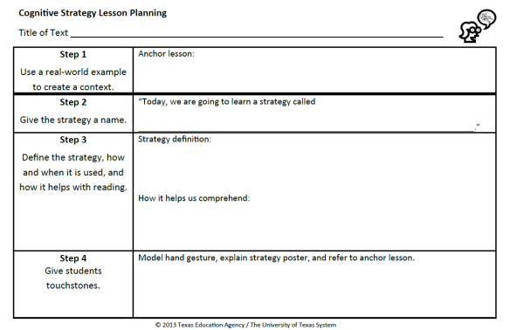
Use a Real-World Example (Step 1)
Record what you will do for Step 1 on your orange Cognitive Strategy Routine Lesson Planning Card.
Notes:
Say: Now it is your turn to think about Step 1. You may choose to introduce Determining Importance and Summarizing to students by using the example of the lost little brother. If you choose to use another anchor lesson, be sure to think about your students’ background knowledge. Whatever you choose to do should be familiar, or something to which your students will be able to relate.
Take a moment to discuss with the colleagues at your table what you think you will say for your Step 1. Record what you will say on the orange Lesson Planning Card. You have a Vis-à-vis and a Sharpie in your supply pouch that you can use to write with.
You may need to return to at a later time. It takes a lot of thought to come up with a really memorable, and effective anchor lesson.
Allow time for participants to complete.

Slide 19
Notes:
Say: An anchor lesson is our introduction to the strategy. Steps 2-7 are how we teach the strategy. What we plan to say and do for the next 3 steps will be repeated EVERY time we teach this strategy. In other words, we do these 3 steps before every think-aloud and every shared practice opportunity.

Slide 20
Give the Strategy a Name (Step 2)
“Today, we’re going to talk about a strategy called Determining Importance & Summarizing.”
Record what you will say for Step 2 on your orange Cognitive Strategy Routine Lesson Planning Card.
Notes:
Say: Step 2 is, “Give the strategy a name.” We want to use clear and consistent language when referring to the cognitive strategies. Our comprehension strategy instruction is stronger if everyone in the district uses the same vocabulary to refer to the strategies we are teaching.
Read slide.
Orange cards will already be completed for the teachers (pre-filled).

Slide 21
Define the Strategy (Step 3)
“Have you ever noticed how difficult it is to remember everything that you read?... Our brains just can’t seem to hold all of that information at the same time.” To help us, we need to determine importance and summarize information. In order to summarize, we must be able to identify the topic and main ideas of text, and then, we need to put that information together in our own words as briefly as possible. When we do this, we understand and remember informational text better.
(McGregor, 2007, p. 81)
Notes:
Say: Step 3 is where we define the strategy and explain how and when it is used and how it helps with reading.
Strategy Definition: Bold Red
How it helps us comprehend: Bold Green

Slide 22

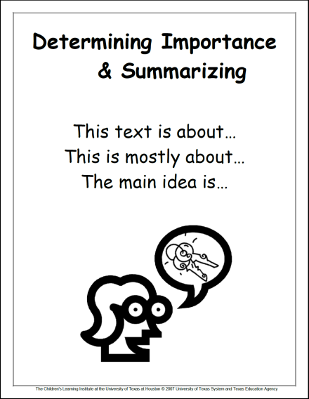
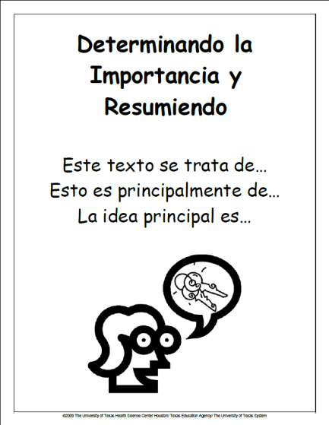
Give Students Touchstones (Step 4)
You may choose to provide students with a hand motion that signals Determining Importance & Summarizing.
Display strategy posters in the classroom.
Notes:
Say: To make the strategy more explicit for our students, we give them touchstones that will help them remember and understand a strategy.
With younger students, these touchstones include a hand motion. You can decide if you think this will be helpful or not for your students. The hand signal for Determining Importance and Summarizing is a thumb up signal. The unimportant details can hide behind my hand so that only the most important or key information is left, the thumb.
For older students, we display the strategy poster which includes a visual icon with words for support. This poster is the same poster we use at each grade level across the district for consistency and alignment.
I want my students to value these touchstones, so I explicitly explain to them what the hand signal and poster represent.
Click to next slide.

Slide 23
Give Students Touchstones (Step 4)
Touchstones: Explain the strategy poster and refer to the anchor lesson.
Remember when our babysitter lost his brother? We had a long list of details about the little brother. All of my fingers represent those details. We didn’t want to tell the police all of those details, instead, we had to figure out which information was the most important to share – like my thumb here. The unimportant details can hide behind my hand so that only the most important or key information is left. You will know when I am determining importance while reading, because I will show you this thumbs up hand signal.
Notes:
Read the red text on the slide.
Say: For older students, you will need to decide how much information you think is relevant to include.
This is a script for what teachers could say for the touchstone step.

Slide 24

Think-Aloud (Step 5)
“A think-aloud is a way to provide instruction rather than just give instructions.”
(Daniels & Zemelman, 2004, p. 238).
Notes:
Say: Now that we’ve introduced the strategy, how do we actually teach students to determine importance and summarize?
Step 5 of the Cognitive Strategy Routine is where the teacher models for students using the strategy through a think-aloud. Remember this quote?
Read the quote on the slide.
Say: This is really the critical piece of our instruction and yet, it is the one step that often gets left behind.
What we need to think about now, is what do we include in think-aloud lessons when teaching students to determine importance and summarize? Well, as you might expect, the answer is fairly complex. In order for students to summarize effectively, we need to teach them about the components they will need to include in a summary. To be explicitly clear, the first thing we need to clarify, is what we mean by the terms topic, main idea and summary.

Slide 25

Topic, Main Idea, or Summary?
Term | Definition | Example
Topic | Who or what the text is about; can often be expressed in one or two words. | Sharks
Main Idea | What the text says about the topic; can often be expressed in one sentence or less. | Sharks do many things.
Summary | A synthesis of the important ideas in a text; may be of varying length, expressed in the reader’s own words and should reflect the structure of the text. | Sharks swim through the oceans hunting for prey, such as fish and seals. Sometimes, they work together to attack prey and may even engage in playful activities.
Handout
2
(Silver, Strong, & Perini, 2000; CIERA, 2003)
Notes:
Say: Take out Handout 2 and follow along as we go over this chart. This is a simple example for discussion purposes.
In order for teachers to explain Determining Importance and Summarizing to students, we must clarify the associated terms in our own minds. Our state standards, the TEKS , expect students to distinguish between topic, main idea, and summary. What are the differences between these three terms?
The topic of a text is “who” or “what” it is about (Silver, Strong & Perini, 2000). The topic can often be expressed in one or two words. For an informational book about sharks, the topic may be, simply, “sharks.”
The main idea is a brief statement of what the text says about the topic (Silver, Strong & Perini, 2000). The main idea may be expressed as a single sentence or less. If the informational book describes things that sharks do, the main idea might be: “Sharks do many things.”
A summary is more complicated than a main idea, as “constructing main ideas [is] .. a critical component of the summarization process” (Johnston & Afflerbach, 1985). A summary synthesizes the important ideas from a text, and the reader expresses them in his or her own words (CIERA, 2003). Summaries include main idea statements from various parts of the text, but they are more than simply stringing together main ideas. The relationships between these main ideas must be probed and interpreted, then expressed in a succinct format – often a few sentences or less. A summary may be as long as necessary to express the important ideas in a text and how they are related and it should reflect the structure of the text that is being summarized. For example, if a text is a compare and contrast piece, then the summary should be written using a compare and contrast structure.
Now that we share a common understanding of these components, let’s think about how we might teach them to students.

Slide 26
Identify Topic
Considerations for Teaching Students to
Notes:
Say: Let’s first discuss what all we need to consider when teaching students to identify the topic of a text.

Slide 27
Identifying Topic
“Usually the topic will be apparent by looking at the title, pictures, or subheadings … Higher level text may confuse students by dancing around the topic instead of stating it directly. In these cases, teach students to look for repeated references to help them find a topic.”
(Kissner, 2006, p. 34)
Notes:
Read slide.
Say: The key here is, repeated references. The text doesn’t always just repeat the same key words.

Slide 28
What is the Topic?
“You may have a wetland at your house and not even know it. Sometimes, small depressions in the lawn fill up with rain and hold the moisture for days at a time. These ‘potholes’ often come alive at night with creatures like spring peepers (tiny frogs), insects, and birds. When people avoid these wet areas and don’t mow them, they are providing a habitat for animals – without even knowing it!”
(Kissner, 2006, p. 34)
Notes:
Say: Emily Kissner (2006), shares this paragraph as an example of how repeated phrases are used to identify topic. “The same idea, pothole wetlands, is repeated four times in the paragraph but is referred to in different ways” (p. 34). The italicized words indicate the repeated idea.
Take a moment to read this paragraph and note the repeated idea.
Provide time for participants to read.
Say: So in this example, the topic is not directly stated but the same idea is repeated many times in different ways. Let’s look at another text example and think about how we might think-aloud showing students how we infer the topic of a challenging text when it’s not explicitly stated.

Slide 29
What is the Topic?
One must be specially trained for a number of years to work with fireworks. Pyrotechnicians wear protective gear like gloves and goggles as they work carefully to ensure that none of the fireworks deploy before they are intended to do so. The fireworks’ fuses are connected to long wires. The wires are long so that the pyrotechnicians can ignite the fuse a safe distance away from the actual explosion. The crowd watching the show is also situated a fair distance away from the site of ignition.
These sentences tell me that the wires are long so that the technicians stay safe.
This last sentence is interesting. It doesn’t talk at all about pyrotechnicians. Instead, it talks about the crowd being away from the fireworks so that they can stay safe too.
I think this paragraph is going to be about fireworks. Let me keep reading to see if I am right.
This sentence tells me that pyrotechnicians wear gloves and goggles. They are also careful when they work with fireworks.
Notes:
Say: What is the topic of this paragraph? Remember, a topic is who or what the paragraph is about and it can be stated in one or two words. Take a moment to read this paragraph to yourself. Jot down what you think the topic is. Pay attention to the words that helped you identify the topic. In a moment, I will think aloud for you how I determined the topic of this paragraph.
Provide time for participants to read silently and think about the topic.
Read first sentence and stop. Click for speech bubble to appear.
Say: I think this paragraph is going to be about fireworks. Let me keep reading to see if I am right.
Click for speech bubble to disappear. Read the second sentence. Click for speech bubble to appear.
Say: This sentence tells me that pyrotechnicians wear gloves and goggles. They are also careful when they work with fireworks.
Click for speech bubble to disappear. Read the next 2 sentences. Click for speech bubble to appear.
Say: These sentences tell me that the wires are long so that the technicians stay safe.
Click for speech bubble to disappear. Read the last sentence. Click for speech bubble to appear.
Say: This sentence is interesting. It doesn’t talk at all about the pyrotechnicians, instead it talks about the crowd being away from the fireworks so that they can stay safe too.
Click for speech bubble to disappear.
Say: When I think about what this paragraph is telling me, it’s more than just explaining how fireworks work or what they are.
Click for each underline to appear as you talk.
Say: It talks about safety equipment or protective gear, working carefully, long wires to keep technicians safe, keeping the crowd safe. That word safe keeps cropping up. I’m inferring that the topic of this paragraph is firework safety.
Identifying topic can be tricky. In order to recognize main ideas and summarize effectively, readers need to be able to identify the topic. We don’t want to make assumptions that identifying topic is easy and all students can just do it. Instead, we model for them how we determine what the topic is by using paragraphs like these examples.
Now that we’ve thought a bit about topic, let’s turn our attention to main idea.

Slide 30
Determine importance and Identify Main Idea
Considerations for Teaching Students to
Notes:
Say: Looking across content areas, students are exposed to a greater amount of informational text than narrative. Informational text can be more detailed than narrative text and it covers topics that students may have less background knowledge about. “Thus, main idea identification in unfamiliar expository material may come to resemble a guessing game more than an intellectual exercise,” (Sjostrom & Hare, 1984 , p. 116). This means it’s critical that we show students how to approach these types of text in a way that helps them determine what information is most important for understanding the author’s message.
Let’s now turn our attention to how we teach students to determine importance and identify main idea.

Slide 31
Main Idea
“Finding the main idea has never been fun for most struggling readers. They have been asked to find it countless times and have produced inadequate answers.”
“Getting the main idea is a complex and challenging habit to develop, and it gets more challenging as texts become more complex in middle school and high school.”
(Zwiers, 210, pp. 31-32)
Notes:
Read slide.
Say: How many of you have students who struggle to find the main idea? Do they tend to produce inadequate answers? Likely, this is frustrating for both of you. Research tells us that, “Despite general agreement about both the importance of main idea comprehension and the difficulty that students experience with main idea tasks, systematic main idea instruction is seriously lacking at all academic levels,” (Sjostrom & Hare, 1984, p. 114).
To support students who struggle, we ensure that our instruction is clear and explicit.

Slide 32
Main Idea
The main idea can usually be stated in one sentence or less. A main idea sentence:
Includes the topic.
Includes the important information that is said about the topic.
Might include a statement about the purpose of the text (Why was the text written?).
Notes:
Say: When identifying main idea, it is helpful to clarify for students what should be included in a good main idea statement or sentence. First, students should remember that a main idea can usually be stated in one sentence or less. If they have been asked to produce a main idea sentence, then they should write the main idea in a complete sentence. Students need to be taught that main idea sentences include two components and by middle school, a possible third component might be required:
Read bullets.
Say: Typically, the most challenging component of the main idea statement is knowing which information is important to include. This is why we need to teach students how to determine importance. Luckily, we have many tools in our Determining Importance Toolbox which we can teach students so that they can be more successful in identifying important information. Let’s take time now to get acquainted with these tools or scaffolds.

Slide 33
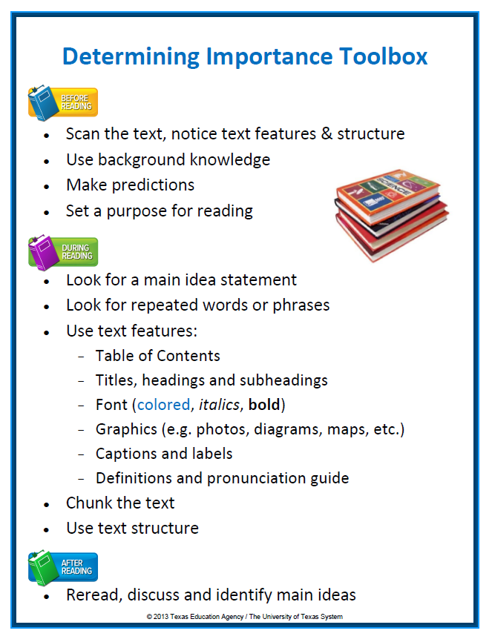
Determining Importance Toolbox
Handout
3
Notes:
Say: After reading the text Mathematical Formulation in our opening activity, we discussed that good readers use many tools to help them determine what is important in a text. For example, before reading, good readers think about their purpose for reading and rely on their background knowledge. During reading, they think about text structure and where the important information might be presented. Important information is sometimes found at the beginning or ending of a paragraph in descriptive text like it was in the math paragraph example. Important information may also be repeated several times like it was in our example. These are the types of tools good readers rely on to make sense of challenging informational text.
In addition to these tools, information text provides us with a wealth of text features which may also indicate importance. They include, but are not limited to: headings, font effects (such as italics or bold text), graphics and maps, definitions of terms, and captions (Harvey & Goudvis, 2007).
After reading, good readers reread parts they found confusing or thought might be important. They certainly take time to process the text by continuing to think or discuss what they have read.
We have provided you a handout that includes the scaffolds in our “Determining Importance Toolbox.” It is Handout 3. You may want to enlarge this handout and hang it in the classroom as a reference for students and may even add to it as you discover other “tools” that help you to determine importance.
It is important to be explicit about how these tools can help readers determine importance while reading. If we present all of these tools at once to our students, they may become overwhelmed. Therefore, in a single lesson, the teacher must decide in advance which tools to reinforce in their think-aloud lesson. In other words, the teacher must determine which tools are most important, in a given situation, to help students determine importance.
Let’s now take some time to talk in-depth about each of these tools or scaffolds. Remember, the way we teach each of these scaffolds to students is by following our Cognitive Strategy Routine. You will notice that the tools have been organized by what good readers do before, during and after reading.

Slide 34

Scan the Text, Notice
Text Features & Structure
Good readers:
Notice the length of the text.
Notice text features that have been included to support the reading of the text.
Look for signal words and organization which indicate text structure.
Think about what the text appears to be about.
Notes:
Say: What do good readers do before reading? When approaching expository text, good readers will often begin by briefly scanning the text. They take note of the length of the text and the text features that are used. For example, they will notice headings, bold words, the glossary in the margin, photos and captions if they are included. Sometimes, a text feature will “grab” the reader’s attention. Briefly reading these parts can sometimes provide the reader with a good sense of what the text will be about which will help them to set a purpose for what they want to learn from reading the text. Readers might even notice the text structure prior to reading if they have had instruction on the various text structures. When scanning text, good readers notice how it is organized and signal words may “jump” out at them indicating the type of structure that will be used.
Good readers scan the text, notice the text features and structure.

Slide 35
Use Background Knowledge and
Make Predictions
Good readers:
Make connections to background knowledge if the topic is familiar.
Make connections to related topics and concepts if the topic is unfamiliar.
  E.g. Spring thaw … ice cubes melting
Make predictions about the text.
Notes:
Say: After scanning the text and getting a sense of what the text might be about, good readers think about the likely topic and what they know about it. It’s always helpful to be aware of what you think you know vs. what you really know to be fact. If the topic is somewhat unfamiliar, readers can make connections to related topics. For example, a reader may not have ever experienced a spring thaw, but they certainly have experienced ice cubes melting.
Once the reader has “primed” their brain for reading, they can then make a prediction about what they think they will learn from reading the text.
Good readers use their background knowledge and make predictions about the text.
So, up to this point, readers have scanned the text, noticed text features and perhaps the text structure, they’ve thought about the possible topic and made some connections to what they know. They may have even made a prediction for what they think they will learn from reading the text. What else do good readers do before reading? They think about their purpose for reading.

Slide 36
Set a Purpose for Reading
Good readers identify a purpose for reading.
  Teacher CPQ?
  Student CPQ?
    Rely on titles or headings.
    Review test questions.
    Consider predictions.
    What do I want to learn from reading this text?
Notes:
Say: Before reading, teachers can support comprehension by providing a CPQ to help students hone in on the important information in the text. A CPQ is a scaffold for helping students to determine importance especially when text is challenging and when teachers want all students to successfully access the content of the text. However, as we release responsibility to our students, we gradually fade the scaffold by helping students set their own purposes for reading. We draw their attention to the title, headings, test questions if they exist, as well as to the predictions they have made prior to reading. We teach students how to turn a heading into a question or how to think about their prediction as reason for reading. We also encourage students to think of questions about what they want to learn from reading the text.
If students are explicitly taught to think about these aspects before reading, they should be successful at setting their own “CPQ” for the reading.

Slide 37
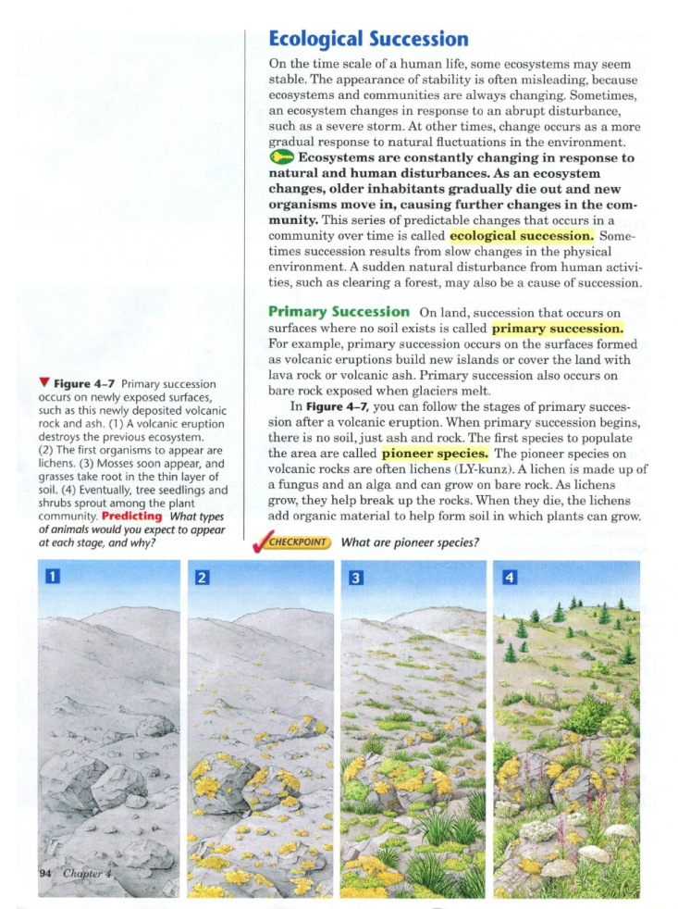
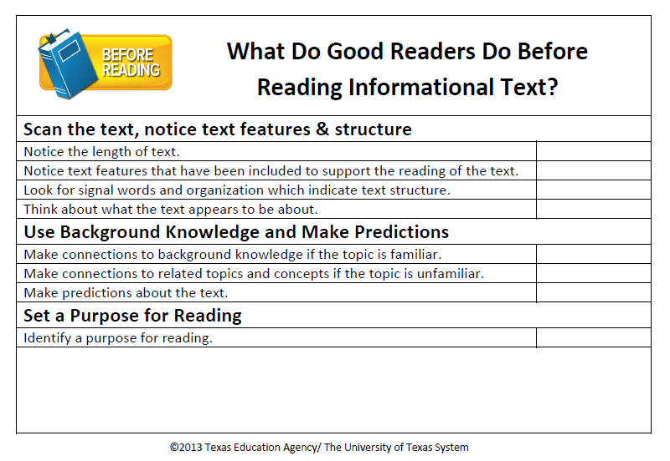
Before Reading Demonstration
Handout
4
Notes:
Say: This text is from our freshman science textbook. “It is estimated that 75 percent of students have trouble reading science textbooks,” (Carnine and Carnine, 2004 in Kissner, 2006, p. 129). Without a strategic approach to understanding the flood of information included in textbooks, “many students lose their way through the text as well as their motivation to keep pushing forward,” (Strong, Silver, Perini, & Tuculescu, 2003).
In my class, we sometimes read the text during class time, and sometimes I need students to be able to read the assigned pages on their own and make notes of the important information. Some of my students struggle to read this text because it is above their reading level which means that they have a hard time determining what information to include in their notes. I also know, that the vocabulary and content is sometimes unfamiliar. I want to show my students how to navigate the class textbook so that they can be more successful when reading independently.
First, I will model for my students how I approach the text before I even begin to read. Let me demonstrate my model lesson for you know.
Class, we’re going to continue to focus on the strategy of Determining Importance and Summarizing. Remember, good readers identify the topic and main ideas of text to help them summarize information so that they don’t have to remember so many little details. When readers do this, they are able to understand and remember the text better.
Today I’m going to show you all the things that go through my mind when I read our Biology textbook. These things happen in my head very quickly, but for this lesson, I’m going to really slow down my reading and show you all the thinking I do to determine importance and summarize.
Before I even start to read, I do a number of things to help me determine importance and summarize. To help you notice what I think about before reading, I want you to look at this checklist. What behaviors do I include in my demonstration? Check them off if you see me doing any of the following things:
Handout 4.
Read checklist.

Slide 38
What is ecological succession?
Ecological succession. What is that?
This highlights vocab words. That’s usually important.
This information is important.
This subheading tells me that the information that follows will be more specific.
This graphic looks like it’s showing how the environment is changing. That’s probably what this passage is talking about.
Miller, K.R. & Levine, J.S. (2008). Prentice Hall Biology. Boston, MA: Pearson Education, Inc.
Notes:
Say: As I scan the text, what do I notice? Well, it’s not too long and there are a number of text features included in the text. I don’t notice any obvious text structure in this first paragraph although, I notice the words “such as” right here (point to those words) which tells me an example has been included.
Click for thought bubble to appear.
Say: There’s a heading, Ecological succession. That must be the topic, but what is that? I know what ecology means, but succession isn’t a word I know.
Click for next thought bubble to appear.
Say: This is a subheading. It’s smaller and a different color than the heading. Primary succession. Ok, so the subheading tells me that the information above will likely be general information and this part will get more specific, a type of succession, primary which means first or most common.
Click for next thought bubble to appear.
Say: There is a key. The textbook tells me that this indicates key concepts. The words are also all bolded so I know this information is important.
Click for next thought bubble to appear.
Say: Yellow highlights are for vocabulary words which are usually important.
Click for last thought bubble to appear.
Say: This graphic kind of grabs my attention. It looks like it’s showing how the environment is changing. I think that’s probably what this paragraph is talking about.
Click for speech bubble to appear.
Say: There is no CPQ for the reading, so I need to set my own purpose to help me understand. The heading is ecological succession. The text will probably describe or explain what that is and since I don’t know what it is, I’ll read to find out.

Slide 39


How might thinking aloud before reading help your students?
How might you use this checklist with students?
Think
Turn
Talk
Notes:
Say: Take a few minutes to discuss this demonstration with a partner. Did I include everything on the checklist? How might thinking aloud before reading help your students? How might you use this checklist with students?
Provide time for participants to discuss.
Say: In part 2 of our training, you will have an opportunity to plan a before reading think-aloud portion of a lesson. Now, let’s turn our attention to what good readers do during reading.

Slide 40
Determining Importance Toolbox
Notes:
Say: Let’s refer to our Determining Importance Toolbox to help us consider what to teach students to think about during reading.
The first tool or scaffold in the during reading portion of the toolbox is look for the main idea sentence.

Slide 41

Look for a Main Idea Sentence
Main ideas can be directly stated in the text or inferred.
“Baumann (1986) found that only about 15% of paragraphs in adult expository material have the topic sentence in the initial position. He also found that only 30% of the paragraphs have the main idea explicitly stated anywhere in the paragraph. These findings strongly suggest that we must teach students to overcome the lack of an explicitly stated main idea.”
(Zwiers, 2010, p. 36)
Notes:
Read slide.
Say: As we saw when we were identifying topic, informational texts don’t always just clearly lay out the topic and main idea for the reader. So, we share this information with students. We let them know that 15% of the time the main idea will be found in the first sentence and 30% of the time it is located elsewhere and then we teach students how to locate those main idea statements that are explicitly stated.

Slide 42
Look for a Main Idea Sentence
When students don’t encounter an explicit main idea in the first sentence, they form a guess about the main idea of the passage and then check later sentences against this guess.”
(Kissner, 2006, p. 42)
When main ideas are implicit, readers rely on other “tools” to help them formulate and check their main idea inferences.
Notes:
Say: We overtly teach students to locate the explicit main idea sentence, but we will spend much more of our instructional time teaching them how to infer the implicit main ideas in text.
Read slide.
Say: What are those other tools? Let’s now consider how text features help readers to identify main idea.

Slide 43

Look for Repeated
Words or Phrases
Important information is often repeated. Good readers look for repeated words or phrases that carry similar meaning. If authors are repeating ideas or concepts in various ways, then likely that information is important.
Notes:
Say: Just like we do when trying to identify topic, we can look for repeated words or phrases to help us identify important information. For example, there may be an overall topic for a section of reading and then a main idea for each paragraph contained in the section. Quite often, important information is repeated using similar words or phrases.

Slide 44
Use Text Features
Table of Contents
Titles, headings and subheadings
Font (colored, italics, bold)
Graphics (e.g., photos, diagrams, maps, timelines, etc.)
Captions and labels
Definitions and pronunciation guide
Notes:
Say: Before reading, the reader takes note of the obvious text features to help them get a sense of what the text is going to be about. During reading, the reader actually uses the features and must be aware of how specific features help them navigate the text. Text features are included in text to provide additional information as well as to support the reader’s comprehension. It is important that we not make assumptions that students just know what various text features are or why an author has included them in the reading. Often, when you know the reason for something, you value it that much more, and more importantly, know how to use it effectively.
As teachers, we look for texts that use a variety of text features and we explain in our think-alouds how those features help us navigate through the text. We tell students what the feature is called and how it helps the reader.

Slide 45
Chunk the Text
“…readers who are unaware of text structure do not approach text with any particular plan of action. Consequently, they tend to retrieve information from the text in a seemingly random way. Students aware of text structure on the other hand, tend to “chunk” or organize the text as they read.”
(Snow, 2002, p.40)
Notes:
Say: Text features also help to guide the reader in knowing how to chunk the text. For example, headings and sub-headings help students to clearly see how the text can be chunked. As well, students who are aware of text structure have a better sense of how to chunk the text as they read.
Read slide.
Say: We want to model for students how we as proficient readers recognize text structure and how it helps us to identify main ideas and summarize the text. “Research based on schema theory has shown that the structure of text and how adeptly a reader recognizes that structure affects the amount of information the students remembers”(Mcgee & Richgels, 1985, p. 739 in Piccolo, 1987).

Slide 46

Five Main Text Structures
?
Descriptive
Sequential/Chronological
Cause and Effect
Compare and Contrast
Problem and Solution
Notes:
Say: The best way to help students understand various text structure is by providing students with direct and explicit instruction on the various structures of informational text. By middle school and certainly by high school, we hope and expect that our students know this information. Often however, they have not received any direct instruction on how to identify text structure and how to use that information to identify main idea and create a summary. They have been “told” to do it many times, but they may not have ever been “shown” how to do it.
Let’s consider the type of common text structures students encounter in informational texts.
Read slide.
Say: The more students know about text structure the better equipped they are to locate the important information and make sense of the text. Keep in mind, that if students are to summarize text, then their summary should reflect the structure of the text.

Slide 47
Descriptive Text Structure
Descriptive texts are written to describe an object, person, place, event or idea.
The topic is described by listing or explaining its features or characteristics, often examples are provided.
Descriptive writing is filled with details; some details are interesting and some details are important. Just because a detail is interesting doesn’t make it most important.
The main idea in descriptive text may be implicitly stated.
Creating mental images while reading descriptive text helps to more effectively identify the main idea.
(Kissner, 2006, p. 56-57)
Notes:
Say: Today, we will focus on descriptive text. In Part 2 of our training, we will look in-depth at the other types of text structures.
We’ve decided to begin with descriptive text because it is often found in content-area texts and it is unique from the other text structures because there aren’t really clear signal words to help the reader recognize the structure. Descriptive texts also pose challenges for students because they are often overloaded with details and they are “difficult to recognize in content area texts because ‘they occur in short segments or within other structures’”(Englert and Hiebert, 1984, p. 71 in Piccolo, 1987, p. 841). It’s also easy to get side-tracked by interesting or unique examples and lose track of the key ideas. All of this can be confusing for students.
Read slide.

Slide 48
Signs of Descriptive Text Structure
Specific characteristics or features are described or explained (size, shape, location, color, etc.).
Descriptive adjectives are used throughout the text.
Details are provided to help the reader visualize the topic.
Examples are often provided (for instance, such as, an example, to illustrate, to demonstrate).
The topic word or a synonym for the topic is often repeated.
Notes:
Read slide.

Slide 49
Descriptive Text Structure
Guiding Questions
Topic: What specific topic, person, idea, or thing is being described or explained? (One-two words.)
Important Details: How is the topic being described or explained? (What is it, what does it look like, what does it do, what happens, etc.)
Main Idea: What features or characteristics are important to remember or understand about the topic being described? (One sentence of less).
Summary: What are the main ideas and important details that are necessary to include? How will you state them in your own words following the structure of the text? (As concisely as possible.)
Adapted from: Orcutt, K. (n.d.).
Notes:
Say: The following guiding questions “that correspond to text structures increase students’ understanding of content area passages” (Orcutt, n.d.), and can help to identify the topic and main idea of descriptive text.
Read slide.
Say: Let’s continue with our example text, Ecological Succession, to understand how we might model for students how we can use these questions to guide our thinking while reading. Remember, this is Step 5 of our routine. For our think aloud, we could use the sticky notes on our orange planning card to mark the text to remind us what we want to say when. We can also model for students how they might use flags to mark important information during reading or we can model how to annotate the text while reading. In our example, we’re going to model filling out a graphic organizer to support our thinking and to make the text structure very clear to our students.

Slide 50
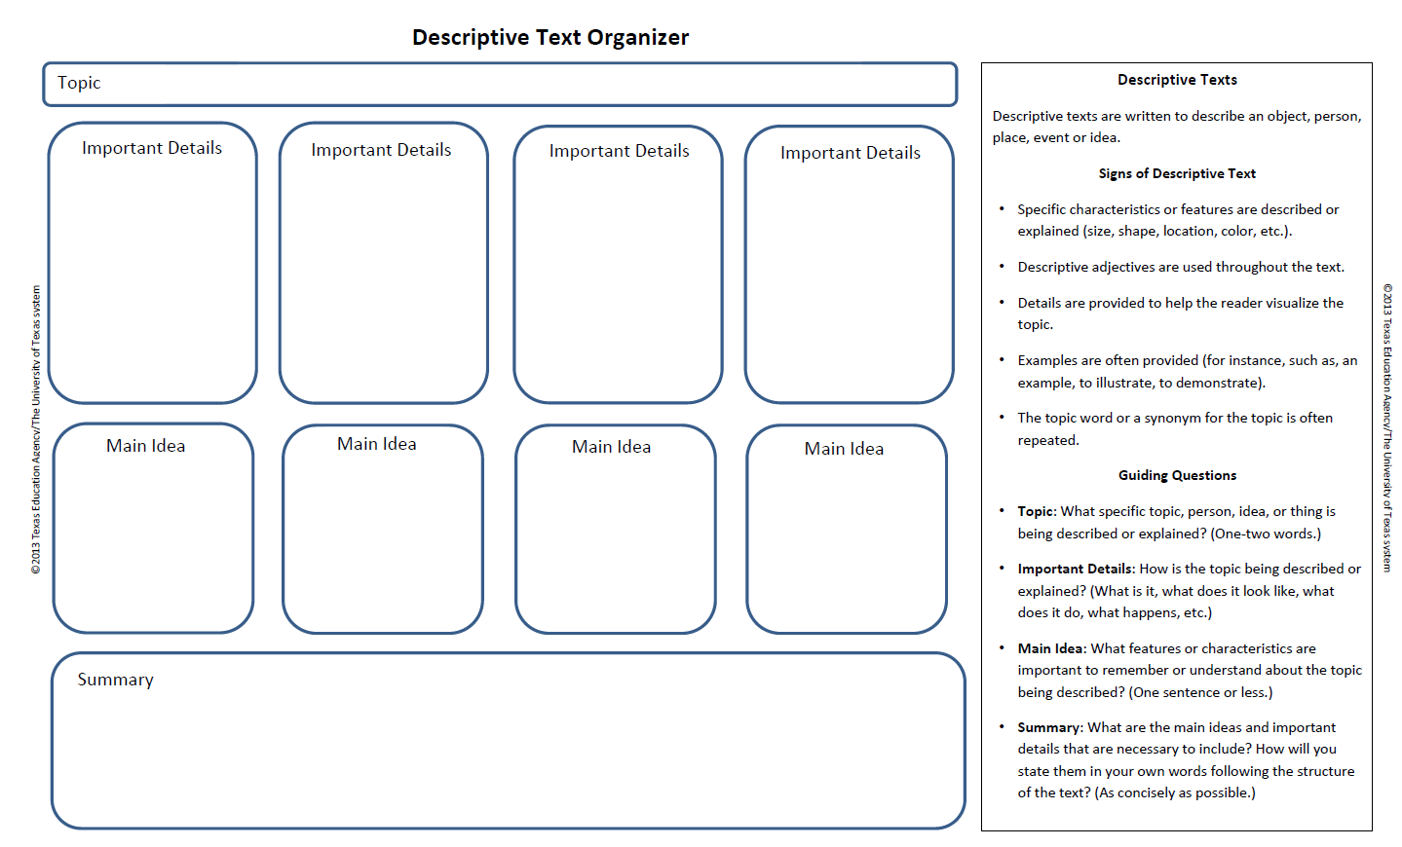
Descriptive Text Structure
Using a Graphic Organizer
Notes:
Say: Graphic organizers are one scaffold that has been found to assist our students in comprehending text (NRP, 2000, CIERA, 2003). You have a copy of this graphic organizer in your graphic organizer packet. It is Graphic Organizer 1. Please take it out so that you can follow along.
This graphic organizer is designed to help me identify the main ideas of descriptive text and I will also use it to help me create a summary. The great thing about graphic organizers, is that I can use them to scaffold reading, but they also are used to plan writing which has been found to improve writing (Armbruster, B, Anderson, T. & Ostertag, J. 1989). Also, graphic organizers can be flexible. I can use it to find the main idea and summarize a single paragraph, or I can use if for a multi-paragraph text. The key is teaching students the structure. Students may internalize the structure better if they draw the organizer in their notebook rather that use a copied version of it.
There are many graphic organizers available for use. To be effective, however, a consistent graphic organizer should be used for each concept at all grade levels (Baxendall, 2003). It doesn’t mean that you have to use this particular graphic organizer, but on your campus, you should be consistent with the graphic organizers you choose to use.
Remember, we would offer this type of scaffolding to students who need it most. Research tells us that many adolescents don’t have the mental background frames for navigating through textbooks (Ciardiello, 2002), so we can’t make assumptions about which students have internalized this understanding. We need to take time to get to know our students well, and determine which of our students need what type of support. It may be that we only need to model using this graphic organizer once or twice for our students to understand how to identify descriptive text structure. We’ll use a short piece of text and we’ll really break it down to show all the thinking that can help determine importance and identify main idea in descriptive text.
Let me continue my think-aloud lesson. I’ve already shown students what I think about before reading.

Slide 51
What is ecological succession?
Miller, K.R. & Levine, J.S. (2008). Prentice Hall Biology. Boston, MA: Pearson Education, Inc.
Notes:
Say: As we read our textbook today, I’m going to show you how I can use a graphic organizer to help me slow down and organize my thoughts during reading. We normally don’t read this slowly, but I want you to see how paying close attention to text structure, will help me to determine importance and summarize.
The graphic organizer I will use today is for descriptive text. We’ve used this before, so let’s briefly review it. On the right, you will see some helpful tools for reading and writing descriptive texts. At the top, it explains the purpose for descriptive texts. Descriptive texts are written to describe an object, person, place, event or idea. I can recognize descriptive texts as I’m reading because there will be a few signs to let me know how the text is organized. Something will be described or explained so there will be lots of details and the author typically will use examples to clarify or provide further explanation. Since there will be lots of details, I will use the guiding questions on the organizer to help me determine importance. Take a moment to review those questions now.
The left side of the organizer is where I will record the important information. Let me show you how as we continue to read this text today. It describes or explains ecological succession.
My purpose for reading to find out … what is ecological succession?

Slide 52
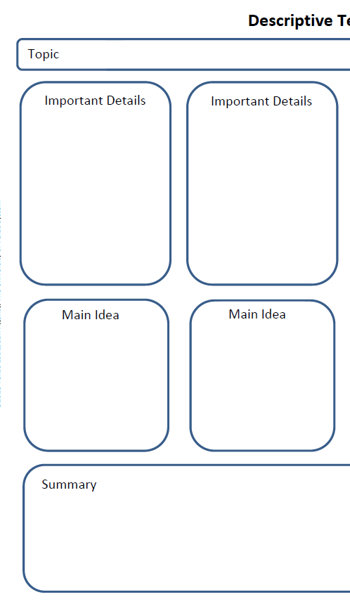
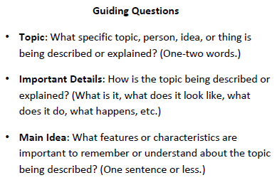
Ecological Succession
Ecological communities are always changing
Response
-natural or human
Gradual/sudden
Ecological succession is a series of changes in an ecosystem.
Ecological succession are the changes that occur in an ecosystem.
Notes:
Click for the red circle to appear around the first question.
Say: The first question on the organizer asks, what specific idea is being described or explained? I’m pretty sure that it will be ecological succession. If so, that will be my topic.
Click for topic to appear on the top of the organizer. Click for the second red circle to appear.
Say: The next question helps me think about the important details. How is it being described or explained? For example, what is it?
Read the text. Stop after “always changing.”
Say: So ecosystems are always changing. Changes occur slowly, but they are always occurring. I’m going to record that as an important detail because that’s what these first two sentences explain.
Click for first important detail to appear.
Continue reading. Stop after “in the environment.”
Say: Okay, changes occur because of an abrupt disturbance or it might be gradual. Changes happen in response to something. The word response is stated twice and examples are used to clarify the type of responses. I think the word response is important.
Click for second important detail to appear.
Continue reading. Stop at the end of the bold text.
Say: The key indicates this part is important and the words are bolded. It explains that the responses are either natural or caused by humans.
Click for natural or human to appear.
Say: It also says that older organisms die and new ones move in. That’s good information but it seems less important. It’s another type of response.
Continue reading to the end of the highlight.
Say: The highlight indicates a vocabulary word, so here, it actually defines ecological succession. This was my purpose for reading, so this is likely the main idea of the paragraph. I’ve already recorded the words always changing and community. Always changing, constantly changing, is similar to a series of changes.
Let me keep reading.
Continue reading to the end of the paragraph.
Say: The rest of the paragraph provides me with more detail about what ecological succession is, but I think I have captured the really important details. The only other repeated idea I haven’t captured is how it explains about slow changes and sudden disturbances which is similar to what is said at the beginning of the paragraph about gradual change and abrupt disturbances. Since this idea is repeated, I’ll add that to the important details too.
Click for last important detail to appear.
Say: The next question on the organizer helps me to identify the main idea.
Click for the last question to appear.
Say: What is important to understand about the topic being described? The definition of ecological succession answers the question I had before reading. This is the main idea sentence. I need to paraphrase this and put it in my own words.
Click for the main idea to appear and read it aloud.
Say: I like ecosystem better than community, it’s more specific but it sounds a bit clumsy, especially since I said “are” instead of “is”. Maybe it should say, ecological succession is … perhaps this is where I need that word “series”.
Click for the main idea to appear and read it aloud.
Say: This is the type of thinking I really do when reading text like this but it happens in my head relatively quickly. Struggling to decide which ideas are most important is tricky but I use the text features to help me, the guiding questions on the organizer, and of course, I think about my purpose for reading. Ideas that are repeated tend to be important, but I’m not going to record them multiple times.

Slide 53
Determining Importance Toolbox
Notes:
Say: Now we’ve considered what we might teach to students before and during reading informational text. Let’s think about what to do after reading.

Slide 54

Reread and Discuss to Clarify and Identify Main Ideas in the Text
“Helping students become conscious and engaged about what they are reading is an important aspect of reading for meaning and summarization. ‘Good readers read text passages at least twice: once to get the general overview and then again to determine what is salient’(Wormeli, 2005, p. 22). Providing them practice and time to reread text will help them have a better understanding of the purpose for the reading.”
(Smith & Zygouris-Coe, 2006, July)
Notes:
Read slide.

Slide 55

Reread and Discuss to Clarify and Identify Main Ideas in the Text
Reread to clarify and confirm the main idea.
Discuss to consolidate understanding and remember the text better.
Notes:
Say: After reading, we prompt students to reread to ensure that they have a good understanding of what they hoped to learn from the text and to confirm that they’ve identified the true main idea. We also provide opportunities for students to share their thinking and discuss with one another. When students engage in discussion about informational text, they typically have to restate the main ideas in their own words which helps to consolidate their understanding and remember the text better.

Slide 56
Notes:
Say: When we break it down, we can see just how complicated it is to teach students to determine importance and identify main ideas in text. Of course, topic and main ideas are only two pieces of the puzzle. We need to continue onto teaching students how to use this information to create a summary. Before we move onto summary, let’s give you a few moments to discuss all of the tools we’ve shared with you today.
Provide time for participants to discuss.

Slide 57
Summarize informational text
Considerations for Teaching Students to
Notes:
Say: Let’s now move on to thinking about considerations for teaching students to summarize informational text.
Summarizing is an important skill that often has never been directly taught to students. In fact, few students even at the college level are proficient at summarizing (University of Kansas, n.d.). “Summarizing can be used as both an assessment tool and a strategy to enhance comprehension” (Kissner, 2006, p. 3).

Slide 58

Summarizing
“…summarizing helps us to understand and make meaning of the events of everyday life—what we read, what we view, what we experience.”
(Kissner, 2006, p.3)
Notes:
Say: We use summarization in our day-to-day lives when we update a friend on a favorite television show or tell a spouse about our day at work.
Read slide.
Say: Most of our students know that in summarizing something, they are providing a shortened version which includes the most important details. Even so, effective summarizing is much more than this. We cannot assume our students know how to summarize effectively and in a manner that supports comprehension. Many students have not received direct instruction in summarization. Instead, from the early grades to the later grades, most students have been told to write a summary but have not been shown or provided a clear explanation of what a good summary should include. For many students it has become a guessing game. We must also keep in mind that the demands of summarization increases as text becomes more complex. For example, a student could be successful with summarizing in fifth grade, but struggle with this skill in high school.

Slide 59
Summarizing
“To summarize effectively, students need to recognize main ideas and key details, disregard unimportant or repetitive ideas, construct topic sentences, paraphrase, and collapse or combine lists or events into general statements.”
(Graham, S., MacArthur, C., & Fitzgerald, J., 2013, p.339)
Notes:
Read slide.

Slide 60
Summarizing
A summary should:
Reflect the structure of the text.
Include a topic sentence.
Include the main ideas.
Include important details.
Be paraphrased and shorter than the original text.
Notes:
Read slide.

Slide 61
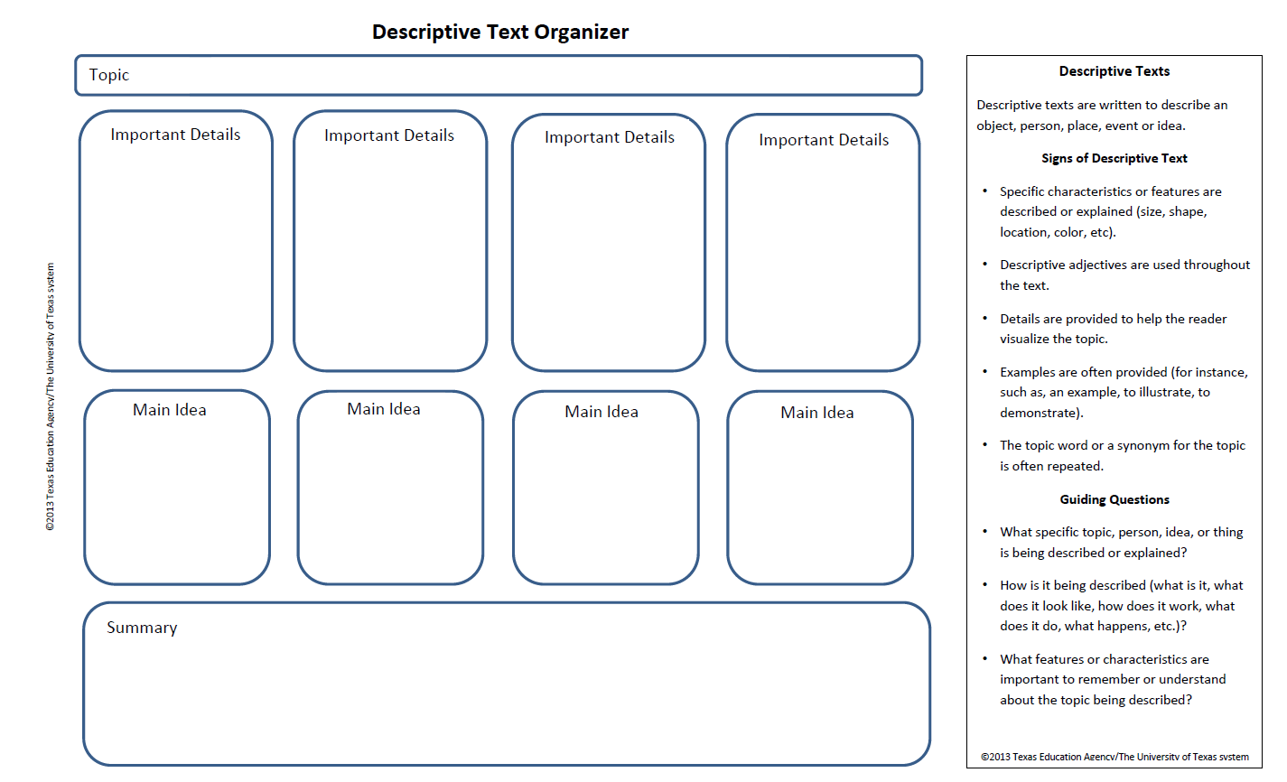

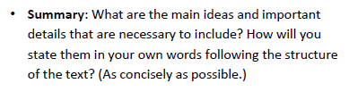
Ecological Succession
Step 5: Think-aloud Summarizing the Text
Ecological communities are always changing
Response-natural or
human
Gradual/sudden
Ecological succession is a series of changes in
an ecosystem.
in response to natural or human disturbances in the ecosystem.
sudden or gradual changes occur
Ecological succession is when a series of
, for example, a severe storm or clearing of a forest.
Notes:
Say: Let’s take a look at how we would model for students summarizing our sample paragraph on ecological succession.
Class, now that I have read the paragraph and I have identified the topic, important details and the main idea, I’m ready to write a summary. Remember, a summary is a synthesis of the main ideas and important details in a text. It should be written as concisely as possible in the reader’s own words. That doesn’t mean your summary should be written in ten words or less, but it also shouldn’t ramble on forever. Concisely means that you state the exact meaning in as few words as possible. Finally, we should also keep in mind that a good summary should reflect the structure of the text.
As I begin to think about my summary, I will of course consider my main idea first. I have a very concise main idea but my summary should include a bit more detail. I will begin with,
Click for the first part of the sentence to appear.
Say: Ecological succession is when a series of … changes occur. I need to describe the changes. In the important details, I have included that changes are either sudden of gradual.
Click for the second part of the sentence to appear. Read the sentence. (Ecological succession is when a series of sudden or gradual changes occur.)
Say: Now I need to explain why these changes occur.
Click for the third part of the sentence to appear. Read the sentence. (Ecological succession is when a series of sudden or gradual changes occur in response to natural or human disturbances in the ecosystem.)
Say: I think that this is a pretty good summary. I know however, that descriptive text often includes examples to clarify ideas and concepts for the reader. If someone read my summary they might not know what types of disturbances I’m referring to. I didn’t record examples in my important details but I could look back at the text to find some.
Click for the last part of the sentence to appear. Read the sentence. (Ecological succession is when a series of sudden or gradual changes occur in response to natural or human disturbances in the ecosystem, for example, a severe storm or clearing of a forest.)
Say: Yes, I think this provides a good summary of the main ideas. If someone was to read my summary they would have a good understanding of ecological succession, and more importantly, if I read this a few weeks from now as I’m studying, I’ll understand and remember what it is.
That is the end of my demonstration lesson.
You’ll notice here, that we only summarized a single paragraph. We’ll use small chunks of text for our model lessons to help students clearly understand what to do (Kosanovich, Reed & Miller, 2010). Another reason we’ve selected a single paragraph to model is because descriptive texts are often only one or two paragraphs long in textbooks. Quite often the first paragraph explains a concept and the subsequent paragraphs in the section follow a different text structure.
When teaching students to identify main ideas and summarize descriptive texts, our expectation of course, is that students will be able to apply this type of thinking to the multi-paragraph descriptive texts they encounter. “Once students can state the main ideas of several connected paragraphs, they can learn how to write a summary of a passage. Summarizing requires the reader to synthesize information extracted across a text and restate it succinctly,” (Kosanovich, Reed, & Miller, 2010, p. 54). We will model for students how to summarize multi-paragraph text, during Step 6 of our Cognitive Strategy Routine.

Slide 62
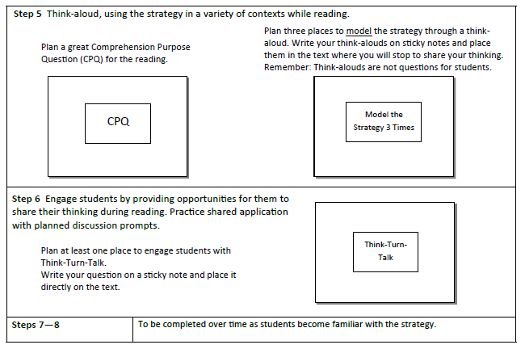
Cognitive Strategy Routine
Notes:
Say: Let’s review what it says for Step 6 of our Cognitive Strategy Routine on our orange planning card.
Choral read Step 6 together.

Slide 63

Step 6
Provide opportunities for students to Think-Turn-Talk as you work through the reading and complete the graphic organizer as a class .
Notes:
Say: For Step 6 of our routine, we choose to work through longer complicated texts with students. Together, we’ll read, discuss and share what are thought to be the important details and the main ideas using our Think-Turn-Talk routine. During the reading, we guide students to understand that sometimes, we’ll chunk the text one paragraph at a time to look for main ideas, and sometimes paragraphs will fit together, and we’ll need to find one main idea for two or three related paragraphs. We’ll explicitly point out and label when the Determining Importance Tools are being used during reading and together, we’ll complete the graphic organizer. When we get to the summary part however, we can slide back into Step 5 as needed to model for students how to write a summary when there are multiple main ideas. We want students to realize that a summary is not simply a listing of the main ideas, instead, a summary recomposes main ideas to form a new text, an activity which helps students improve their writing skills (Caccamise, 2011).

Slide 64
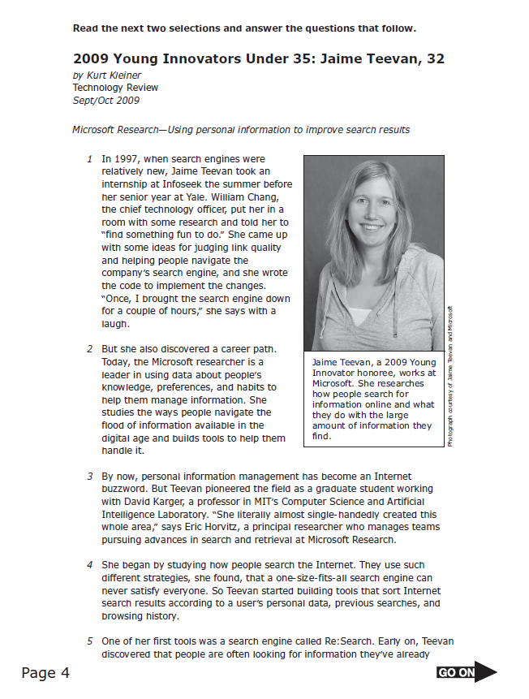

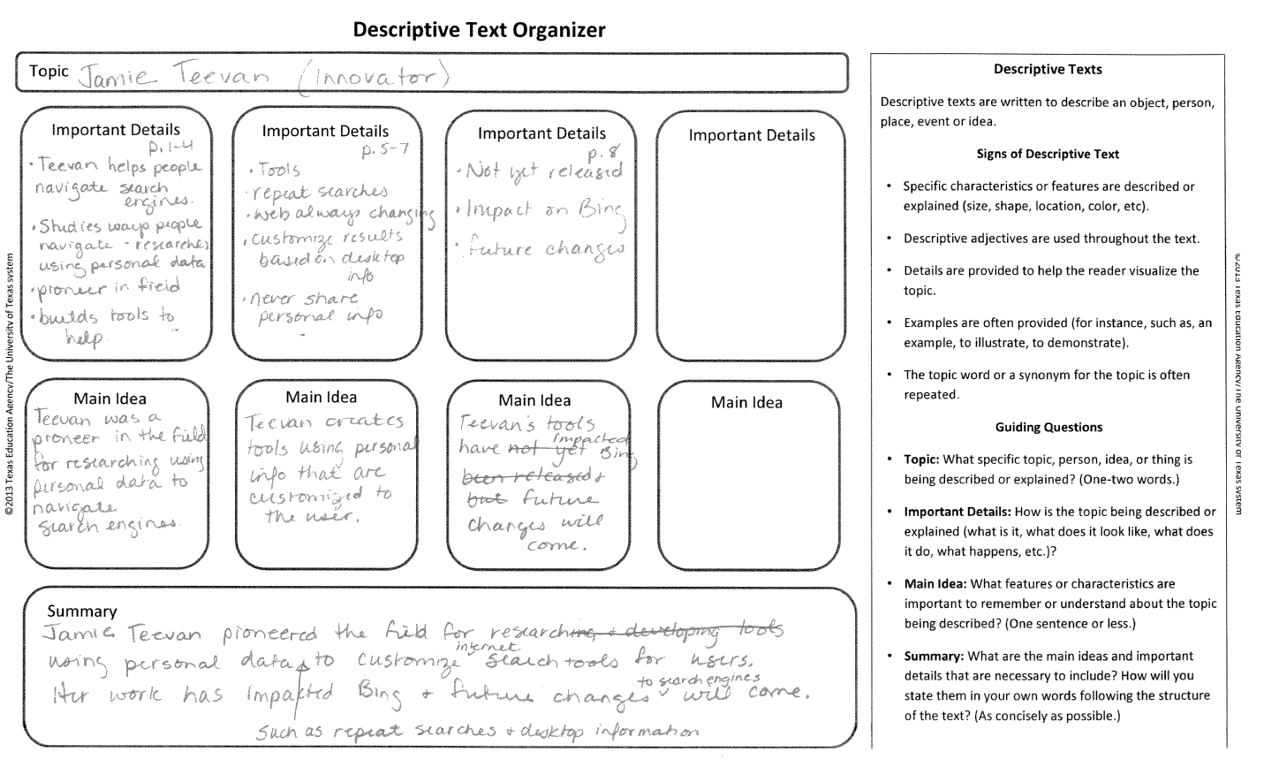
Notes:
Say: Let’s take a look at an example. We’ll use an excerpt from a released English II EOC. Please take out Graphic Organizer 3. You will have a copy of the text in your Text Excerpt packet. We don’t need to read this text right now, but I want to show you that if students understand how to use text structure to help them summarize then they will be much better prepared for answering summary test questions on exams.

Slide 65
Summary Example
Jamie Teevan pioneered the field for researching and developing tools using personal data to customize search tools for users. Her work has impacted Bing and future changes will come.
such as repeat searches and desktop information
˅
internet
˅
to search engines
˅
Notes:
Say: With multi-paragraph texts, we show students how we include the main idea from each paragraph in our summary. We think aloud how to combine ideas into well constructed sentences. We model revising, to ensure that we’ve captured the important information and that our summary reflects the structure of the text. After doing all of this modeling, we might end up with a product that looks like this on our organizer in the summary section.
Read text.
Jamie Teevan pioneered the field for research using personal data such as repeat searches and desktop information to customize internet search tools for users. Her work has impacted Bing and future changes to search engines will come.
Say: Notice that the main ideas are included in the summary and that it took a couple of revisions to get it just right. If students have opportunities to practice writing summaries in a scaffolded manner such as this, they will be more successful at being able to construct a good summary. If they internalize the components of a complete summary, how might it help them to select an answer on an assessment like STAAR?

Slide 66
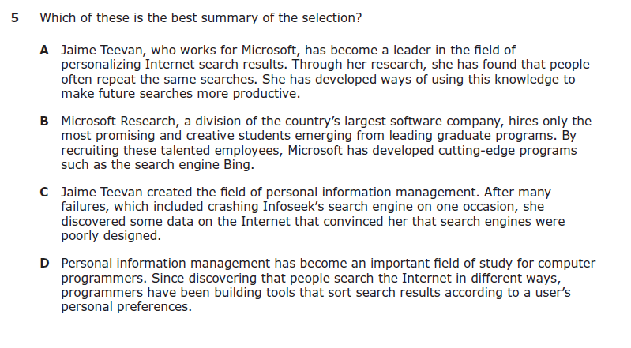
Handout
5
Texas Education Agency, English II STAAR, 2013.
Notes:
Say: Take a moment to read these four answer choices. You have a copy of them in your Additional Handout packet. It is Handout 5. I know that you haven’t read the text, but compare these answer choices to the summary I just modeled for you. Which answer would you choose based on the summary I just modeled?
Provide time for participants to read and select.
Participants should select answer A.
Say: Let’s look at a few student examples and think about how teaching students about text structure might affect their reading success.

Slide 67

Step 7
Complete the graphic organizer in pairs or small groups with teacher monitoring and support as necessary.
Notes:
Say: In Step 7, students take more of the responsibility for using the strategy. They might work in pairs or in small groups on a structured task. For example, I might have students work in small groups to complete a graphic organizer. While the groups work, the teacher continues to monitor the class. Some groups of students might be able to complete the graphic organizer with minimal assistance, while for some I might use a combination of an individualized think-alouds and strategic questioning to provide more support.

Slide 68
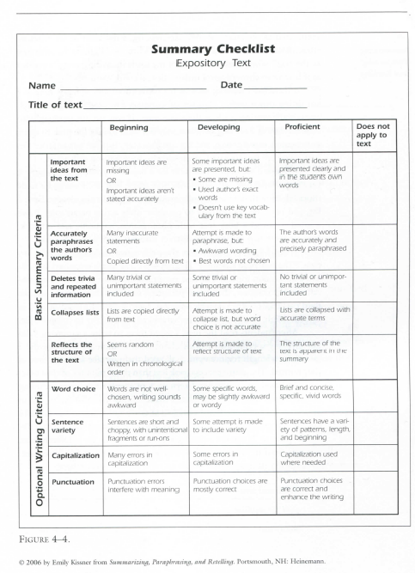
Step 8
Handout
6
Complete the graphic organizer independently to demonstrate understanding.
Use a rubric to support students and to assess.
Notes:
Say: In Step 8, students are accountable for using the strategy independently. You may decide to use a rubric similar to the one in your handout to guide students in understanding your expectations as well as for assessment.

Slide 69

Keep in mind that identifying text structure is not the goal. The goal is for students to internalize knowledge about text structure and use it to enhance their reading comprehension and improve their writing organization.
(Orcutt, K., n.d.)
Notes:
Read slide.

Slide 70

“Given the rapidly changing world in which today’s students operate and given the plethora of information at their fingertips, the importance of modeling how we determine importance has increased dramatically.”
~ Keene & Zimmermann, 2007
Notes:
Say: We have seen how critical it is for us to explicitly teach students how to Determine Importance and Summarize. We just can’t TELL students to identify main ideas and create summaries, and we can’t just assume that they know how to do this successfully. Instead we have to show them. Fortunately, we can rely on “tools” like setting our own purpose for reading, knowing how to use text features to aid in identifying important information and we also can teach students about text structure to help them Determine Importance and Summarize.
In Part 2 of this training, we’ll focus on the other text structures.
Read slide.

Slide 71
References
Armbruster, B., Anderson, T.H., & Ostertag, J. (1989, November). Teaching text structure to improve reading and writing. The Reading Teacher, 43(2), 130-137.
Baxendell, B. (2003). Consistent, coherent, creative: The 3 Cs of graphic organizers. Teaching Exceptional Children, 35(3), 46-53.
Bluestein, N.A. (2010, April). Unlocking text features for determining importance in expository: A strategy for struggling readers. The Reading Teacher (63)7, 597-600.
Caccamise, D. (2011). Improved reading comprehension by writing. Perspectives on Language Learning and Education, 18(1), 27-31.
Center for the Improvement of Early Reading Achievement (CIERA). (2003). Put reading first: The research building blocks for teaching children to read. National Institute for Literacy.
Ciardiello, A.V. (2002). Helping adolescents understand cause and effect text structure in social studies. Social Studies, 93, 31–37.
Coyne, M., Chard, D., Zipoli, R., & Ruby, M. (2007). Effective strategies for teaching comprehension. In M. Coyne, E. Kame’enui, & D. Carnine (Eds.), Effective teaching strategies that accommodate diverse learners (pp. 80-109). Upper Saddle River, NJ: Pearson Education, Inc.
Duke, N. K., & Pearson, P. D., (2002). Effective practices for developing reading comprehension. In A. E. Farstrup & S. J. Samuels (Eds.), What research has to say about reading instruction (pp. 205-242). Newark, DE: International Reading Association, Inc.

Slide 72
References
Dymock, S. & Nicholson, T. (2007). Teaching Text Structures: A Key to Nonfiction Reading Success. New York, NY: Scholastic, Inc.
Fletcher, J., Lyon, R., Fuchs, L., & Barnes, M. (2007). Learning disabilities: From identification to
intervention. New York, NY: The Guilford Press.
Graham, S., MacArthur, C.A., & Fitzgerald, J. (2013). Best practices in writing instruction (2nd ed.). New York, NY: Guilford Press.
Harvey, S., & Goudvis, A. (2007). Strategies that work: Teaching comprehension to enhance understanding (3rd ed.). Portland, ME: Stenhouse Publishers.
Israel, S. E., & Duffy, G. G. (Eds.). (2009). Handbook of research on reading comprehension. New York: Routledge.
Johnston, P., & Afflerbach, P. (1985). The process of constructing main ideas from text. Cognition and Instruction, 2(3/4), 207-232.
Keene, E., & Zimmermann, S. (2007). Mosaic of thought: The power of comprehension strategy instruction (2nd ed.). Portsmouth, NH: Heinemann.
Kissner, E., (2006). Summarizing paraphrasing and retelling. Skills for better reading, writing, and test taking. Portsmouth, NH: Heinemann.

Slide 73
References
Kleiner, K. (2009, September/October). 2009 Young innovators under 35: Jaime Teevan, 32. Texas Education Agency STAAR Released Test Questions. State of Texas Assessments of Academic Readiness English II Reading 2013 Released Selections and Test Questions. Retrieved January 7, 2014 from http://www.google.com/url?sa=t&rct=j&q=&esrc=s&frm=1&source=web&cd=2&cad=rja&ved=0CC8QFjAB&url=http%3A%2F%2Fwww.tea.state.tx.us%2FWorkArea%2FDownloadAsset.aspx%3Fid%3D25769805979&ei=uCPgUryUPKrj2wWp44HgDA&usg=AFQjCNF4ENUmaan22_U_6burUqrTnskwuA
Kosanovich, M. L., Reed, D. K., & Miller, D. H. (2010). Bringing literacy strategies into content instruction: Professional learning for secondary-level teachers. Portsmouth, NH: RMC Research Corporation, Center on Instruction.
Lapp, D., Fisher, D. & Grant, M. (2008, February). “You can read this text-I’ll show you how”: Interactive comprehension instruction. Journal od Adolescent and Adult Literacy, (51)5, 372-382.
McGregor, T. (2007). Comprehension connections: Bridges to strategic reading. Portland, ME: Stenhouse Publishers.
Miller, K.R. & Levine, J.S. (2008). Prentice Hall Biology. Boston, MA: Pearson Education, Inc.
National Reading Panel. (2000). Report of the National Reading Panel: Teaching children to read. Report of the subgroups. Washington, D.C.: U.S. Department of Health and Human Services, National Institutes of Health.
Orcutt, K. (n.d.). Teaching text structure and more. ESSDACK. Retrieved from http://www.literacyleader.com/sites/litlead.essdack.org/files/Text%20Structure%20GCHS.ppt.pdf

Slide 74
References
Piccolo, J. (1987). Expository text structure: Teaching and learning strategies, The Reading Teacher, 40(9), 838-847.
Pressley, M. (2000). What should comprehension instruction be the instruction of? In M. Kamil, P.
Mosenthal, P. D. Pearson & R. Barr (Eds.), Handbook of Reading Research (Vol. III, pp. 545–561). Mahwah, NJ: Lawrence Erlbaum.
Quantum mechanics.(n.d.). In Wikipedia.org. Retrieved March 27, 2009, from http://en.wikipedia.org/wiki/Quantum_mechanics
RAND Reading Study Group. (2002). Reading for understanding: Toward an R&D program in reading comprehension. Santa Monica, CA: RAND, Office of Educational Research and Improvement, U.S. Department of Education.
Shanahan, T. & Shanahan, C. (2008). Teaching disciplinary literacy to adolescents: Rethinking content-area literacy. Harvard Educational Review, 78(1), 40-59.
Silver, H., Strong, R., & Perini, M. (2000). Discovering nonfiction: 25 powerful teaching strategies grades 2-6. Los Angeles, CA: Canter & Associates, Inc.
Sjostrom, C.L., & Hare, V.C. (1984). Teaching high school students to identify main ideas in expository text. Journal of Educational Research, 78(2), 114-118.
Smith, L. & Zygouris-Coe, V. (2006, July). Summarization. Orange County Public Schools. Retrieved from https://www.ocps.net/cs/services/cs/currareas/read/IR/bestpractices/SZ/Summarization.pdf

Slide 75
References
Snow, C. (2002). Reading for understanding: Toward an R&D program in reading comprehension. Washington, DC: RAND Reading Study Group.
Strong, R., Silver, H., Perini, A., & Tuculescu, G. (2003, September). Boredom and its opposite. Educational Leadership. Building Classroom Relationships. 61(1), 24-29.
Teacher's Curriculum Institute. (n.d.). History alive! Pursuing American ideals. Retrieved from http://www.teachtci.com/programs/high-school/history-alive-textbook/pursuing-american-ideals/HA_PursuingAmericanIdeals_HS_SampleChapter.pdf
Thiede, K. W. & Anderson, M. C. M. (2003). Summarizing can improve metacomprehension accuracy. Contemporary Educational Psychology, 28(2), 129-160.
University of Kansas. (n.d.). Teaching Section Summarization Strategies. Retrieved from http://www.specialconnections.ku.edu/?q=instruction/reading_comprehension/teacher_tools/teaching_section_summarization_strategies
University of Texas System/Texas Education Agency. (2009). ELAR/SLAR TEKS handbook. Austin, TX: Texas Education Agency.
Zimmermann, S., & Hutchins, C. (2003). 7 keys to comprehension: How to help your kids read it and get it! New York, NY: Three Rivers Press.
Zweirs, J. (2010). Building reading comprehension habits in grades 6-12: A toolkit of classroom activities (2nd ed.). Newark, DE: International Reading Association, Inc.

